Slide 1
High-current Light Ion Gradient Cyclotron for Security, Material Science, and Radioisotope Production
C. Johnstone, S. Kutsaev, O. Odonyev, R. Agustsson, R Lanza, F. Ford, R. Johnson, and S. Boucher
Dec 3, 2020
FFA20,
TRIUMF, Vancouver, BC, CA
This work was supported by the US Department of Energy, under SBIR grant DE-SC0020009.

Slide 2
Applications of a Light Ion, (Q/A ≅ 1/2) ISO-FFA
The capability to produce high current, low loss, extracted external beams, of different ion species, is an enabling technology for nuclear security, Isotope production, medical, and material science applications
Nuclear Security
  Interrogation and radiography using high-energy, monoenergetic gammas (produced via excitation of nuclear states)
    Absorption is pair-production dominated , exhibiting a strong dependence on Z – identifying Special Nuclear Materials
    Gamma ray transmission imaging and delayed transmission (requires precision timing)
  Fast monoenergetic Neutron production by light ions on targets
    Neutron transmission imaging
    Neutron interrogation based on delayed neutrons indicating presence of fissile material (requires precision timing signal)
  Simultaneous monoenergetic gamma and fast neutron beams for cargo inspection
Isotope Production
  Medical Isotope production such as theranostic radioisotopes and rare alpha emitters, ²²⁵Ac and ²¹¹At for Radioimmunitherapy
    ²²⁵Ac is produced using a proton (H-) beam and ²¹¹At with an alpha beam on a bismuth target
  Isotopes for material science, nuclear medicine, security, oil exploration , … such as
    ²⁴¹Am, ²⁵²Ca, ⁹⁹Mb, ²³²U, ¹⁵³Gd, ¹⁴⁷Pm, ⁶⁷Cu, ⁸⁹Zr, and ¹¹⁷Sn
Radiobiology
  Cell irradiation by different light ions - measure RBE vs LET and tumor/normal tissue damage response

Slide 3
Baselining the Design
Gross specifications for a broad application base design concept
Beam Specifications
  Ion beams required: H₂⁺(p), D⁺ , He²⁺,Li³⁺,B⁵⁺,C⁶⁺,N⁷⁺,O⁸⁺, Ne¹⁰⁺, S¹⁶⁺ , Ca²⁰⁺
    15-20 MeV/u for high-energy gamma and neutron secondary production
    High current, up to 1 mA for protons, (implies continuous wave (CW) or high duty-factor operation)
  Multi-ion capability (injection of a cocktail of ion species for rapid ion switching)
  Low loss extraction into an extremal beamline (allows locally shielded target vault, lower radiation dose for machine maintenance)
  Individual turn extraction capability – overlapping turns not extracted for timing resolution
    High acceleration gradient (specification is 400 keV/turn)
Operational Specifications
  High, >90% machine reliability (specification given for most medical, commercial, and security applications)
    Turnkey or least low overhead operation
  Normal conducting for reliability, high currents (SC quenching is not sustainable in a security, medical , or commercial isotope facility)
Gross Parameters
  Small footprint– depends on turn-to-turn separation requirement and current (for a fixed acceleration gradient)
    Space charge effects start to dominate and increase beam size ~500 μA
  Transportability – size and weight (different current regimes for degree of compactness)
    Variants for different applications

Slide 4
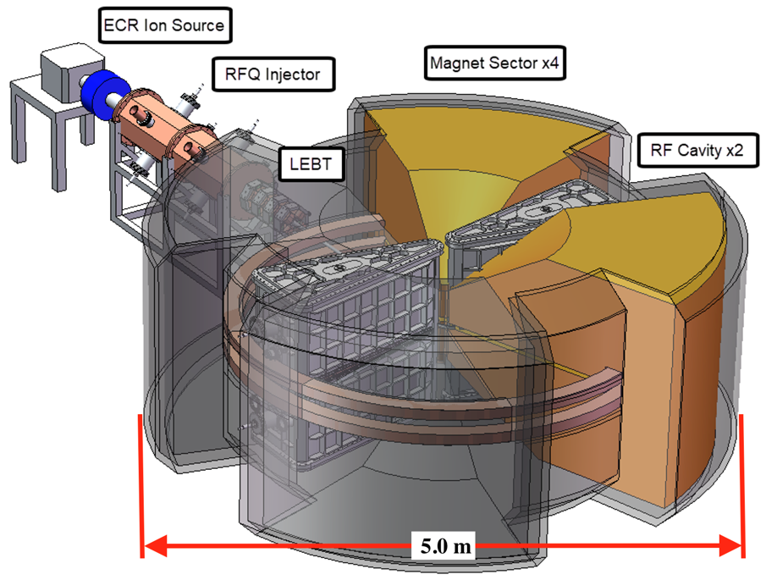
Subsystem Concepts
The three main sections of the Accelerator
Injection
  ECR source
    Pre-mixed ion gases and evaporated metals injected (plasma chamber)
  Adjustable frequency RFQ (Tandem was considered)
    Compensates for small changes in q/A for different ion species
  LEBT to transport/match into the FFA
    A buncher plus quads; injected beam passes between sector magnets
  Injection electrostatic inflector (horizontal)
FFGA
  Separated sector, 4-fold periodicity
    Optimized radial gradient field profile, opposing RF cavities
Extraction
  Horizontal betatron kick from electrostatic defector
    Electron stripping cannot be used; ions are in their highest charge state
    Deflector is located 90° upstream from extraction channel
    Beam is extracted through a bore in the return yoke
Conceptual model of the base design

Slide 5
The Injection Subsystems
Injection occurs at 0.5 MeV/u to eliminate the lossy central region
Preaccelerator and Injection Line
  Tandem eliminated due to contamination from different ion charge states
  Variable-frequency ion RFQ chosen; 1% tunable frequency range needed
    HZB RFQ accelerates Q/A > 0.15 with (85-120 MHz, tunable)
  Beam from the RFQ is transported and bunched
    Enters inner region of FFGA between sector magnets
Injection into FFGA
  Injection into the ring initiates between sector magnets
    3 inflectors, ~5MV/cm , 15 mm plate separation.
    Injection occurs at 0.28 m radius in the base design
    Ring center outer radius~0.1 m
    Magnetic shielding and end mirror plates will be needed
HZB ion beams – two species due to incomplete stripping in tandem
Notational sketch of injection line into the central region of the FFGA ring

Slide 6
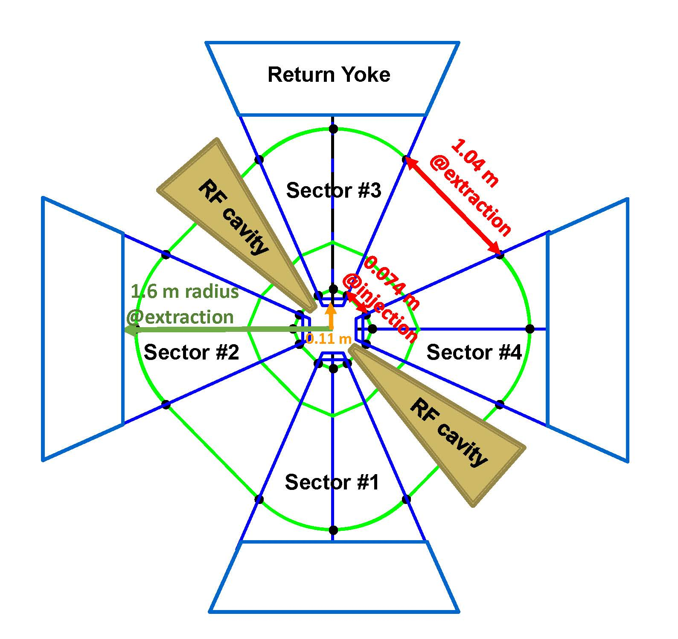
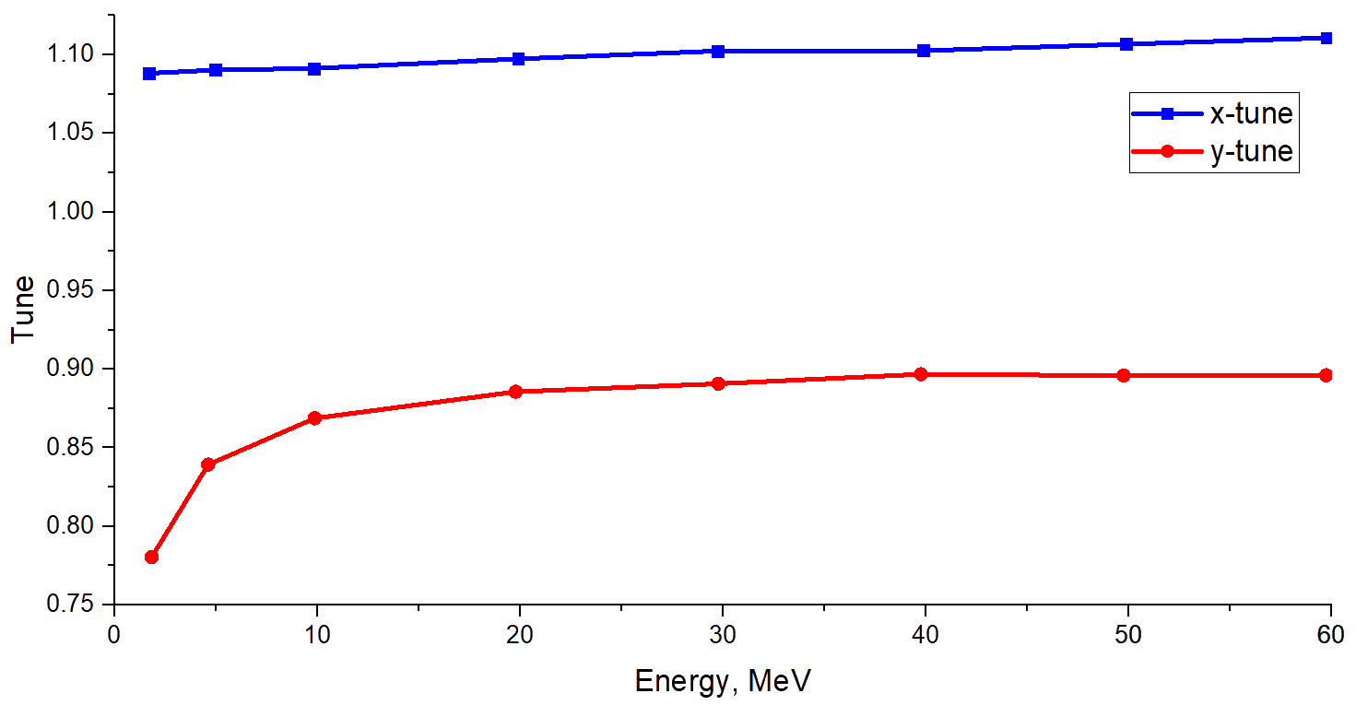
The FFGA ring (Fixed Field Gradient Accelerator)
Separated Sector FFA with a radial field gradient
Machine Layout
  4 separated sectors with opposing high-gradient cavities
  Meter component-free straight at 15 Mev/u facilitates low-loss extraction
  Radial field gradient serves the same purpose as an azimuthally-varying field
    Nonlinear radial gradient up to sextupole;
    Provides 97° horz and a strong 80° vert phase advance
    Near 90° mitigates transverse “kicks” from opposing cavities
    Linear edge limits the highest order feeddown– to octupole
    Vertical tune falls as fringe fields overlap near injection energies
  Acceleration uses 8th harmonic for Q/A of ½ (45 MHz)
    At 400 keV/turn, at extraction orbits are separated by 0.8 cm center to center
Layout of Ring
Nonlinear radial field gradient (lright) Machine tunes (right) for He²⁺ (left)

Slide 7
The Extraction System
Extraction occurs at 15 MeV/u. At this energy no extraction septum is required.
Extraction System
  A meter-long 6.6 MV/m electrostatic deflector, 15 mm plate separation
    On extraction orbit @1.6 m radius in upstream sector magnet
    90° upstream of extraction channel
    Betatron oscillation peaks at entrance to downstream sector magnet
  76 mm of radial displacement is achieved at downstream sector magnet
    Beam enters and crosses the low-field, between-coil region
  Extraction occurs through a 200 mm bore in the return yoke
    Extraction system designed/modeled using TOSCA OPERA
Extraction line
  Extraction optics are known starting from the FFGA ring
    External target beamline under design
    Dispersion from the ring is high
  To cleanly isolate and extract only the last acceleration turn
    Radial collimation is required at low energy in the ring
    Could exploit high dispersion from ring in external beamline for narrow dp/p
    Space charge will broaden and flatten extracted beam
Layout of extraction from OPERA model and TOSCA tracking through return yoke

Slide 8
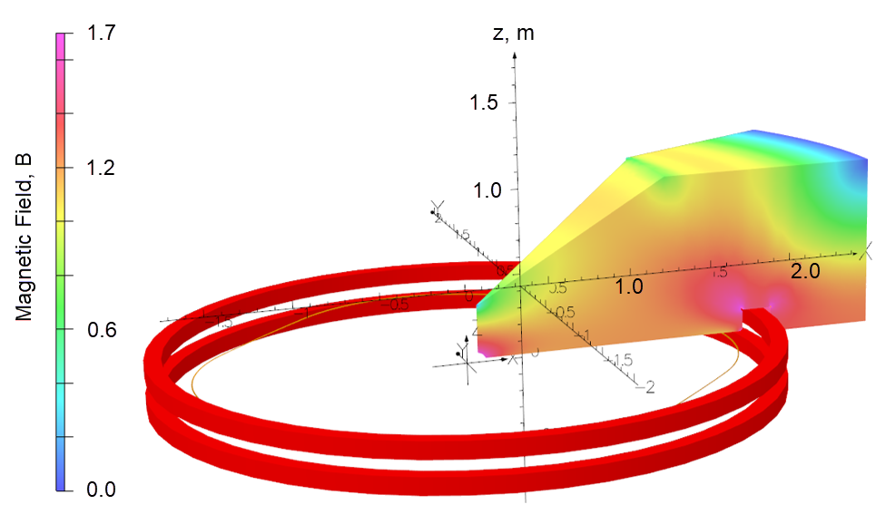
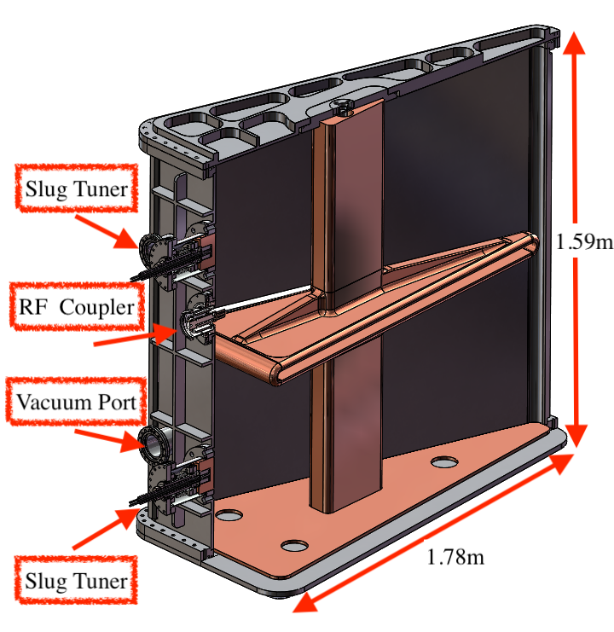
Magnets and RF
Magnets and RF have been designed using OPERA to match the design lattice performance
Magnet System Design
  All 4 sectors are excited by a coil fitted in top and bottom slots
    The integrated field of the magnets matches the integrated design field
    Integrated coil current is 18,500A (925A in water-cooled Cu coils)
    Power consumption estimated to be 31.4kW
    Further optimization can significantly reduce current magnet weight (42 tons)
  Magnet gap is currently 40 mm although 50 mm is also dynamically stable
RF Cavity Design
  Two opposing HWR cavities, 200 keV/turn/cavity – HWR chosen for optics stability
    Size and field uniformity dictated TEM-class double-gap coaxial line geometry
    45 MHz (8th harmonic), RF losses below 20 kW
Half of a sector magnet showing flux density in iron core using OPERA3D
Engineering design of HWR cavity
Field versus azimuthal angle at different radii in ½ of a sector magnet

Slide 9
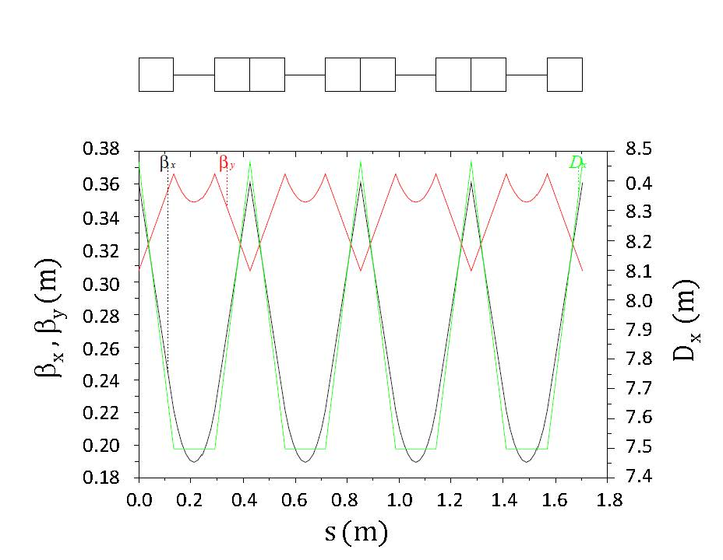
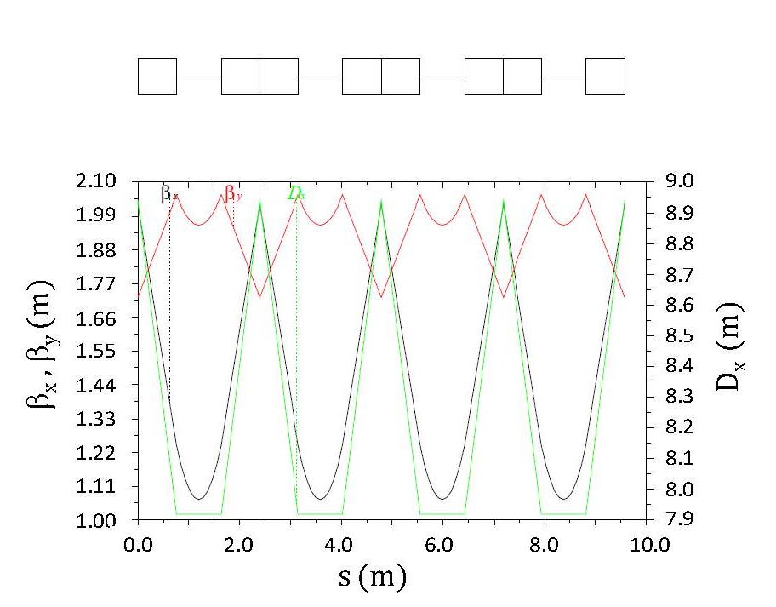
Performance Simulations
Performance modeling of the conservative base design are presented
Lattice Design
  Adiabatically increasing Courant Snyder functions (MADX)
    Emittance depends on extraction turn separation
Acceleration
  10⁻⁴ to 10⁻⁵ isochronism required for low-loss acceleration (OPAL)
    10⁻³ to 10⁻⁴ achieved in magnet design to date
Space Charge
  500μA to a mA on H₂⁺ injected 5π mm-mr geometric emittance (σ=2mm, OPAL)
Injection
500 μA
He²⁺ Acceleration in 10⁻⁴ isochronousorbits
OPAL
1 mA
Extraction

Slide 10
Scaled Variants for Different Applications
Three scaled variants with decreasing footprint and weight are proposed adapted to specific applications
Baseline design for prototype is ultra-conservative technology
  Targeted application is ion radiobiology where size/transportability is less of an issue
Radioisotope – high currents
  Ultra-high >90% machine reliability, turnkey (specification for almost all medical, commercial, and security applications)
Security – transportable for cargo scanning
  Smallest, lightest based on a 1.7 T peak field (consistent with existing machines) – transportable in a standard cargo container
    Potentially ramp magnets for second-level beam pulses to reduce total power consumption and achieve higher fields

Slide 11
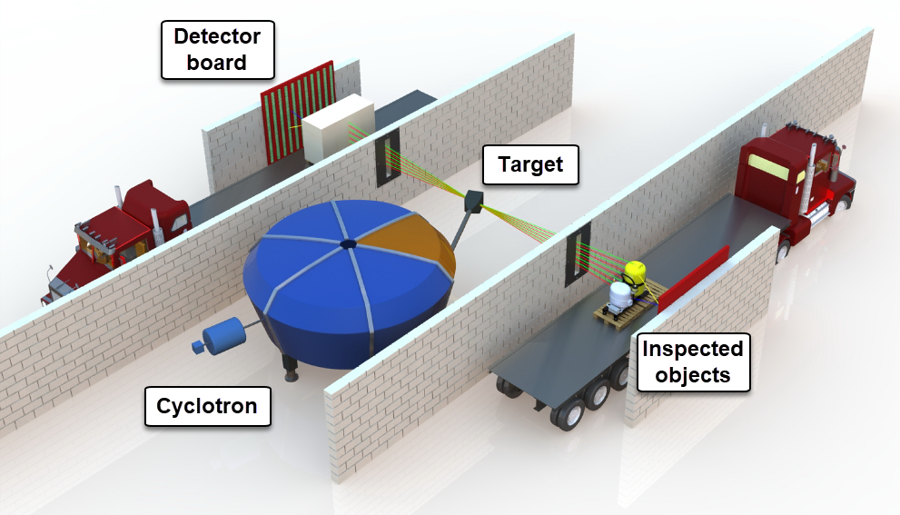
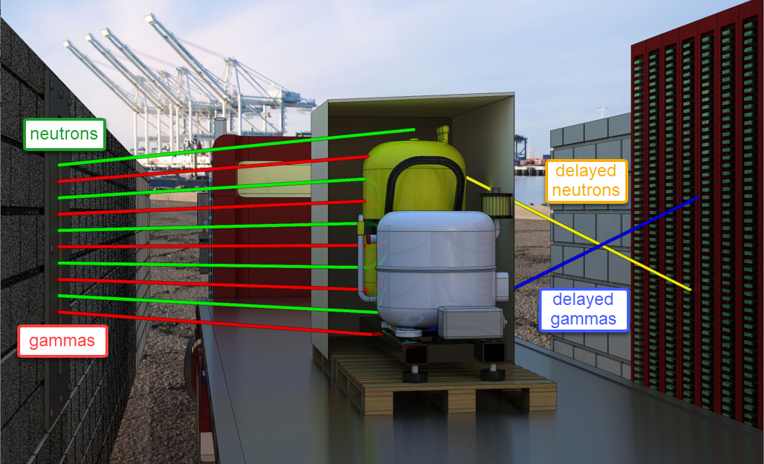
Summary
A multipurpose base gradient-field FFA has been designed, scalable to specific targeted applications
General Properties
  Accelerates ions from H₂⁺ up to Ca²⁰⁺ for Q/A near ½
  mA currents for protons, currents depend on isotope/application
  External beams for separate target vault
  Supports injecting a cocktail of ions for rapid ion switching
    using small 1% level RF frequency changes
Security Applications (cargo scanning)
  Transportable version with slow-ramped (second) magnets
  Generation of monoenergetic gammas and fast neutrons

