Slide 1
High-Intensity Multi-slice Target Development
C. Johnstone, FNAL, M. Kiburg (PPD, Fermilab), B. Kiburg (PPD, Fermilab), A. Mazzacane (CD), C. Loss (TRIUMF and AD, Fermilab)
LDRD presentation
Fermilab
12-2-2020

Slide 2
Sample of related Snowmass LOIs:
Letter of Interest for an Upgraded Low-Energy Muon Facility at Fermilab https://www.snowmass21.org/docs/files/summaries/RF/SNOWMASS21-RF0-AF0-007.pdf
A New Charged Lepton Flavor Violation Program at Fermilab https://www.snowmass21.org/docs/files/summaries/RF/SNOWMASS21-RF5_RF0-AF5_AF0_Robert_Bernstein-027.pdf
A Phase Rotated Intense Source of Muons (PRISM) for a μ→e Conversion Experiment, https://www.snowmass21.org/docs/files/summaries/RF/SNOWMASS21- RF5_RF0-AF5_AF0_J_Pasternak-096.pdf
Bunch Compressor for the PIP-II Linac, https://www.snowmass21.org/docs/files/summaries/RF/SNOWMASS21-AF5_AF0-RF5_RF0_Prebys-071.pdf

Slide 3
New Physics Opportunities
Low-energy muon (LEµ) address physics beyond Standard Model with high sensitivity
  Do leptons violate flavor symmetry
  Forces weaker than the Weak Force
  Do antileptons experience gravity equal to leptons
Precision muon & muonium experiments required:
  Charged Lepton Flavor Violations: decay searches and μ →e conversion (µ⁺ AND µ–);
  Muon EDM measurements (µ⁺);
  muonium & antimuonium transitions, gravity & spectroscopy (µ⁺)
  World-class µSR facility (µ⁺)
  Muon catalyzed fusion (µ–).
LEµ experiments: synergistic, intense muon beams of both signs required for new physics; (sensitive to different physics amplitudes)

Slide 4
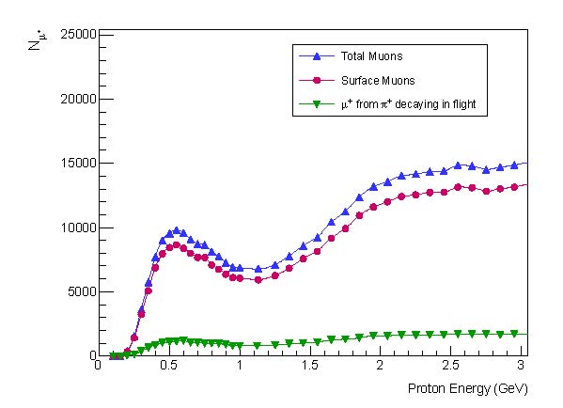
The physics of pion/muon production
  Single pion production threshold is 280 MeV, pair 600 MeV
  Total and surface pion/muon production cross sections begin to level at ~800 MeV and ~2 GeV, respectively
  Multi-GeV proton beams not required for intense muon beams –in principle power can be reduced by an order of magnitude on target
    800 MeV PIP II beam is ideal for unprecedented LEμ intensities
    400 MeV Linac/MTA beam produces experimentally-significant intensities
PIP II
Total single π+ production cross section
dependence on proton energy
Variation of µ⁺ yield with incident proton energy for muons with momenta ≤ 30 MeV/c; i.e. surface muons

Slide 5
Pion Production favors heavy targets
Production cross sections* for charged pions were measured using the 730-MeV proton beam from the 184ʺ LBNL cyclotron
Total cross sections for π⁺/π– production beyond carbon to a good approximation are
σ_{Τ}(π⁺) ≈ 24.5 Ζ^{1/3}
σ_{Τ}(π–) ≈ 2.33 Ν^{2/3}
  Heavier targets favor both
  π⁺ and π– as shown in Table
  – Tantalum has a factor of 3 (8)
  π⁺ (π –) increase over graphite
*D.R.F. Cochran, et al, “Production of Charged Pions by 730-MeV Protons from Selected Nuclei”, Phys. Rev. D 6, 3085 (1972)

Slide 6
Current Muon Beam Facilities
Fermilab currently supports muon beams for g – 2 & Mu2e using 8 GeV protons, likewise COMET at J-PARC
Current Muon Facilities are for MuSR (μ⁺, < 30 MeV/c)
Except for Mu2e, all production targets are light
  4% IL graphite targets at PSI and ISIS (4% limit from spallation programs)
  ≤ 25% IL Be target at TRIUMF
  Graphite planned for COMET, J-PARC
  Tungsten at Mu2e – chosen for heat tolerance and deformation properties
  Note CW accelerator Intensity limited to ~1 surface muon/10 μsec for MuSR

Slide 7
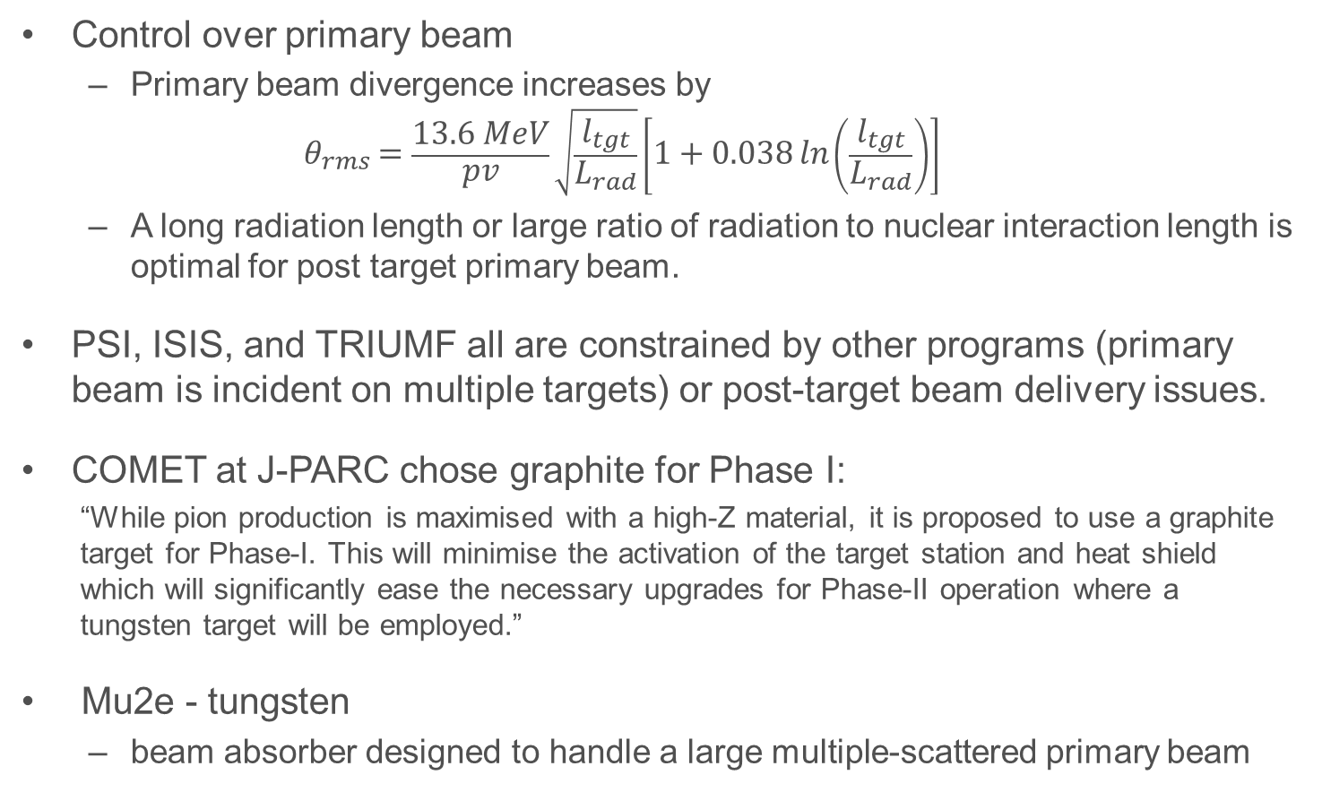
Why light targets
Control over primary beam
  Primary beam divergence increases by
  $$θ_{rms}=\frac{13.6 MeV}{pv}\sqrt{\frac{l_{tgt}}{L_{rad}}}\left[1+0.038\ln\left(\frac{l_{tgt}}{L_{rad}}\right)\right]$$
  A long radiation length or large ratio of radiation to nuclear interaction length is optimal for post target primary beam.
PSI, ISIS, and TRIUMF all are constrained by other programs (primary beam is incident on multiple targets) or post-target beam delivery issues.
COMET at J-PARC chose graphite for Phase I:
  “While pion production is maximised with a high-Z material, it is proposed to use a graphite target for Phase-I. This will minimise the activation of the target station and heat shield which will significantly ease the necessary upgrades for Phase-II operation where a tungsten target will be employed.”
Mu2e - tungsten
  beam absorber designed to handle a large multiple-scattered primary beam

Slide 8
Summarizing pion production concepts
At all energies, heavy targets are optimal, but destructive to primary beam
  Heavy targets are essential to intense μ- production
High multi-GeV proton energies,
  Low energy muons are increasingly produced backward – closer to 180°
  Muons occupy a smaller solid angle increasing captured particle density.
  Additionally
    Less scattering out of production target, longer production targets, more pions
    Eventually pion absorption/increased net beam size over long target lengths and difficulty focusing higher energy beams will deteriorate capture efficiency
  Bent solenoids applied to capture, remove contaminant secondaries, and control momentum properties
Below a GeV in proton energy,
  low energy pions are more forward – symmetric about incident beam direction
  ≥90° beamlines are standard at muon facilities with chicanes and spectrometers replacing expensive bent solenoids.
  Multiple beamlines can view the same production target
    Potentially supports multiple precision experiments.

Slide 9
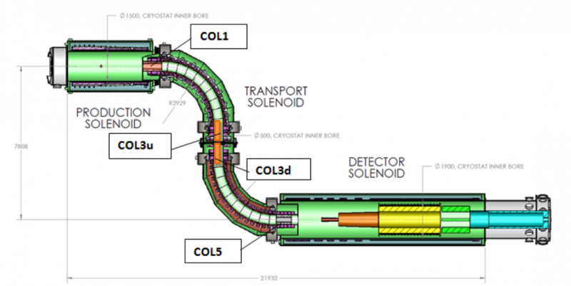
Is this the only future of conversion experiments?
  Cost and experiment-specific are limiting precision muon science
  Backward production requires multi-GeV proton beam energies
  Not an economical approach for LEμ production
Total single pion production cross section
dependence on proton energy
Variation of µ⁺ yield with incident proton energy for muons with momenta ≤ 30 MeV/c; i.e. surface muons

Slide 10
What this LDRD proposes to do
Develop an economical approach to producing an intense multi-application LEμ beam; capable of providing intense μ+ or μ- beams.
Essential R&D for muon beam facility planning for PIP-II
R&D overview
  Develop a heavy target for lower-energy proton beams (<1 GeV)
    Optimize interaction length, beamline orientation and capture Ω
    Optimize target geometry and orientation
      rotate target (increases IL without changing surface to volume or mean-free path of pion to target surface)
      Break the target into slices allowing LEμ to escape.
    Optimize # of target slices and spacing
  Test concepts at MTA
    Install a precision low-energy muon beamline in the MTA (in-house components, summer 2021)
    Study performance compared to simulations
    Support a DOE muon catalyzed fusion experiment to further quantify performance and successful application- provides detailed muon production measurements

Slide 11
Related Work:
30-MeV μ- production from a 780 MeV proton beam
Differential 20-MeV pion production cross sections as a function of angle for a Thorium target showing consistent peak locations for low energy muons, both signs

Slide 12
Current Fermilab Accelerator Complex, MTA facility
400-MeV MTA
400 MeV
8 GeV
8-120 GeV
400-MeV beam absorber
20’
400-MeV MTA Facility
40’
Rollup door
Shield wall
400-MeV primary
Layout – HE muon beams supported in Delivery Ring & g-2; LE (≤100 MeV) muon beams at MTA facility and potentially at Mu2e exploiting available beamline & infrastructure.

Slide 13
Pion Production using the 400-MeV Linac beam
Pion Production at the MTA
  Pion Thresholds
    Single pion: 280 MeV
    Pair Threshold: 600 MeV
      4 production channels
  Operational Limits
    7.5 x 10¹¹ p/sec (average)
    20 x 10¹³ p/sec (peak)
Surface Muon production
  10⁻⁹ μ⁺/p (C target, 4% IL);
    assume μ– half of μ⁺
    ~375 μ–/s (average)
    ~200,000 μ–/s (peak)
Full Linac Capability and Operational Parameters @15 Hz
Parameter | Value | Unit
Kinetic Energy | 401.5 | MeV
Energy Spread | 1 | MeV
RF Structure | 201.24 | MHz
Bunch Length | 0.208 | ns
Max Pulse Length | 80 | µs
Max Particles Per Bunch (28 mA) maA | 0.88x10⁹
Max Particles Per Pulse | 1.6x10¹³
Peak Current | 28 | mA
Avg Current | 38 | µA
Max Beam Power | 15.7 | kW
Beam Emittance (99%) | 8 | mm-mrad

Slide 14
Prior MTA work:
Muon production on gas RF cavity steel windows
Notes:
  Peak production angle backward
    Highest net flux
    ~90 -135°
  Low backgrounds:
    Forward primary protons
      Within a forward ±20° cone
Muon flux in the experimental hall for 2.67 x 10¹¹ p/sec (1.6 x 10¹³ p/pulse and 1 pulse/minute in Experiment mode) on a gas-filled RF test cell with thick (>100% Interaction length) walls

Slide 15
Prior MTA Work
Muon production 2″ steel (MARS run)
Notes:
  Average flux
    Assuming μ⁺ plus μ–
    Flux integrated over solid angles/area
    Max rate is 2.8 x higher
    μ– rate then is ~1/3
    Average for 20% IL target
      ~200 μ– /sec/cm² (steel)
      ~1500 μ– /sec/cm² (Ta)
  Energy range:
    4 MeV – 100 MeV
  Depending on directionality
    Flux likely higher
Muon energy spectrum from 400-MeV protons incident on a gas-filled RF test cell for 2.67 x 10¹¹ p/sec (1.6 x 10¹³ p/pulse and 1 pulse/minute)

Slide 16
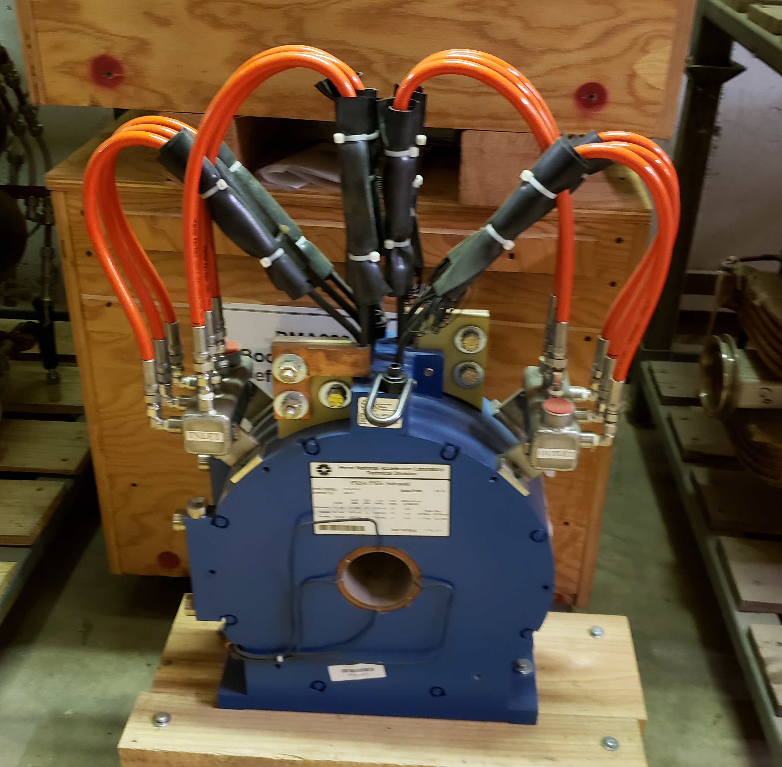
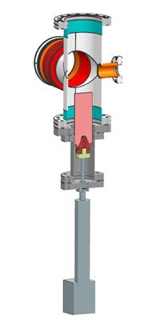
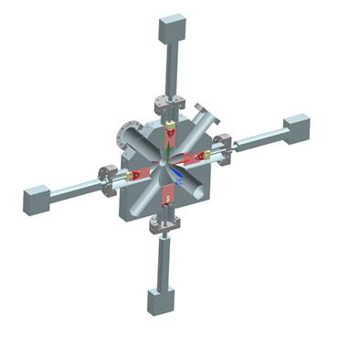
Pre-LDRD work has begun
Radiation/production studies with a heavy target
  Uses the current MTA MARS model
Pre-conceptual beamline design
  Primary beam absorber and target location
  Capture of 10-100 MeV π- or π+
    Appropriate decay length for 50 MeV pions (9 meters)
    Chicane (poor-man’s spectrometer) for particle and momentum selection
In-house available components identified
  PXIE solenoid, air core dipoles and quadrupoles (Booster correctors)
  Power supplies available, HRM and controls and cabling costed
  Power distribution available in MTA service buildings
Retractable target and absorber
  Based on existing mechanical (PIP-II) designs with modifications

Slide 17
Secondary Beamline Layout: Conceptual
0.25m
0.25m
0.25m
0.25m
F
D
F
0.5m
5.7m
~0.75m
0.75m
Experiment
SOL
Experimental Beam Absorber
Decay section and
momentum selection chicane
Beamline strawman 15-50 MeV pions/muons
  Decay length to experiment ~9 m
    Target just upstream of ITA shielding cave
Primary beam absorber
Production Target
Experimental Area

Slide 18
PI experience – beamlines – (design, install, commissioning, operation)
400-MeV Booster injection line
400-MeV MTA beamline
MCENTER (MIPP and NOVA) primary and secondary production lines
MTEST primary and secondary beamlines
  6.5 months from inception to first beam
Mu2e and g-2 experimental beamlines
  Successfully merged Mu2e and g-2 beam and located experiments
Location and clocking of g-2 ring

Slide 19
Costing example:
Mechanical engineering labor and contingency
 |  |  | TASK | HOURS | DAYS | PERSONNEL
45° TANTALUM TARGET & HOUSING | HOUSING | DESIGN | RESEARCH | 4 | 0.5 | ENG
 |  |  | MODELING | 8 | 1 | ENG
 |  |  | DRAWINGS | 12 | 1.5 | CAD
 |  |  | CONTINGENCY | 24 | 3 | ENG, CAD
 |  | ANALYSIS | CALCULATION | 8 | 1 | ENG
 |  |  | DOCUMENTATION | 8 | 1 | ENG
 |  |  | SUBTOTAL | 64 | 8
 | TARGET | DESIGN | RESEARCH | 12 | 1.5 | ENG
 |  |  | MODELING | 16 | 2 | ENG
 |  |  | DRAWINGS | 24 | 3 | CAD
 |  |  | CONTINGENCY | 32 | 4 | ENG, CAD
 |  | ANALYSIS | CALCULATION | 32 | 4 | ENG
 |  |  | DOCUMENTATION | 20 | 2.5 | ENG
 |  |  | SUBTOTAL | 136 | 17
 |  |  | NET TOTAL | 200 | 25
BEAM ABSORBER & HOUSING | HOUSING | DESIGN | RESEARCH | 4 | 0.5 | ENG
 |  |  | MODELING | 8 | 1 | ENG
 |  |  | DRAWINGS | 8 | 1 | CAD
 |  |  | CONTINGENCY | 12 | 1.5 | ENG, CAD
 |  | ANALYSIS | CALCULATION | 4 | 0.5 | ENG
 |  |  | DOCUMENTATION | 4 | 0.5 | ENG
 |  |  | SUBTOTAL | 40 | 5
 | DUMP | DESIGN | RESEARCH | 8 | 1 | ENG
 |  |  | MODELING | 12 | 1.5 | ENG
 |  |  | DRAWINGS | 20 | 2.5 | CAD
 |  |  | CONTINGENCY | 28 | 3.5 | ENG, CAD
 |  | ANALYSIS | CALCULATION | 32 | 4 | ENG
 |  |  | DOCUMENTATION | 20 | 2.5 | ENG
 |  |  | SUBTOTAL | 120 | 15
 |  |  | NET TOTAL | 160 | 20
PION BEAMLINE | VACUUM | DESIGN | RESEARCH | 8 | 1 | ENG
 |  |  | MODELING | 28 | 3.5 | CAD
 |  |  | DRAWINGS | 24 | 3 | CAD
 |  |  | CONTINGENCY | 64 | 8 | ENG, CAD
 |  | ANALYSIS | CALCULATION | 24 | 3 | ENG
 |  |  | DOCUMENTATION | 28 | 3.5 | ENG
 |  |  | SUBTOTAL | 176 | 22
 | STANDS | DESIGN | RESEARCH | 8 | 1 | ENG
 |  |  | MODELING | 32 | 4 | ENG
 |  |  | DRAWINGS | 28 | 3.5 | CAD
 |  |  | CONTINGENCY | 64 | 8 | ENG, CAD
 |  | ANALYSIS | CALCULATION | 28 | 3.5 | ENG
 |  |  | DOCUMENTATION | 40 | 5 | ENG
 |  |  | SUBTOTAL | 200 | 25
 |  |  | NET TOTAL | 376 | 47
GRAND TOTAL & CONTINGENCY |  |  |  | 736 | 92
BREAKDOWN BY ACTIVITY |  | DESIGN | RESEARCH | 44 | 5.5 | ENG
 |  |  | MODELING | 104 | 13 | ENG
 |  |  | DRAWINGS | 116 | 14.5 | CAD
 |  |  | CONTINGENCY | 224 | 28 | ENG, CAD
 |  | ANALYSIS | CALCULATION | 128 | 16 | ENG
 |  |  | DOCUMENTATION | 120 | 15 | ENG
 |  |  | ENG | 396 | 49.5
 |  |  | DRAFTING | 116 | 14.5
 |  |  | CONTINGENCY | 224 | 28 | 44%
 |  |  | TOTAL | 512 | 64
 |  | TOTAL + CONTINGENCY |  | 736 | 92

Slide 20
Costing Example
Mechanical M&S estimates contingency
 | INSTALLATION |  | MATERIAL COST
ITEM | HRS | DAYS | DESCRIPTION | $/QTY | QTY | COST
TANTALUM HOUSING | 8 | 1 | CUSTOM HOUSING | $7,500 | 1 | $7,500
 |  | 0 | LINEAR ACTUATOR | $2,500 | 1 | $2,500
 |  | 0 | SUPPORT STAND | $2,500 | 1 | $2,500
TANTALUM TARGET | 4 | 0.5 | TARGET MATERIAL (Ta⁷³) | $8,000 | 1 | $8,000
 |  | 0 | TARGET FABRICATION | $3,000 | 1 | $3,000
NICKEL BACKUP TARGET | 4 | 8 | TARGET MATERIAL (Ni) | $4,000 | 1 | $4,000
 |  | 0 | TARGET FABRICATION | $1,500 | 1 | $1,500
RETRACTABLE BEAM ABORBER | 8 | 1 | ASSEMBLY | $2,500 | 1 | $2,500
 |  | 0 | LINEAR ACTUATOR | $2,500 | 1 | $2,500
BEAM ABSORBER | 4 | 0.5 | TARGET MATERIAL | $1,000 | 1 | $1,000
 |  | 0 | TARGET FABRICATION | $1,500 | 1 | $1,500
SIMPLE COLLIMATOR - PION LINE | 8 | 1 | MAT/FAB | $2,000 | 2 | $4,000
VACUUM COMPONENTS | 80 | 10 | ROUGH COST/FOOT | $150 | 40 | $6,000
 |  | 0 | ROUGH FLANGE COST | $200 | 25 | $5,000
CORRECTOR STANDS | 16 | 2 | COST PER STAND | $5,000 | 8 | $40,000
SOLENOID STAND | 8 | 1 | COST PER STAND | $7,000 | 1 | $7,000
 |  | 0 |  |  |  | $0
MISC HARDWARE |  | 0 | MISC | $10,000 | 1 | $10,000
TOTAL | 140 | 25 |  |  |  | $108,500

Slide 21
Notes on labor budget
PI time has been reduced to oversight and Q&A
  External beamline design and support is part of lab responsibilities
  TRIUMF is supporting an experienced beam post-doc for the LDRD work
    Full time until beginning of LDRD or until continuous onsite presence is required
  Post doc significantly reduces senior scientific staff hours
Contingency rate consistent with Preliminary Design Rate of ~35%
FTBF is providing 0.2 FTE support for radiation/production and shielding assessment studies outside of LDRD request
  An experienced MARS and experimental scientist has been identified for this work

Slide 22
Summary
A LE muon facility at Fermilab offers immediate and long-term unique science opportunities and capabilities not achievable at other facilities
“Estimated” Muon Production @MTA
  With a segmented Ta or W target
    >1000 μ⁺ or μ– /s; cm² spot size; 4–100 MeV variable energy
      Instantaneous flux higher
    Space available for small-scale experiments and target R&D
A DOE supported muon (μ–)-catalyzed fusion experiment is proposed to be installed in the MTA hall (shutdown 2021)
For Snowmass (independent of LDRD)
  Provide basic R&D needed to plan/integrate a green-field muon facility into PIP-II (compatible with PIP II civil planning)

Slide 23
BACK UP SLIDES – pictures of MTA

Slide 24
MTA Experimental area and Beamline Stub
Upstream view of Beamline stub

Slide 25
MTA Experimental area and Beamline Stub
Downstream view of Experimental Hall

Slide 26
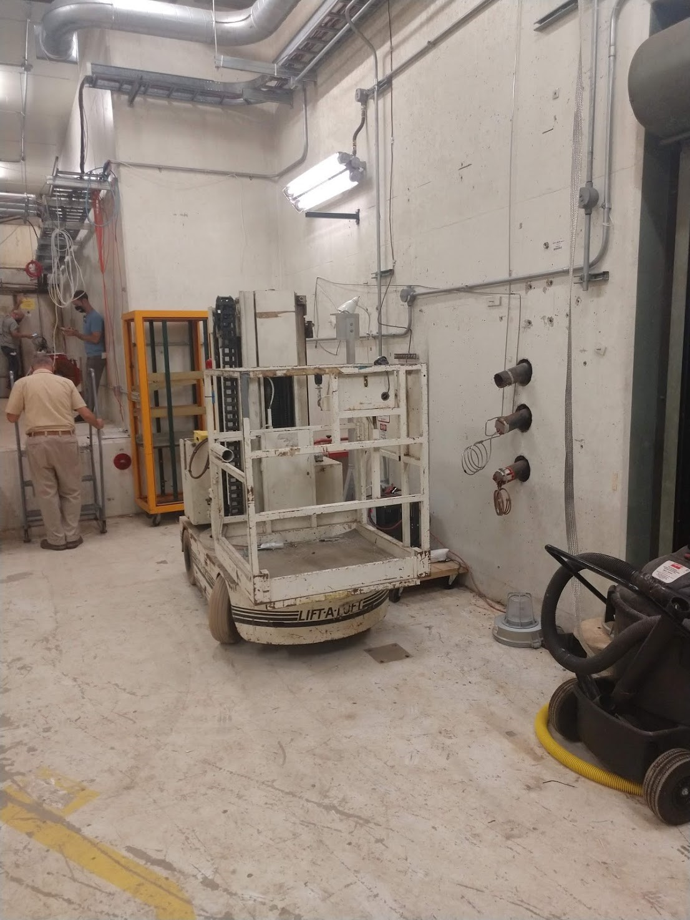
East Side of MTA hall near roll-up door
Area available for beam measurements and small experiments

