Slide 1
Status of FFA accelerator in Kyushu University
Faculty of Engineering, Kyushu University
Yujiro Yonemura

Slide 2
Contents
Overview of accelerator facility of Kyushu University
Status of beam commissioning
Experimental results of beam extraction
Summary

Slide 3
Overview of Accelerator Facility
Internal
Ion Source
10 MeV Proton
125 MeV Proton
150MeV Proton or Heavy Ion beam
Experimental
Hall
150 MeV
FFA
Cyclotron
Ion Source
(p, d, Heavy Ion)
12 MeV Proton
or Heavy Ion
8 MV Tandem Accelerator

Slide 4
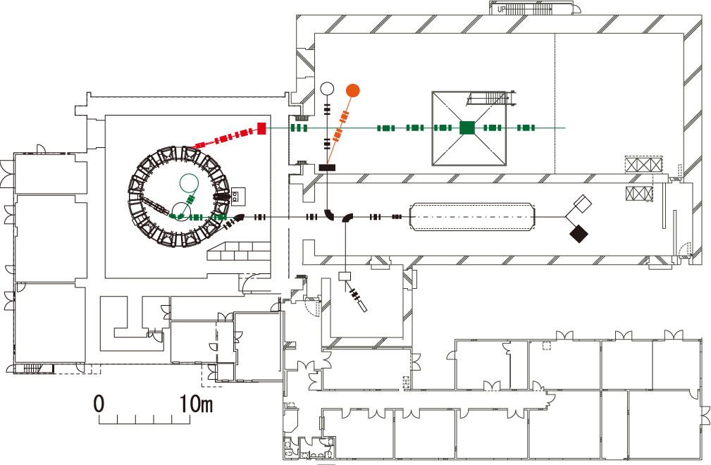
Construction status of accelerator facility
1st Stage
Almost completed
Beam commissioning of the 150 MeV FFA accelerator and the tandem accelerator have been completed. In order to increase beam energy and current, optimization of operating parameters and improvements of equipment have been carried out.
Experimental hall
150 MeV FFA
Tandem accelerator
2nd Stage
Applying for a budget
Several projects are planned in the future.
The improvement of the magnets of the main ring
the expansion of experimental hall
  Construction of proton and neutron Irradiation room
  Neutron source with the modified ERIT ring
the demonstration of heavy ion injection and acceleration with FFA accelerator
Details will be reported later in my presentation.

Slide 5
Status of Beam Commissioning(1)
2016-2018
Construction and operation test of the beam extraction system
operation test of the extraction kicker and the extraction septum has been successfully performed. All technical troubles of power sources and water-cooling system were resolved by repairing or replacing failed devices.
(reported in FFA workshop 2018)
2019
Jan. – May
Beam acceleration test / Tune measurement
Jun.
Installing additional magnetic pole
(tune correction patch)
Operation time
in 2019
~ about 27 days
Jul.
Beam acceleration
Aug.
Driver amplifier broke down, and it was temporarily replaced with an amplifier with low output power.
Sep.
Beam acceleration up to final energy
Position adjustment of extraction kicker
Optimization of timing system

Slide 6
Status of Beam Commissioning(2)
2019 Oct. –
2020 Feb.
Installation of additional beam monitor
Hight power test of extraction septum and kicker
Beam extraction
Mar.
Water-cooling system of injector cyclotron broke down
Apr. – Aug.
Operation was suspended due to Covid-19
Sep. – Nov.
Maintenance period
Repair of water-cooling system
Commissioning schedule
Dec.
Beam commissioning
2021
Jan.-Mar.
Beam experiment for extraction

Slide 7
Experimental condition of beam extraction
Particle: Proton from injector cyclotron
Injection energy: 10 MeV
Extraction energy: 75 MeV ( 1st Stage), 100 MeV (2nd Stage)
Repetition rate: 20 Hz

Slide 8
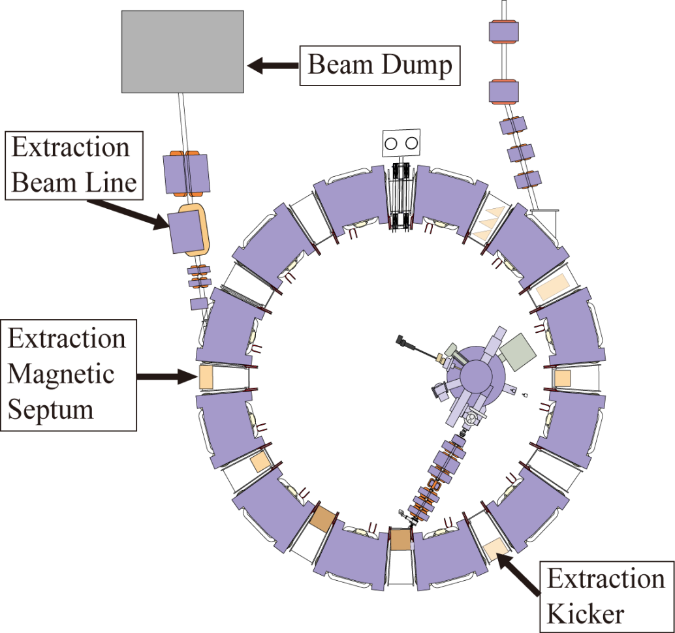
Configuration of Beam Extraction System
x [m]
Extraction
Septum
Extraction
Kicker
Phase [deg.]
Extraction method : Fast extraction
Phase advance between kicker and septum: 440 deg.(4 cells) ≅ 3 π

Slide 9
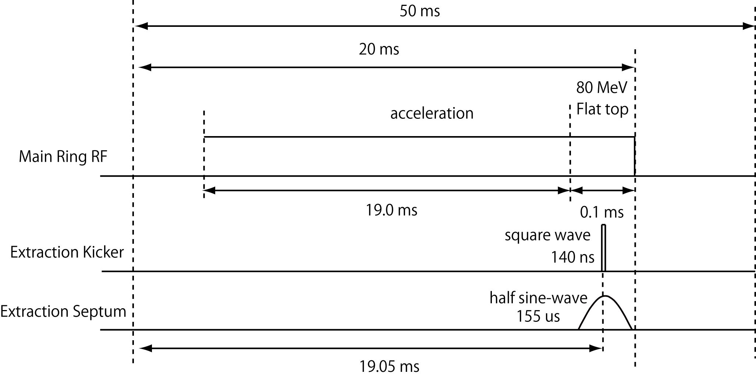
Timing chart of beam acceleration and Extraction
Repetition rate:
20 Hz
75 MeV
Acceleration cycle:
50 Hz (20 ms)
Gap Voltage | 3 .0 kV/cavity
RF frequency | 1.5 – 4.2 MHz
Synchronous Phase | 20 deg.

Slide 10
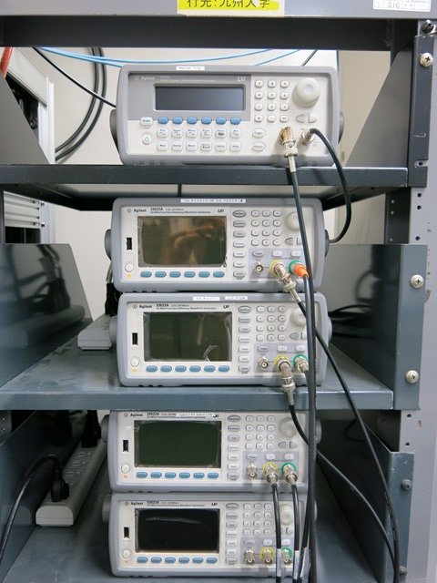
Timing system
Agilent 33210A
Function/Arbitrary Generator
Cyclotron RF
Agilent 33522A
Function/Arbitrary Generator
Pulse Ion Source
Agilent 33522A
Function/Arbitrary Generator
Beam Chopper
Main ring RF
Tektronix
AWG 2021
Injection Bump #1
Agilent 33522A
Function/Arbitrary Generator
Injection Bump #2
Extraction Kicker
Agilent 33522A
Function/Arbitrary Generator
Extraction Septum
The timing was adjusted so that the beam current was maximized.

Slide 11
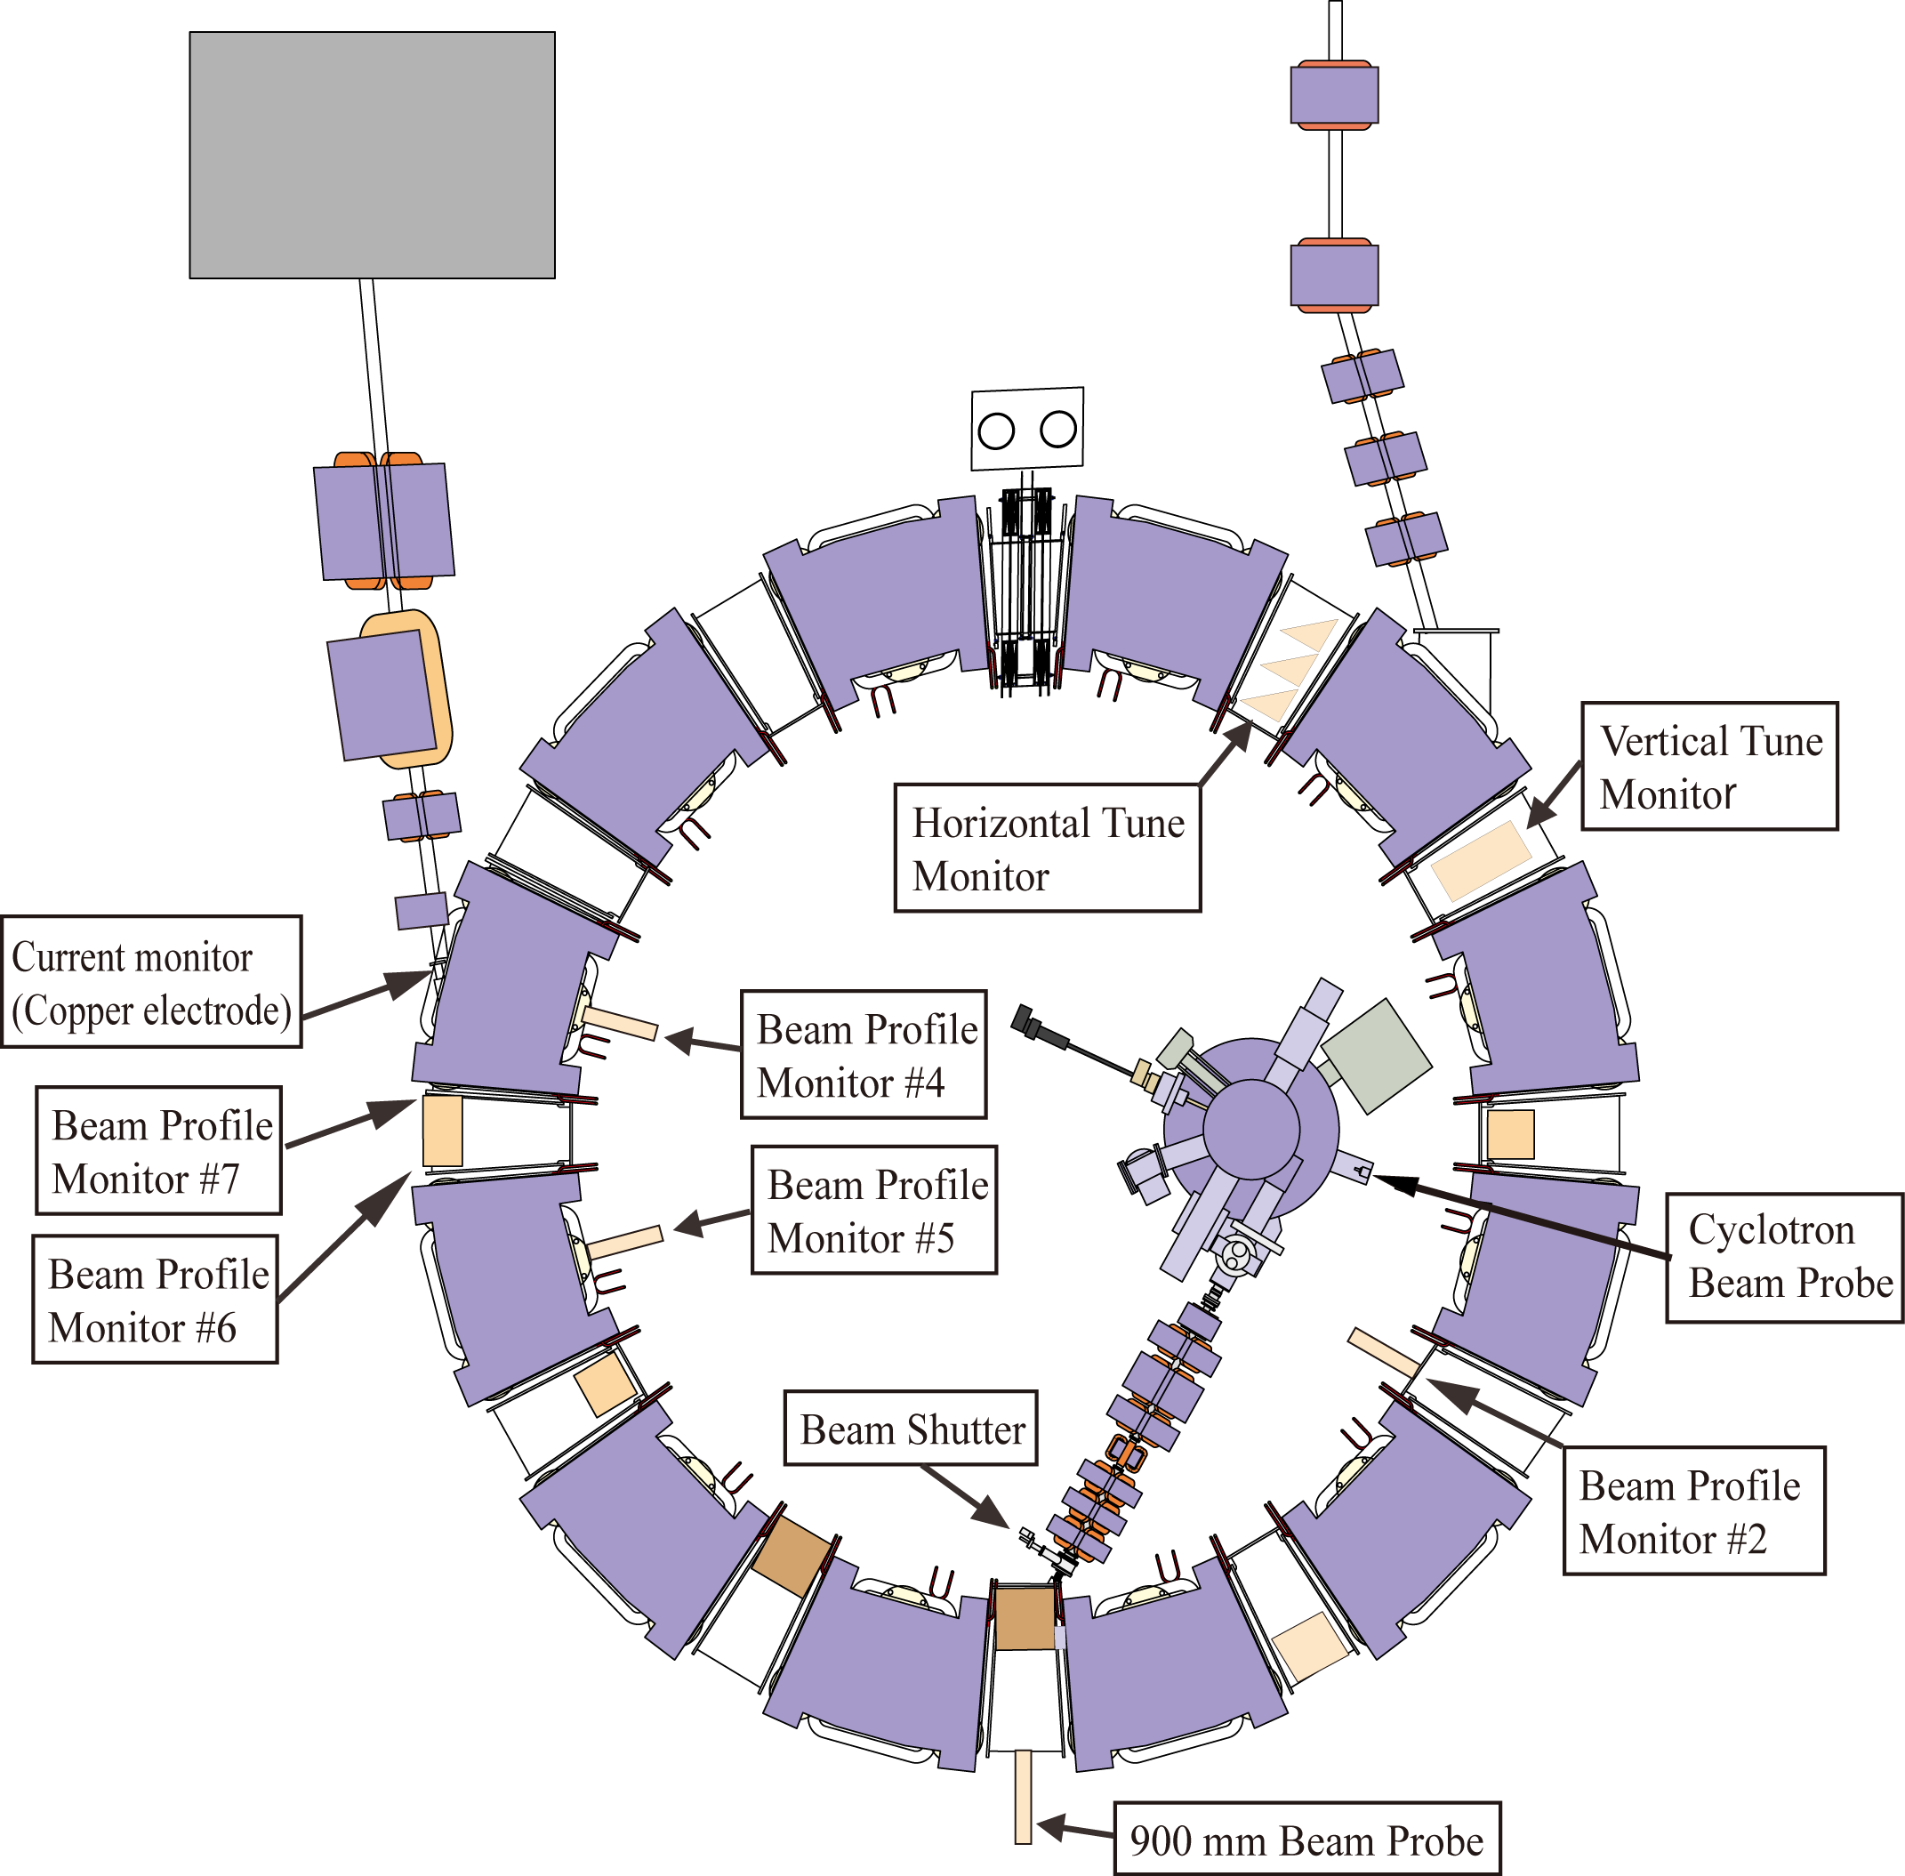
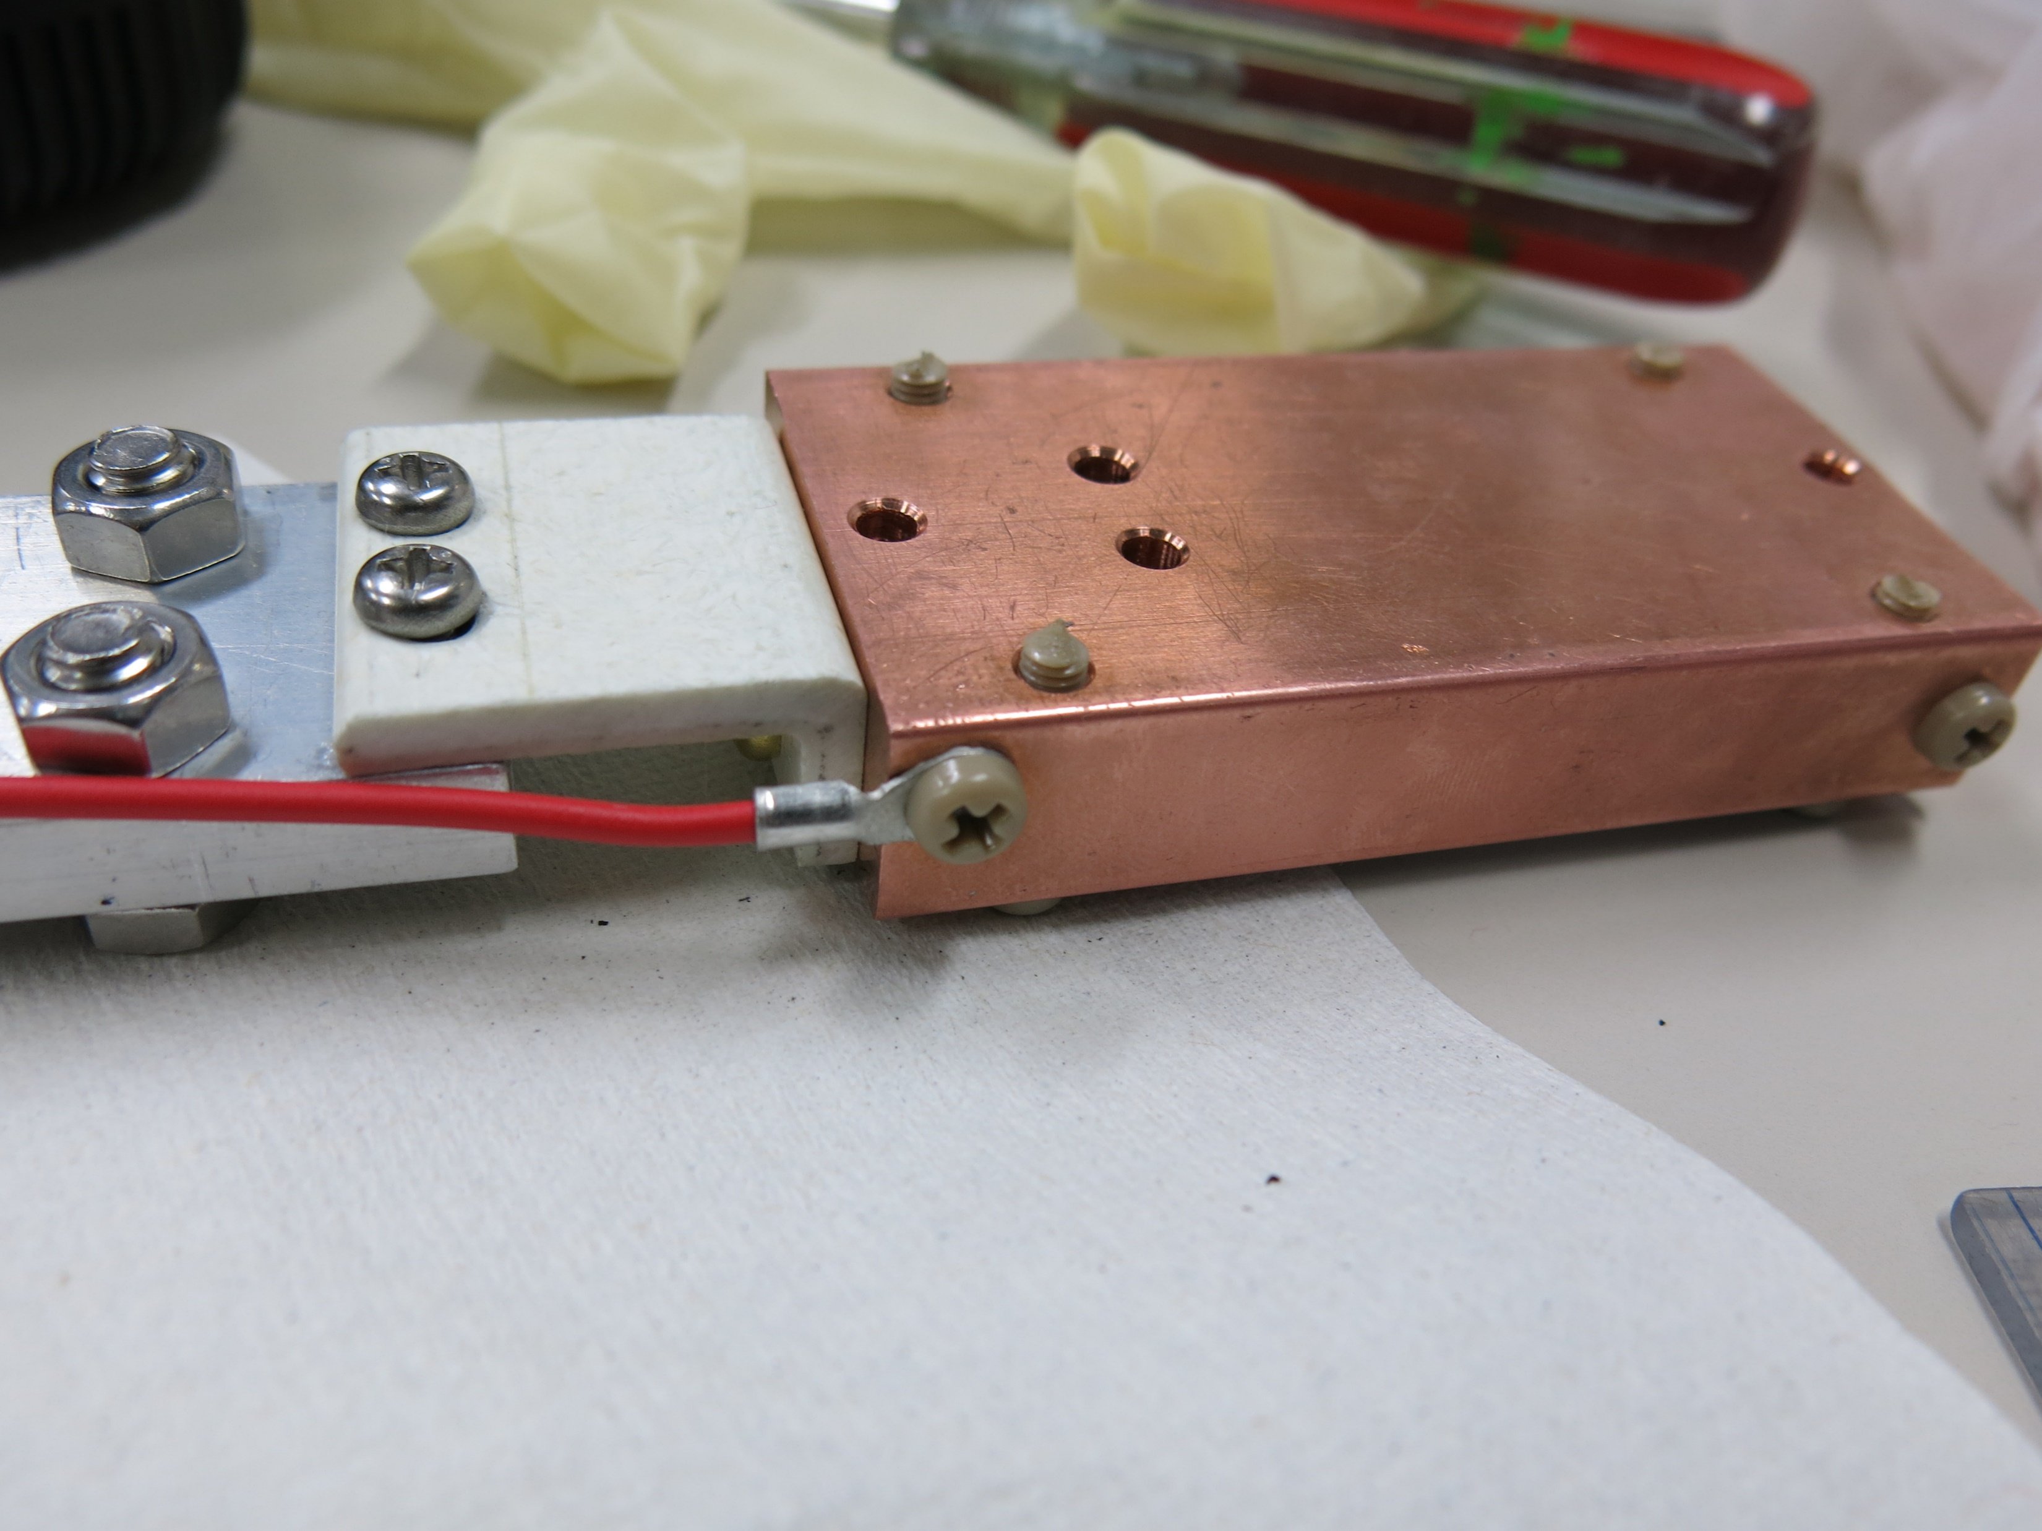
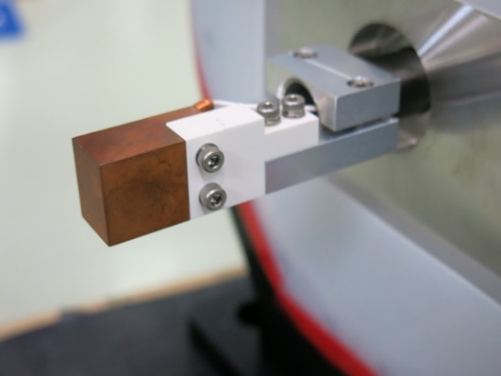
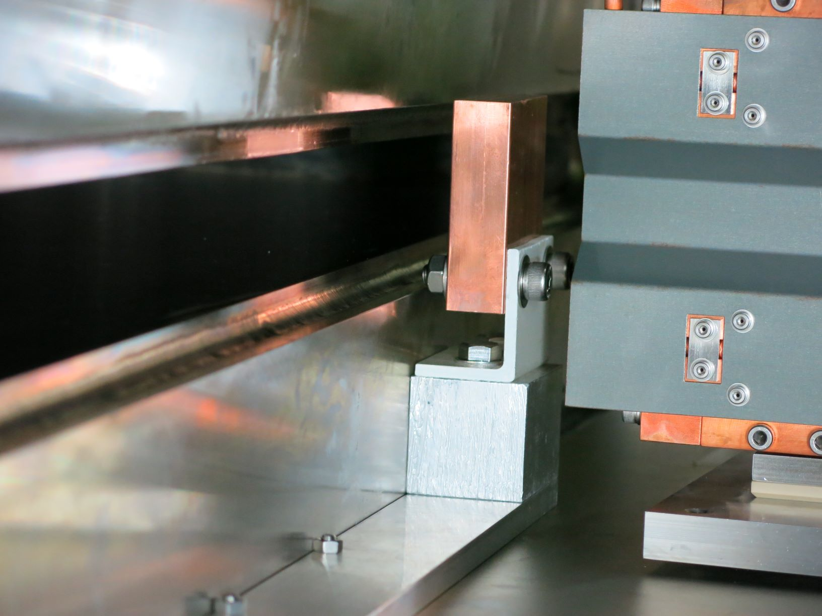
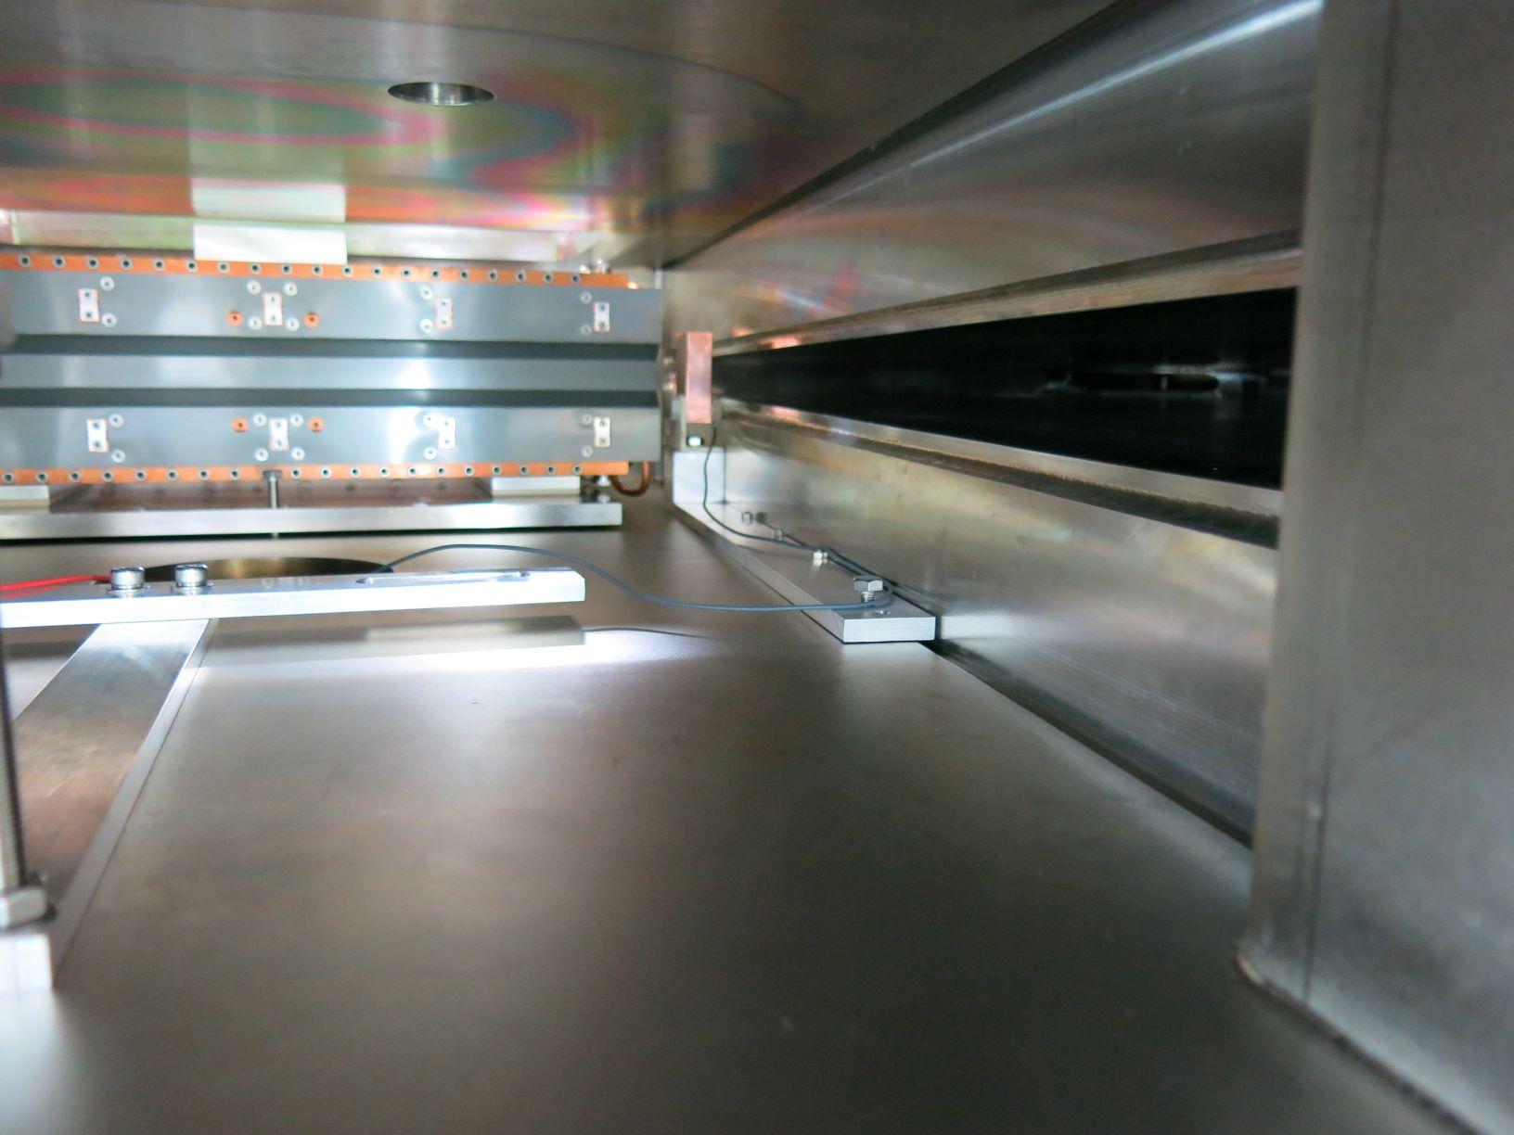
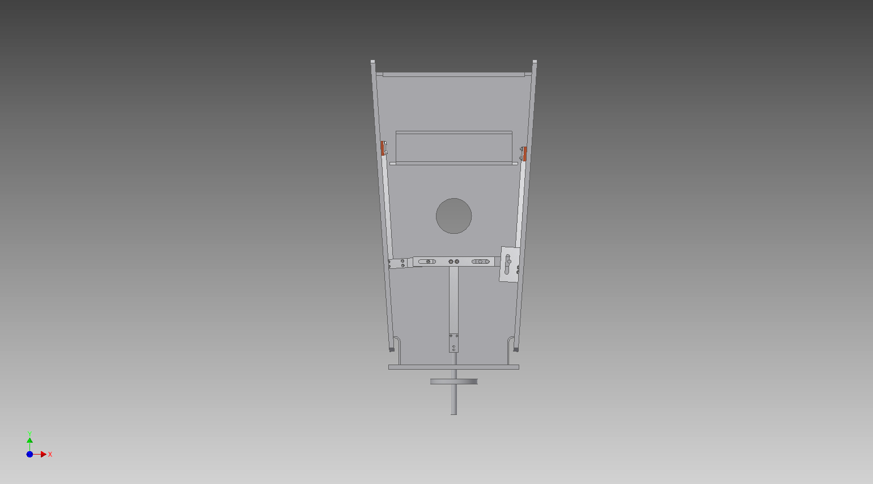
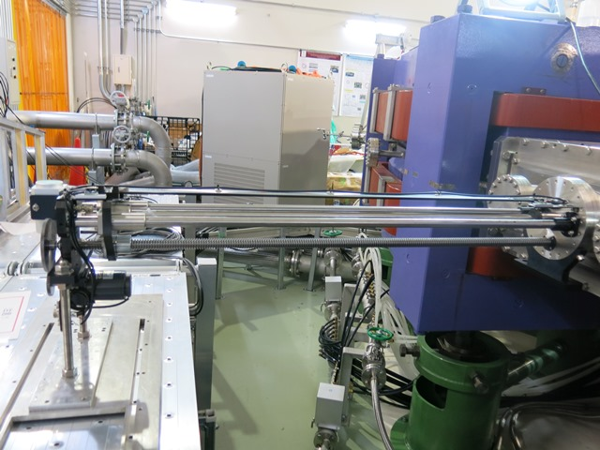
Layout of beam monitors
Destructive beam monitor
Copper electrode
900 mm
Extraction magnetic septum

Slide 12
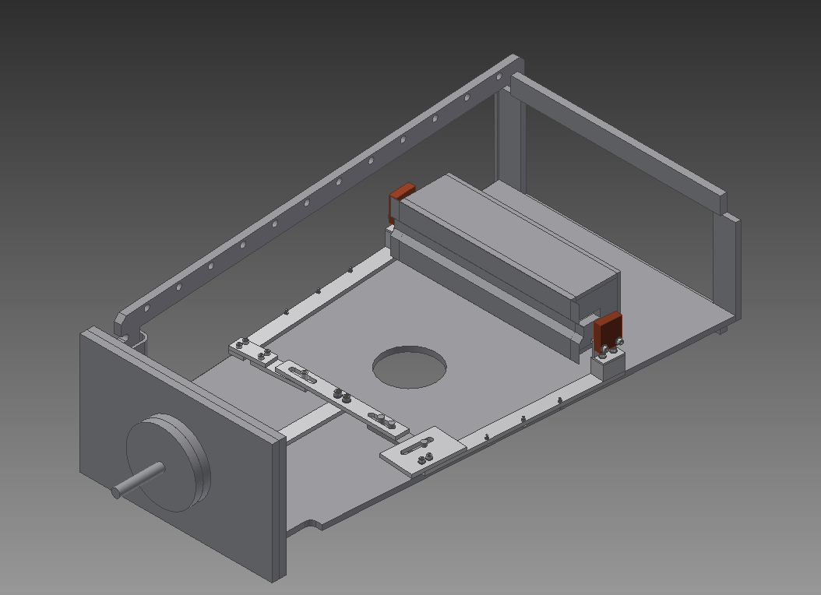
Beam profile monitor at extraction septum
Extraction
Septum
Movable beam shutter #1 (Inlet)
Movable beam shutter #2 (Outlet)
extracted beam
circulating beam

Slide 13
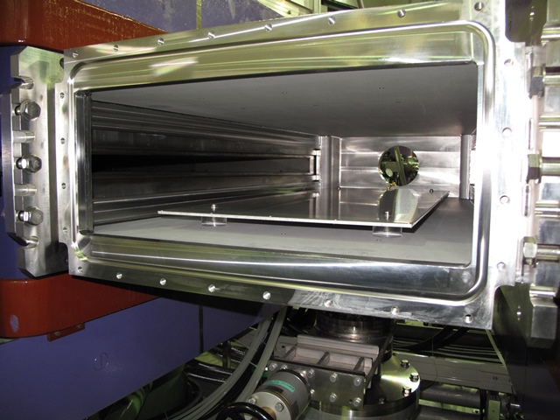
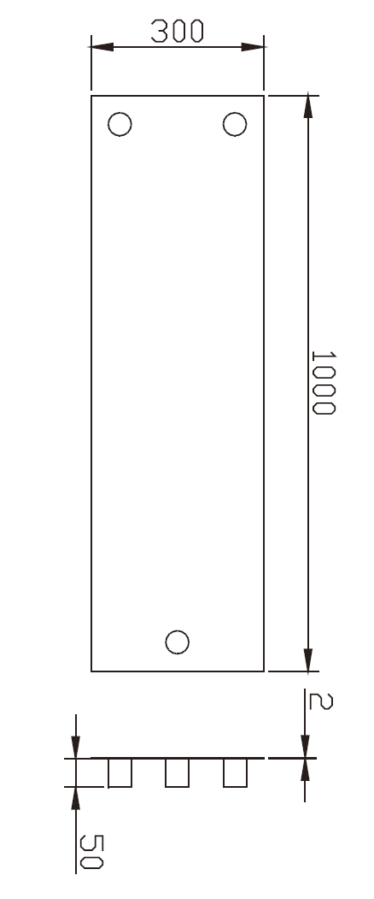
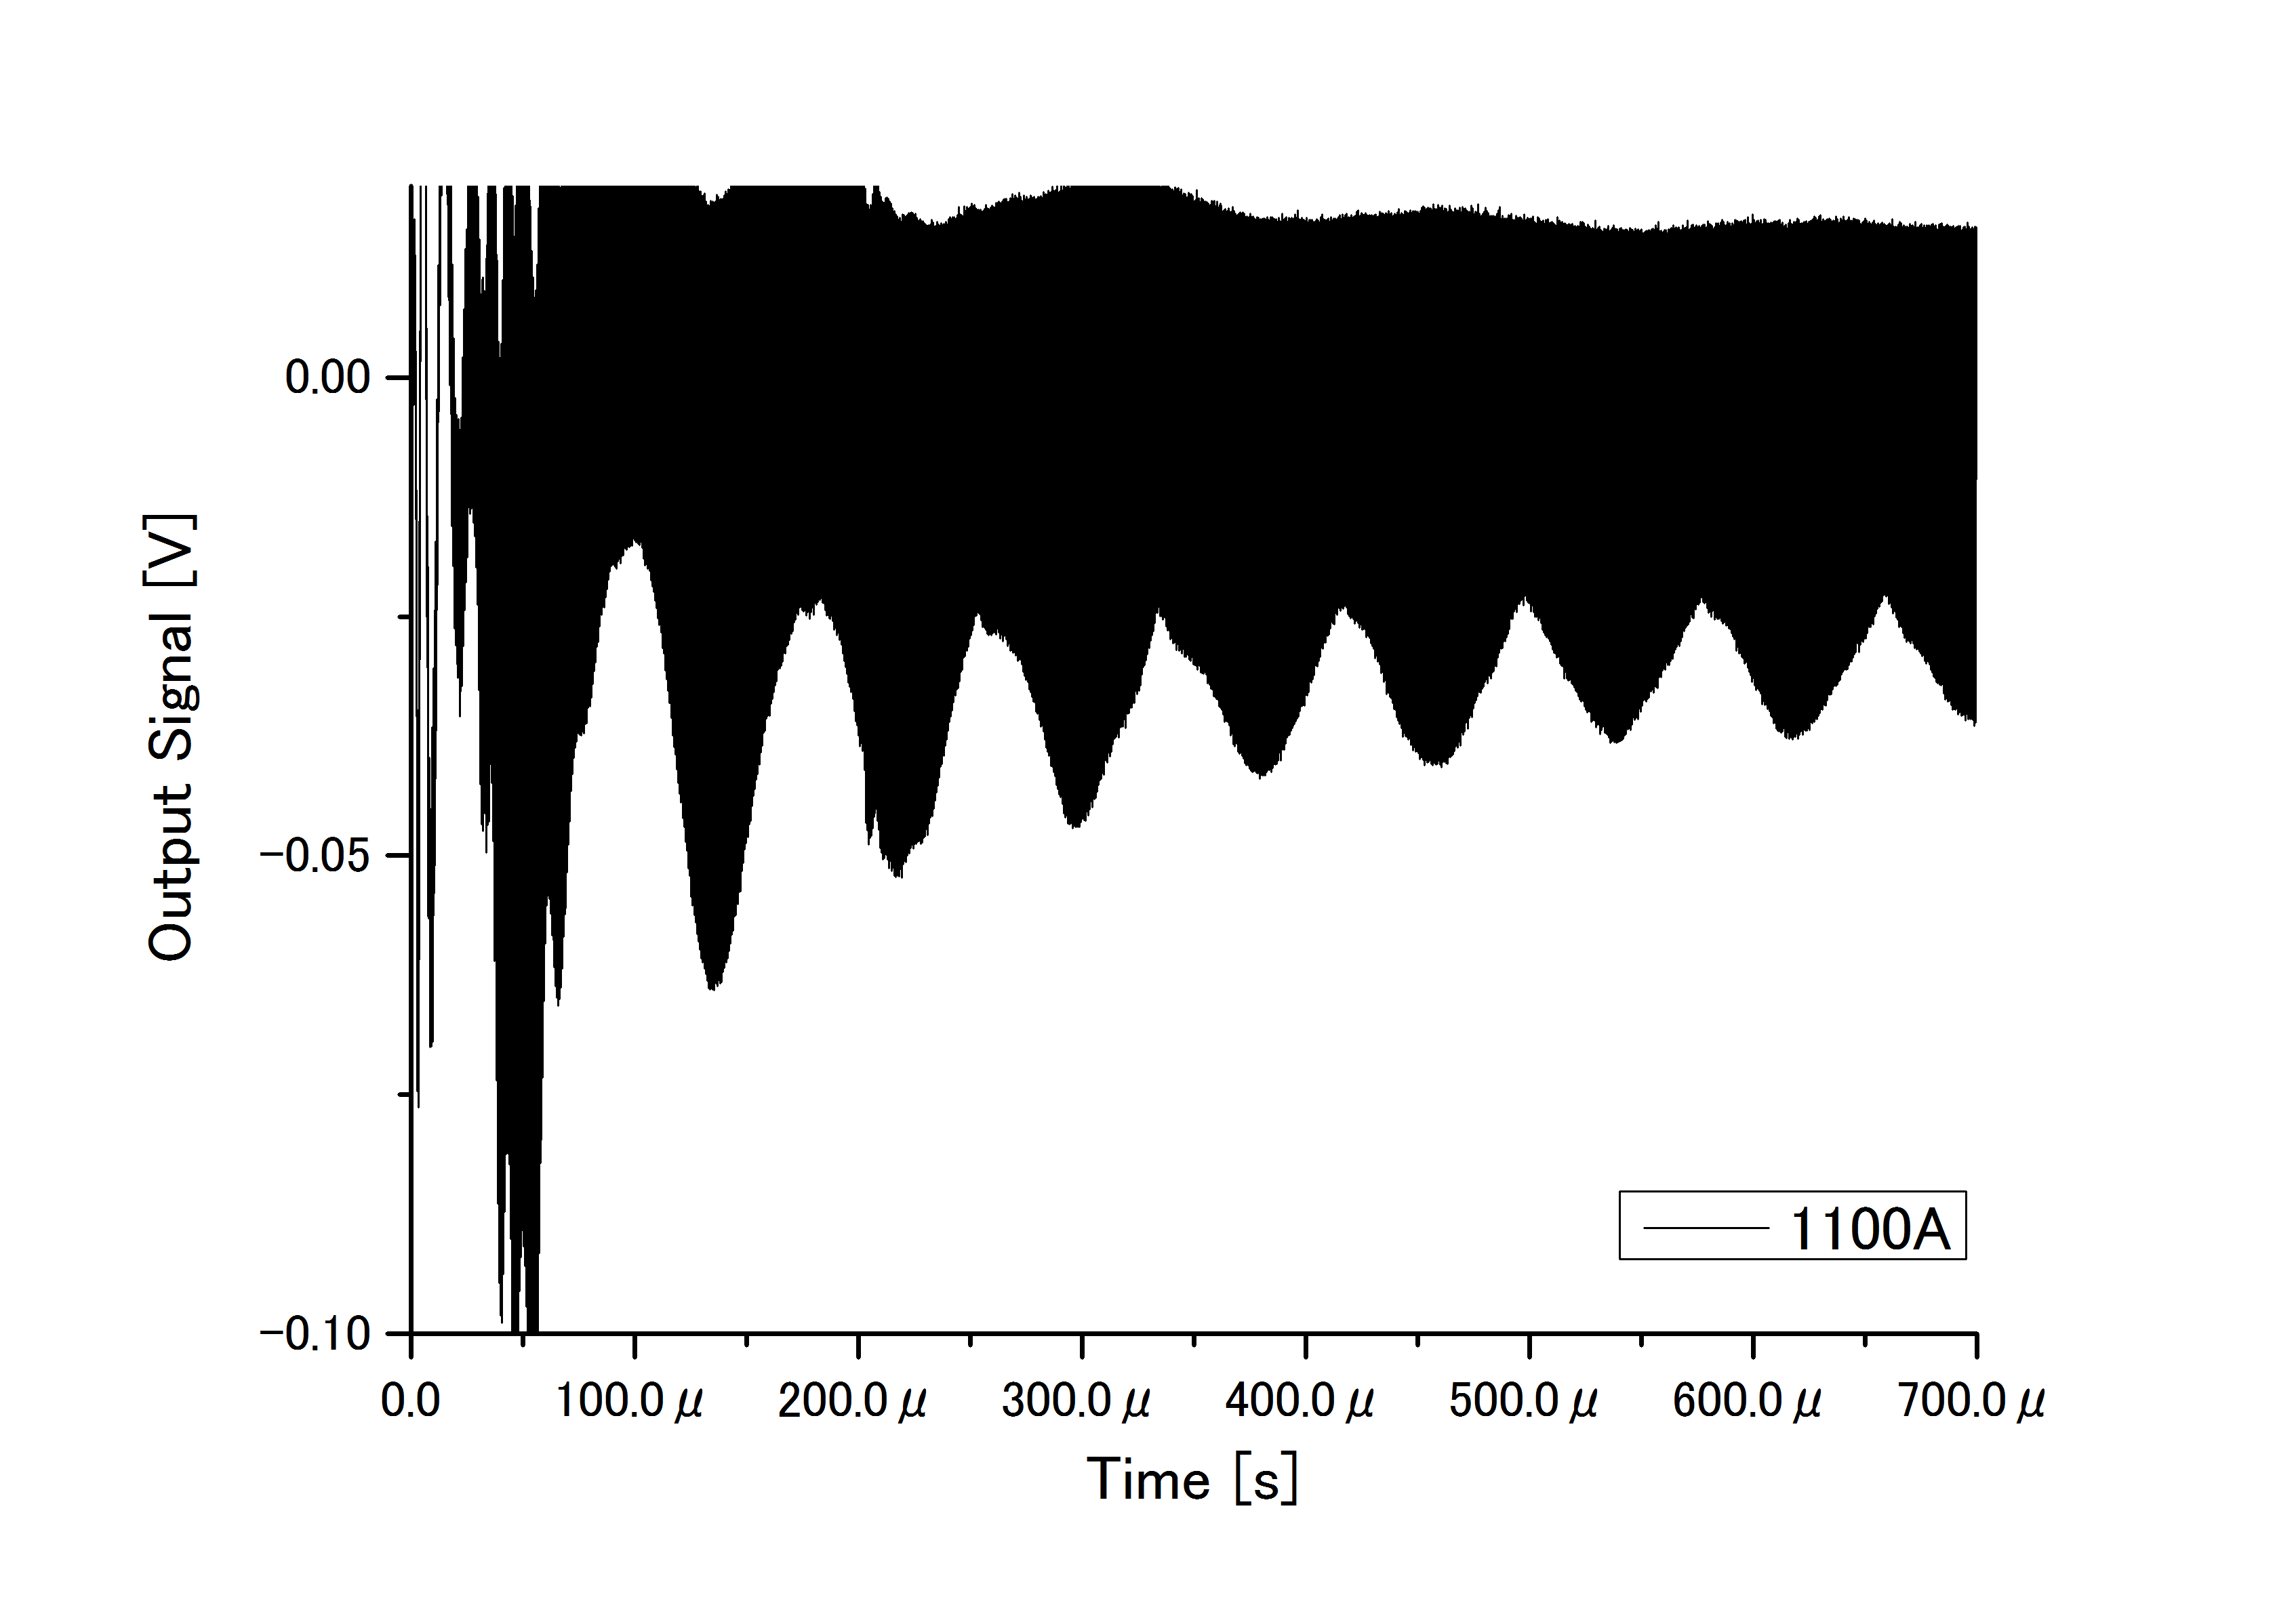
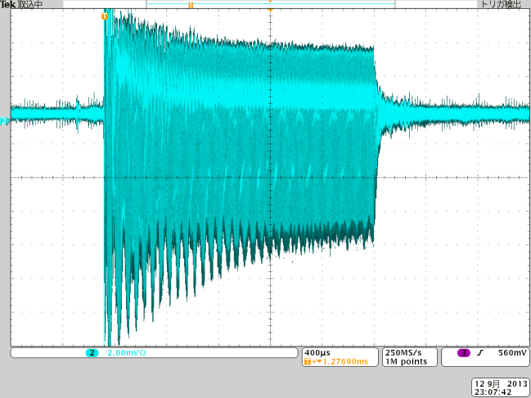
Vertical tune monitor
It is employed as a bunch monitor
Aluminum electrode
Installed vertical tune monitor in vacuum chamber
Electric Insulation rod

Slide 14
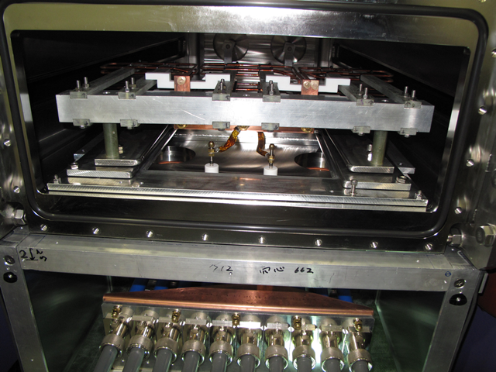
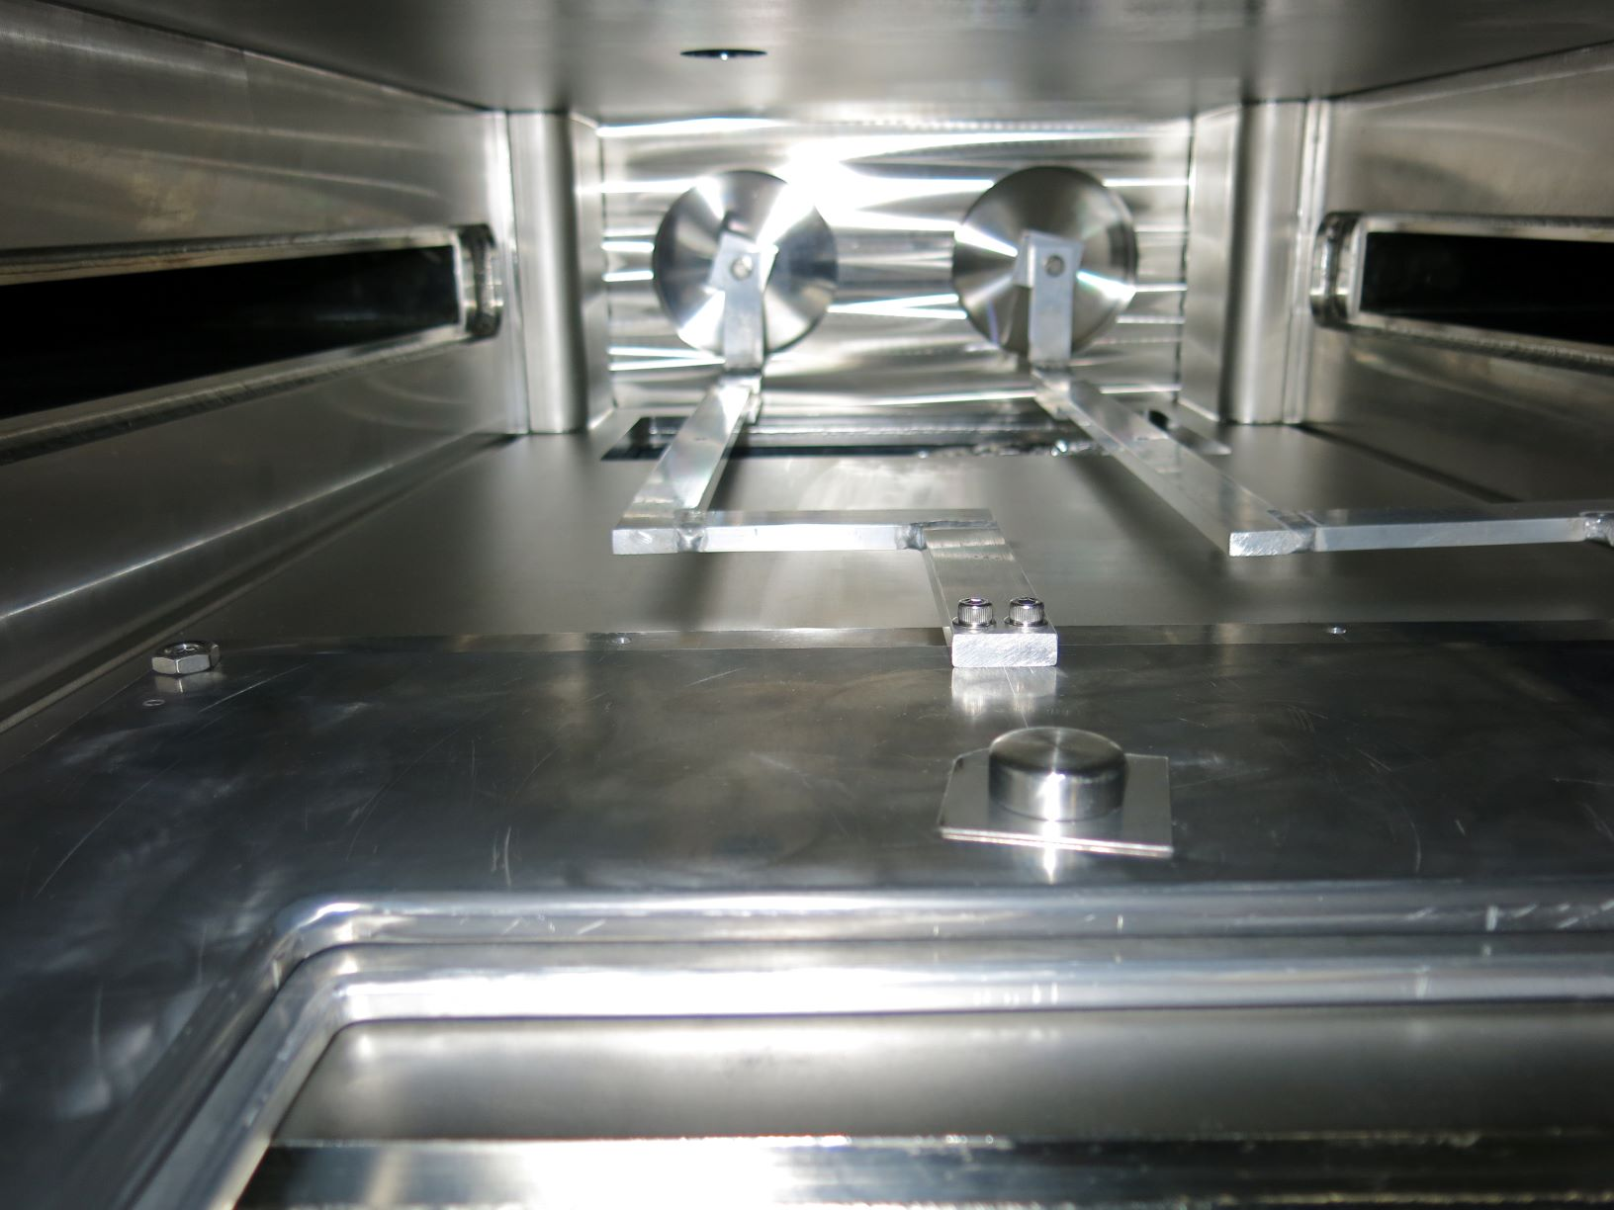
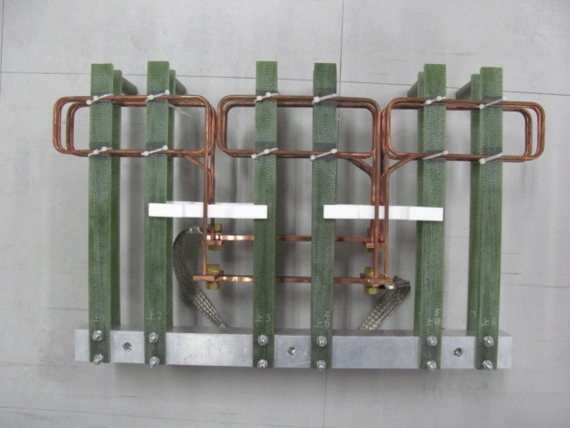
Position adjustment system of extraction kicker
rod
rod
turntable
rod
rod
Radial direction
Position adjustment system
(turntable and
rod for moving turntable)
turntable
Extraction kicker installed in vacuum chamber
To adjust position and angle of the extraction kicker magnets, the turntable that moves in the radial direction was installed.
Extraction kicker magnet

Slide 15
Optimization of position and excitation timing of extraction kicker magnet
The beam profile at the inlet of the extraction septum was measured
by changing the position and excitation timing of the extraction kicker magnet.
Measured beam profile with respect to the position of kicker magnet
Measured beam profile with respect to the excitation timing of kicker magnet
Optimum conditions for the position and the timing are experimentally determined.

Slide 16
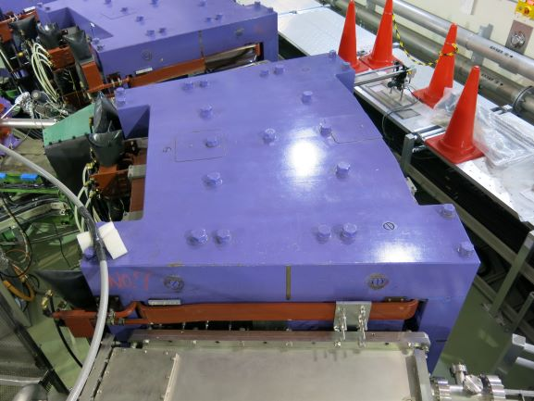
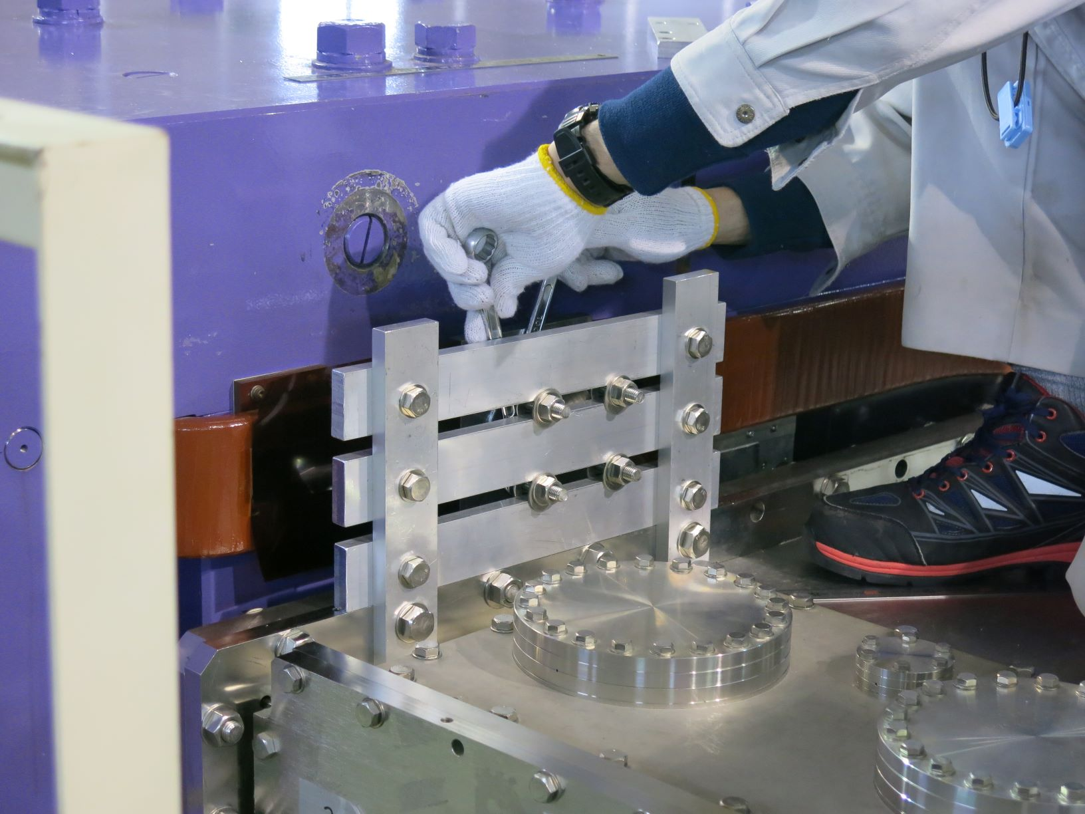
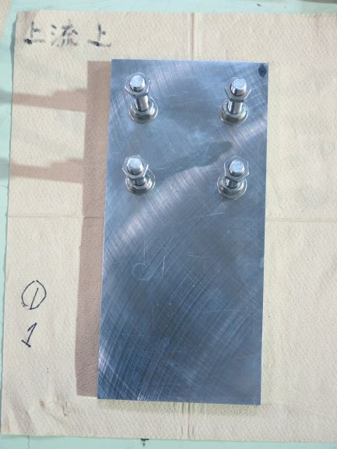
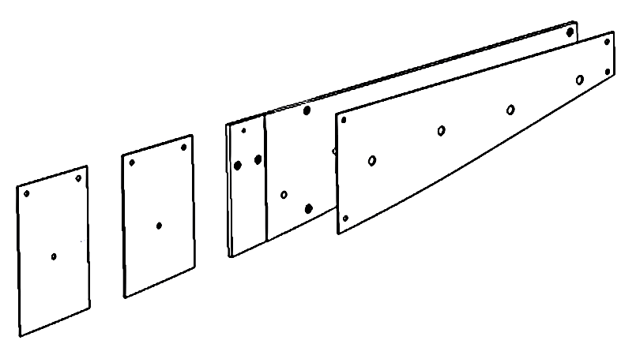
Optimization of position and dimensions of additional magnetic pole
In order to reduce beam loss during acceleration, iron plates that reduce variation of vertical tune are installed in both side of the magnet.
Position adjustable plate to control vertical tune near the extraction septum.
Dimension
300 x 140 x 15
Additional magnetic pole to control vertical tune during acceleration.

Slide 17
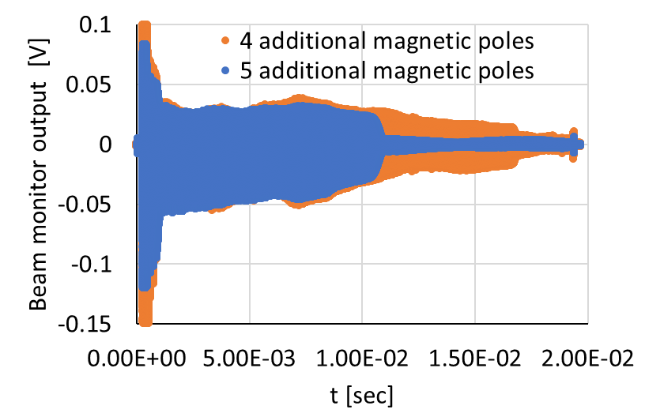
Experimental results
The output signal of the bunch monitor was measured
by changing the dimensions and position of the additional magnetic plate.
Additional magnetic pole
Position adjustable plate
Beam loss
Beam loss
The beam loss was minimized if the additional magnetic pole consists of 4 iron plates.
Details will be reported
in Mr. Waga’s presentation.
Optimum position are experimentally determined.
Beam loss has significantly been reduced.
Small beam loss still exists.
Additional optimization is needed.

Slide 18
Beam extraction
The extraction septum magnet and extraction kicker are excited.
The extracted beam current is measured with current monitor at the extraction port.
Beam loss was cased by error field of
The extraction septum magnet
163 pA
87 pA
Flat top
(75 MeV)
Inlet of Extraction septum: 36 pA
Extracted beam: 5 ~ 10 pA
Beam extraction has been successfully performed.
In order to increase the efficiency of beam extraction,
the optimization of position and angle of extraction magnetic septum are required.
The optimization will be started in the next beam experiment.

Slide 19
Future plan
Applying for a budget
In Kyushu University, several projects are planned in the future.
Improvement of the magnets of the main ring
  Additional return yoke
  Magnetic shield
Expansion of experimental hall
  Construction of proton and neutron Irradiation room
  Neutron source with the modified ERIT ring
Demonstration of heavy Ion acceleration with FFA

Slide 20
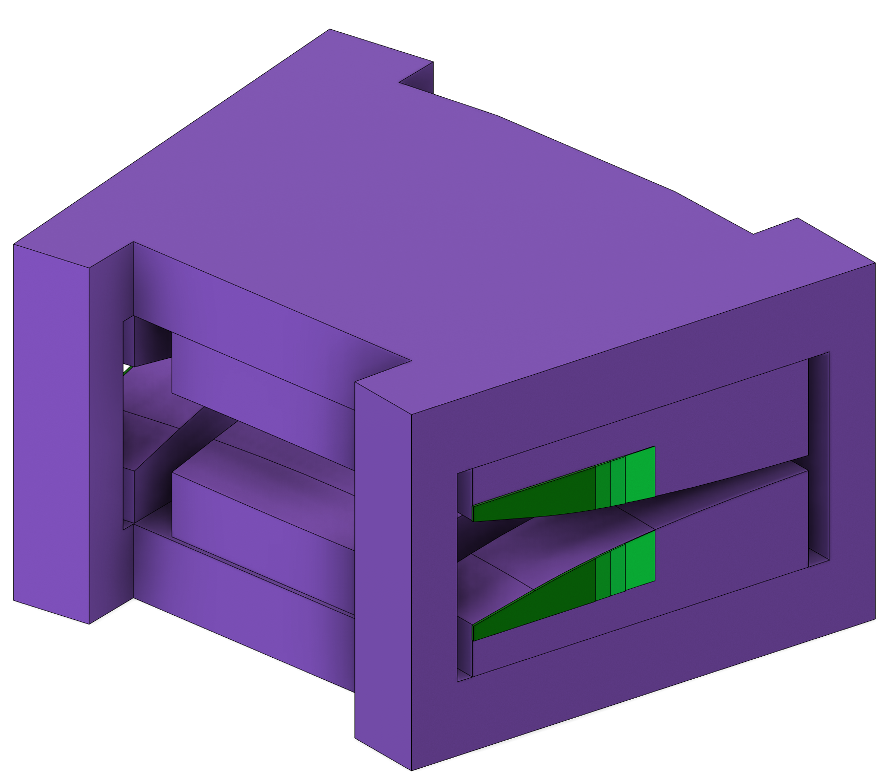
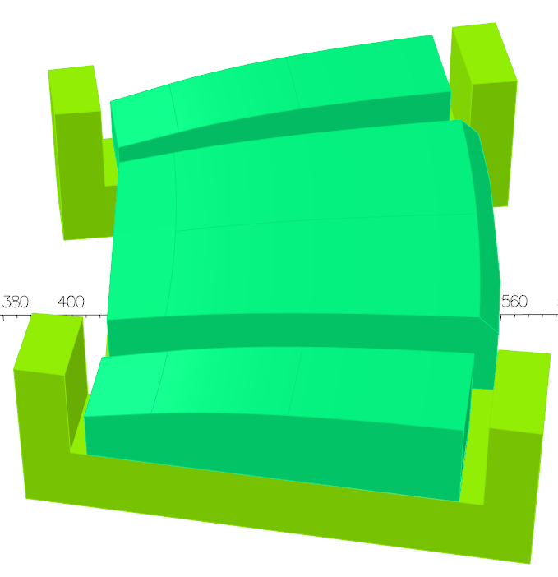
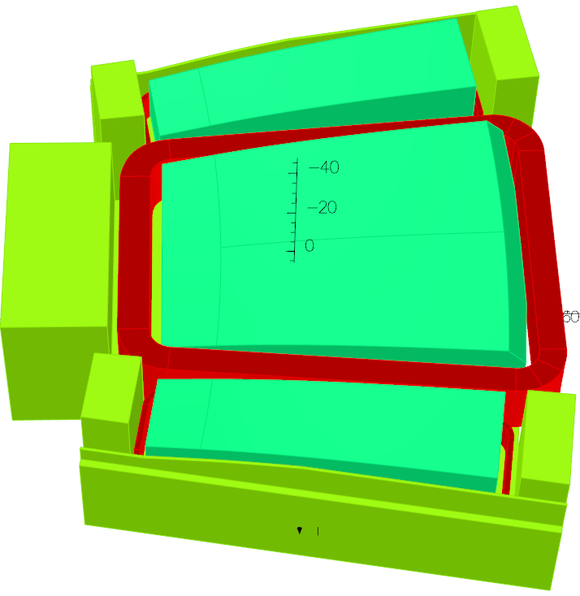
Improvement of the magnet
In order to reduce the tune variation,
the study on the improvement of magnet of 150 MeV FFA has been conducted.
Optimization of shape of additional magnetic pole
Additional return yoke and Magnetic shield
Details will be reported in Mr. Waga’s presentation

Slide 21
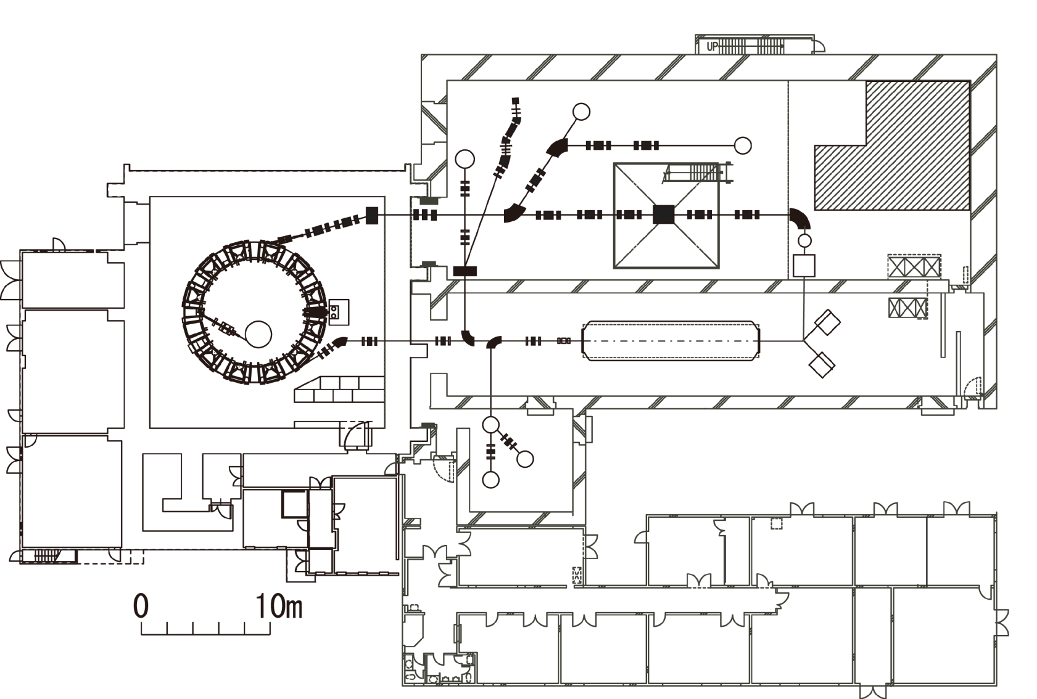
Neutron source with 100 MeV ERIT ring
To promote study of nuclear physics, neutron science and medical field,
we are planning to relocate the ERIT ring from Kyoto University to Kyushu University
and remodel it to the 100 MeV ERIT ring.
Proton beam from FFA
100 MeV ERIT ring
A budget for relocation has been applied for.

Slide 22
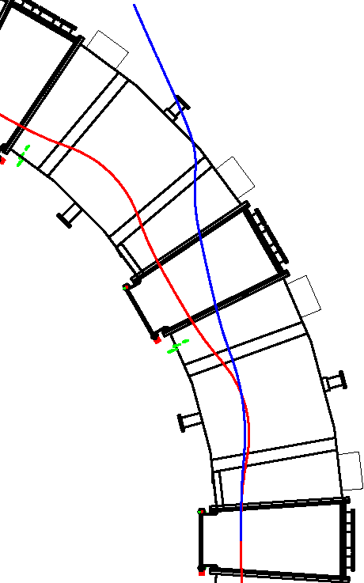
Demonstration of heavy Ion acceleration with FFA accelerator
In order to measure double differential cross section of compound nucleus in low energy region,
we are planning to accelerate heavy ion beam with the 150 MeV FFA accelerator.
He¹⁺
Injector: 8 MV tandem accelerator
Charge exchange injection （He¹⁺ ➔ He²⁺）
Injection Energy of He¹⁺ : 14 MeV
Performance test of Heavy Ion source has been almost completed.
Mechanical design of charge converting film will be started.
He²⁺
Charge converting Film

Slide 23
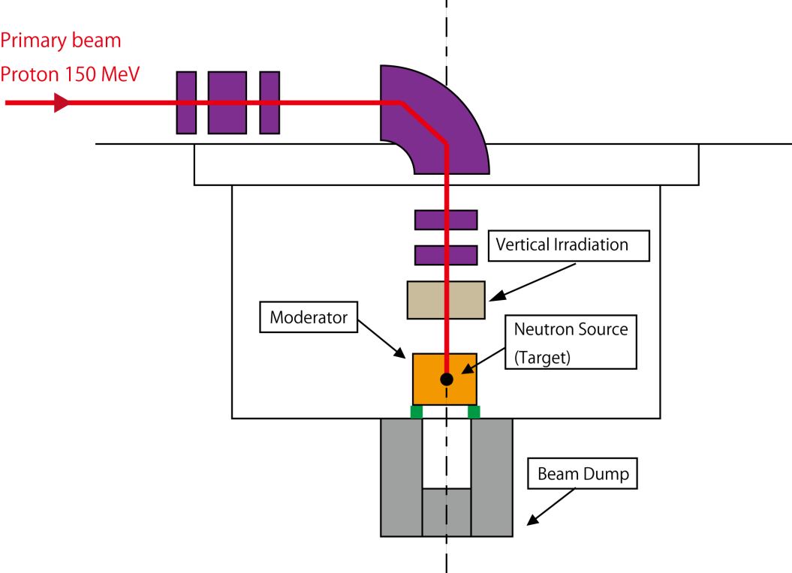
Construction of proton and neutron Irradiation room
The irradiation room will be used in the field of life science, material science, agriculture and neutron science.
A budget for construction has been applied for.

Slide 24
Summary
Beam extraction has been successfully performed.
Beam loss has significantly been reduced with the additional magnetic poles.
In order to increase the efficiency of beam extraction,
optimization of position and angle of extraction septum is required.

