Slide 1
Electron model of Vertical FFA with multi-coil type electromagnet
Kyosuke Adachi
Graduate School of Engineering, Kyushu University
Y. Waga, A. Ito, T. Usui, T, Kobori, Y. Yonemura, H. Arima, N. Ikeda : Kyushu Univ.
Y. Mori : Kyoto Univ.
FFA’20 December 4, 2020

Slide 2
Outline
Introduction
Magnet design ・Multi-coil type electromagnet ・Guideline
Acceleration
Summary

Slide 3
Outline
Introduction
Magnet design ・Multi-coil type electromagnet ・Guideline
Acceleration
Summary

Slide 4
Coil
Magnet
Orbit
Electron VFFA (prototype)
Focusing system | F-D Singlet
Number of cell | 16
Magnet | Sector
Injection energy | 20 [keV]
Maximum energy | 40 [keV]
Radius | 1.0 [m]
Development and Proof-of-Principle Experiment is goal in our study. The final energy after acceleration is twice as much as injection energy.

Slide 5
Electron VFFA (prototype)
Focusing system | F-D Singlet
Magnet | Sector
$$y$$
$$z$$
$$x$$
F magnet
Advantage
Edge angle is 0.
Vertical kick is negligible. →$B_{x}$ and $B_{z}$ of fringing field = 0
Design orbit would be closed.
$$θ_{F}$$
Beam
$$r_{0}$$
D magnet

Slide 6
Electron VFFA (prototype)
Focusing system | F-D Singlet
Magnet | Sector
Magnetic field of vertical FFA
F magnet
$$B=B_{0}e^{my}$$
$m$ : field gradient
$$y$$
$$y$$
$$θ_{F}$$
Beam
$$r_{0}$$
$$y$$
$$B=B_{0}e^{my}$$
$y=\frac{1}{m}ln\left(\frac{P_{n}}{P_{0}}\right)$
Excursion
D magnet
$$B$$
$$P$$
0
Magnetic field
0
Momentum
Notes:
Before explanation of optics design, I would explain beam optics of VFFA.
Magnetic field of VFFA becomes this formula. When expanded, it becomes this formula.
As you can see, from this formula, field of VFFA include skew component.

Slide 7
Outline
Introduction
Magnet design ・Multi-coil type electromagnet ・Guideline
Acceleration
Summary

Slide 8
Concept
Increased Density
Magnetic
flux lines
X [AT]
X [AT]
X [AT]
X+α [AT]
Field gradient is made by current distribution
Increment of density depend on current of each coil
Notes:
Just like this.

Slide 9
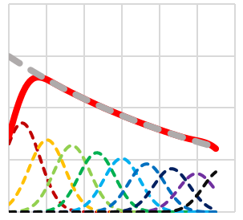
Multi-coil type electromagnet
A field gradient by making different magnetic field generated by each coil.
Magnetic pole shape : Simple
Field gradient “$m$” : Adjustable
$$y$$
Good field region
Magnetic
flux lines
0
Magnetic field
$$B_{y}$$
Coil
Magnet

Slide 10
Outline
Introduction
Magnet design ・Multi-coil type electromagnet ・Guideline
Acceleration
Summary

Slide 11
Parameters of Electron VFFA
Operating point
$$θ_{F} \left[deg.\right]$$
F-D singlet
$$m \left[1/m\right]$$
Particle | electron
Number of cell | 16
Radius | 1.0 [m]
$$θ_{F}$$ | 22.5 [deg.]
$$θ_{D}$$ | 11.25 [deg.]
$$m$$ | 3.0 [1/m]
Orbit excursion | 0.1 [m]
Injection energy | 20 [keV]
Maximum energy | 40 [keV]
B (F) | 60.8 [gauss]
B (D) | 22.2 [gauss]
FD ratio | 2.73
RF gap Voltage | 50 - 200 [V]

Slide 12
Flowchart of magnet design
Determination of initial current value of each coil
Magnetic field calculation
Closed orbit
calculation
Adjustment of current value
Derivation of $m$ value on CO
Design values and calculated values agreed?
No
Yes
Finished

Slide 13
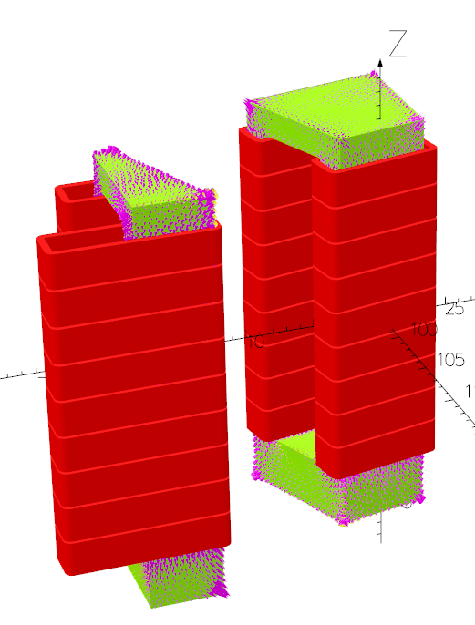
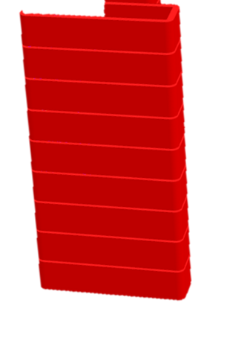
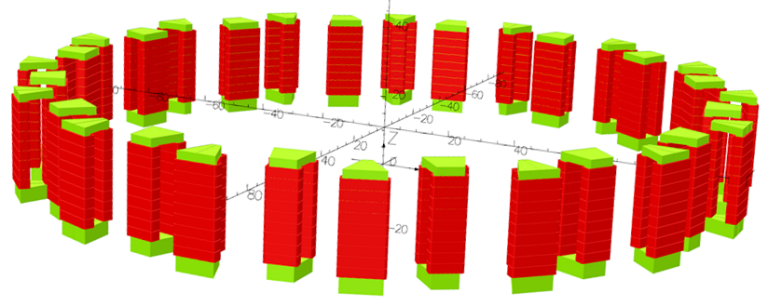
Calculation system in OPERA-3D
Coil
Number | 9
Thickness | 5 [mm]
Height | 25 [mm]
$$y$$
Width
Height
Magnet size (inside)
Height | 240 [mm]
Width | 55 [mm]
D-magnet
F-magnet (half)
Overall view of ring
* "Opera-3d User Guide" (Vector Fields Software, 2016).

Slide 14
Determination of initial current value of each coil
If magnet has infinite length, it is conceivable that current of each coil is determined to exponential.
The magnetic field was calculated by determining the current value of each coil from the following formula.
・Position of $n$-th coil
$y_{n}→\left(L_{G}+\frac{L_{W}}{2}\right)n+L_{W}\left(n−1\right)$
・Current of $n$-th coil
$I_{n}→I_{0}×\exp\left(my_{n}\right)$
$$\left(n+1\right)th$$
$$I_{0}$$ | : | Base current [AT]
$$y_{n}$$
$$n th$$
$$L_{G}$$
$$\left(n−1\right)th$$
$$L_{W}$$

Slide 15
Initial calculation
The initial current determined from the formula were shown below.
The calculated positions of closed orbit at center of F-magnet were shown below.
‘Ideal’ was calculated by
The closed orbits close to the ideal values are obtained in a narrow area around the center of the magnet.
$$y=\frac{1}{m}ln\left(\frac{P_{n}}{P_{0}}\right)$$
Near the top and bottom edges of the magnetic poles, the worse the magnetic field becomes ?

Slide 16
$m$ value with initial calculation
The upper graph show the closed orbit and the lower graph show the m value on the closed orbit.
The local value of $m$ is different than the design value. →Only range of shows good agreement.
The $m$ value shows magnetic field near the edge become larger than ideal value.
Therefore, it is necessary to adjust the current value for the coil near the edge.

Slide 17
Current adjustment value
Adjustment guidelines of local $m$ value is shown below. Increase : Increase of current Decrease : Decrease of current
The current values adjusted from initial current were shown below.
Adjustment value of near the edge coils is larger than around center one. →These adjustment value were determined by iteration.

Slide 18
Result of after adjustment
The calculated positions of closed orbit at center of F-magnet and value of $m$ on closed orbits were shown below.
Range of the closed orbits were obtained wider after adjustment. →Local $m$ value shows good agreement at wide range.
I achieved design target “accelerated energy is twice as much as injection energy {18.6 – 37.2 [keV]}.” !!

Slide 19
Beam trajectory
Trajectories of one turn in each energy are shown below at left figure. And position of closed orbit at center of F-magnet are shown below at right figure.
$$y [m]$$
$$T [keV]$$
$r$ [m]
This result shows that the change of orbit in the r-direction is small and the increase in the y-direction is large. →Achieved generating magnetic field satisfying the scaling law.

Slide 20
Outline
Introduction
Magnet design ・Multi-coil type electromagnet ・Guideline
Acceleration
Summary

Slide 21
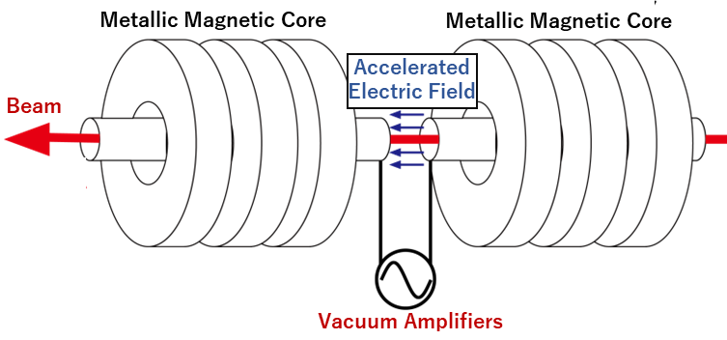
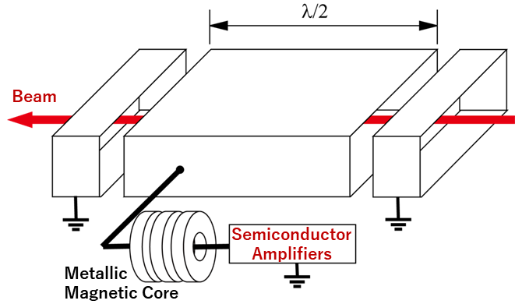
Acceleration system
Currently, We under consideration of two types RF cavity.
① $λ/4$-wave coaxial resonators
② $π$mode acceleration cavity
An acceleration method similar to the D-electrode of a cyclotron
In this time, I calculated the turn separation obtained by some accelerating voltages.
米村祐次郎 工学研究院若手研究者育成研究助成成果報告会 2016/11/24

Slide 22
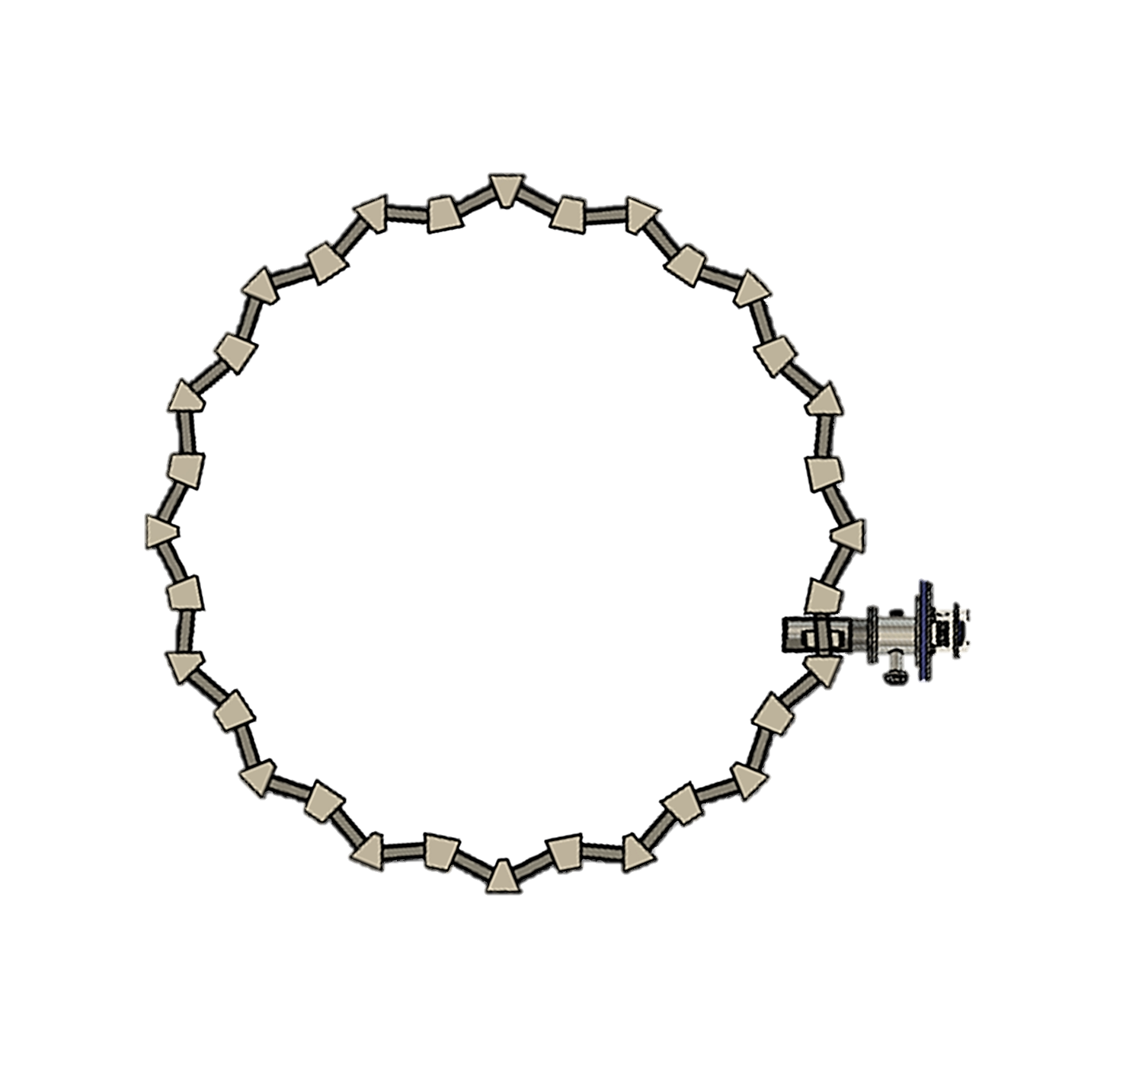
Acceleration simulation systems
Calculation system is shown below at left figure. →Two RF cavities and Electron gun has been installed.
Tip of the electron gun is shown below at right figure.
Tested whether enough turn separation ($Δy$) can be obtained.
180+22.5+
5.625 [deg.]
2nd turn
RF②
1st turn
beam
0 [deg.]
$Δy$ [mm]
RF①
Electron gun
22.5+
5.625 [deg.]
Septum
Ground
0.06 [mm]
Top view
Tip of the electron gun

Slide 23
Result of Acceleration simulation
Accelerating voltages were selected 50, 100, 150, 200 [V]
The turn separation $Δy$ was calculated by $Δy=y_{1st turn}−y_{n−th turn}$ at electron gun.
$Δy$ [mm]
$n−th turn$ [mm]
Turn separation of 0.59-2.36 [mm] was obtained by accelerating voltages of 50-200 [V].
The$Δy$ of the 2nd turn was the lowest, and the $Δy$ increased with each lap.

Slide 24
Outline
Introduction
Magnet design ・Multi-coil type electromagnet ・Guideline
Acceleration
Summary

Slide 25
Summary
The m-value on a closed orbit is useful as an indicator of current value adjustment.
In the adjustment of $m=3$ [1/m], achieved an optical system with an energy range of twice the design target.
Sufficient turn separation was obtained by using the two RF cavity systems.
Future plan
Field measurement for sector type magnet.
Calculation of dynamic aperture at each energy and position of $y$.

