Slide 1
Experimental Investigation of Accelerator Beam Dynamics with a Linear Paul Trap
Lucy Martin
FFA 2020

Slide 2
Introduction
How is a LPT useful for accelerator physics?
What is a linear Paul trap (LPT) and how do they work?
Which accelerator physics questions can we answer with a Paul trap?
High intensity resonance studies.
Commissioning of the Intense Beam Experiment (IBEX) at RAL.
First experiments using IBEX.
Future work.

Slide 3
Intense Beams

Slide 4
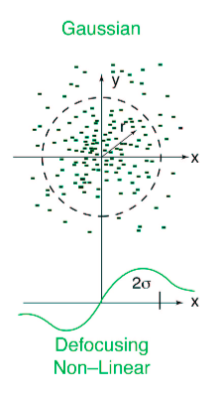
The problem with high intensity beams
I₁
+
+
I₂
F
P
P
P
P
F
Space Charge:
  Like charges repel
  Two like currents attract
Extra forces can lead to defocusing terms
Different tunes for different particles

Slide 5
Why is achieving high intensity difficult?
Why study these effects?
Tune in y
Why are they hard to understand?
Why not just use simulation?
Why not study resonances with an accelerator?
Tune in x

Slide 6
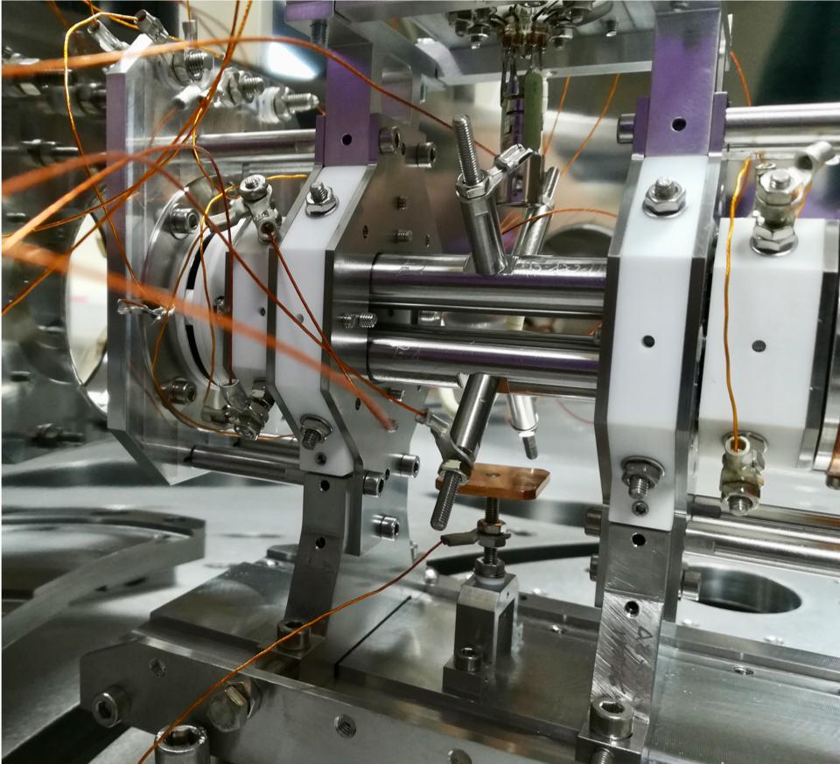
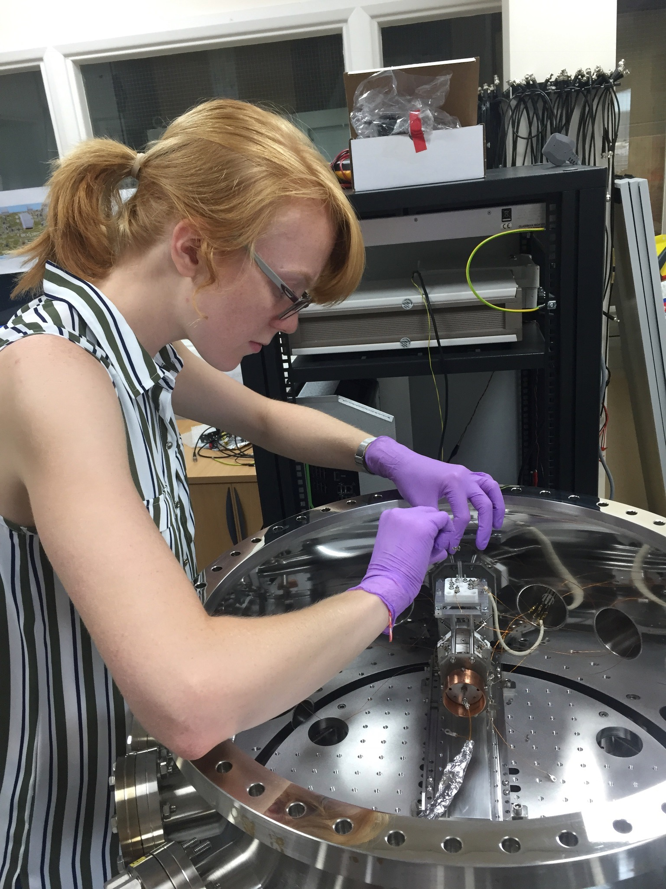
The intense Beam Experiment (IBEX) at the Rutherford Appleton Lab, Oxfordshire

Slide 7
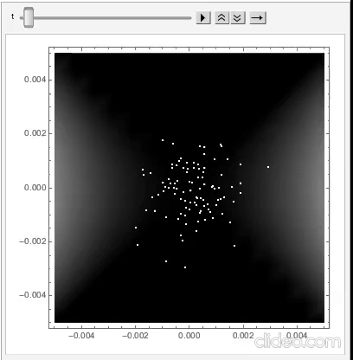
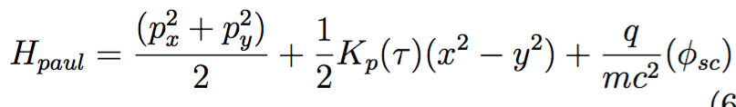
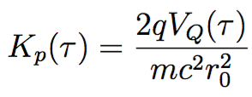
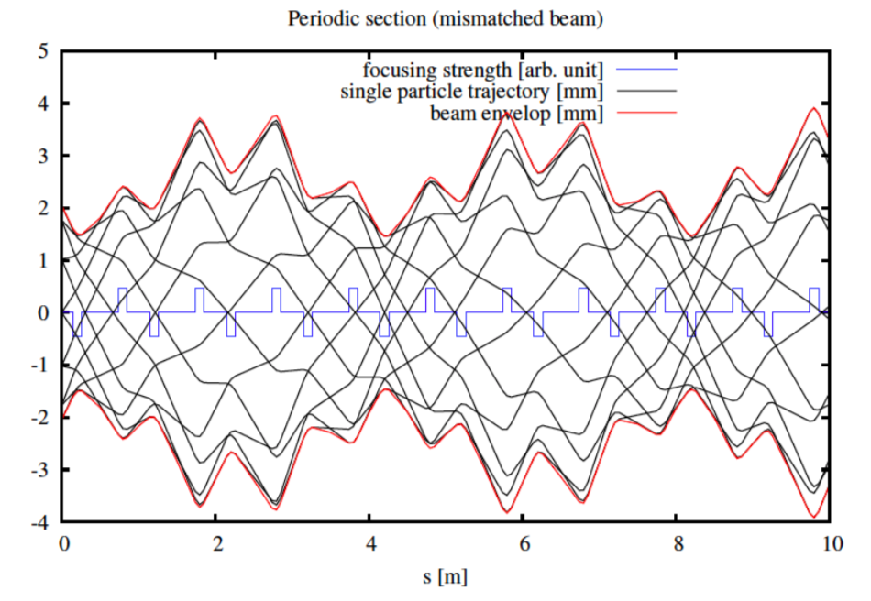
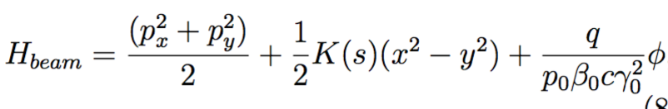
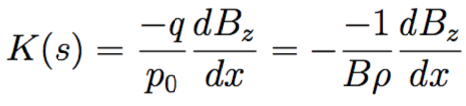
Motion in a Paul trap
Hamiltonian of a Paul trap :
where
Hamiltonian of a conventional accelerator:
where

Slide 8
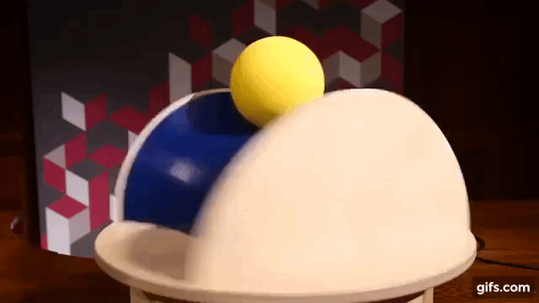

Slide 9
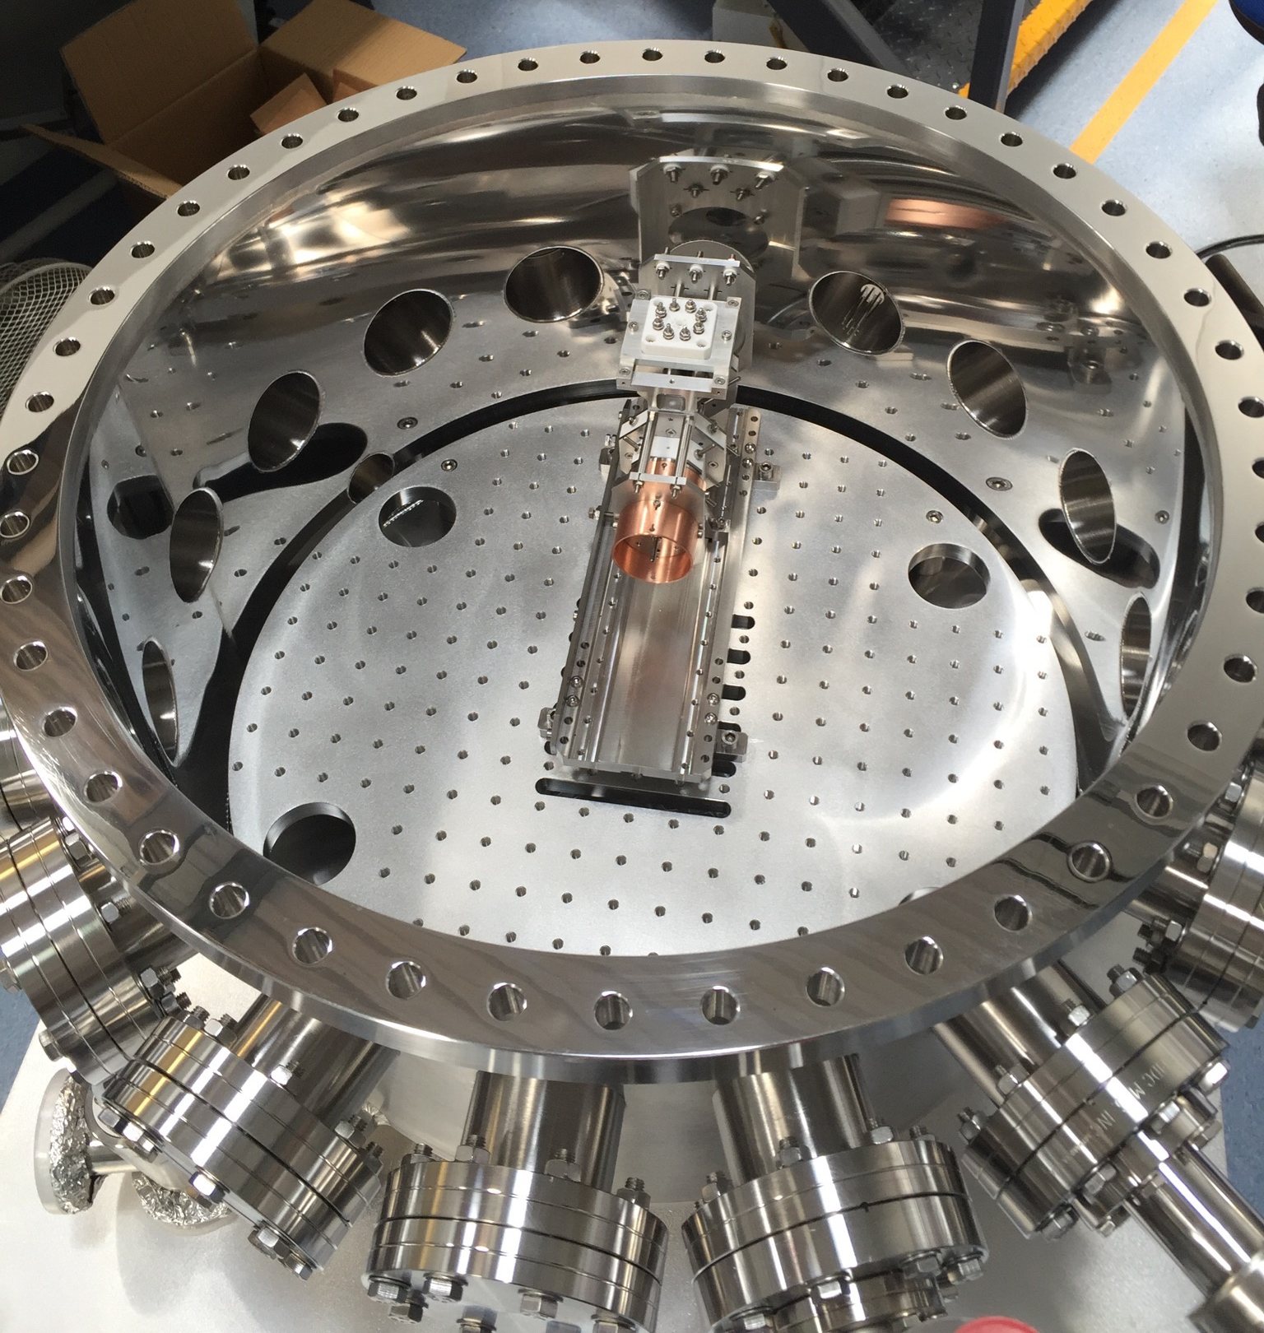
IBEX and SPOD: Linear Paul Traps
IBEX at the Rutherford Appleton Lab, UK
S-POD at Hiroshima University, Japan
PTSX at Princeton Plasma Physics lab, US
What are the advantages of a LPT?
What are the limitations?
  No longitudinal effects = coasting beam

Slide 10
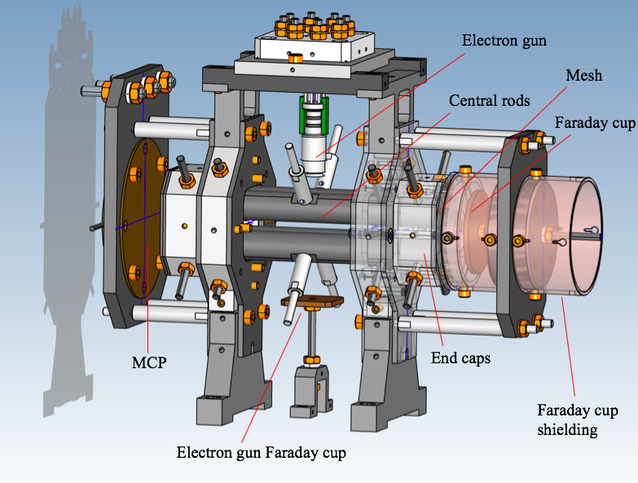
Linear Paul Trap
1. Argon gas introduced to vessel at ~10⁻⁷ mbar
2. Electron gun ionises Ar in trapping region
3. Ions confined transversely via 4 cylindrical rods
4. Ions confined longitudinally with end caps

Slide 11
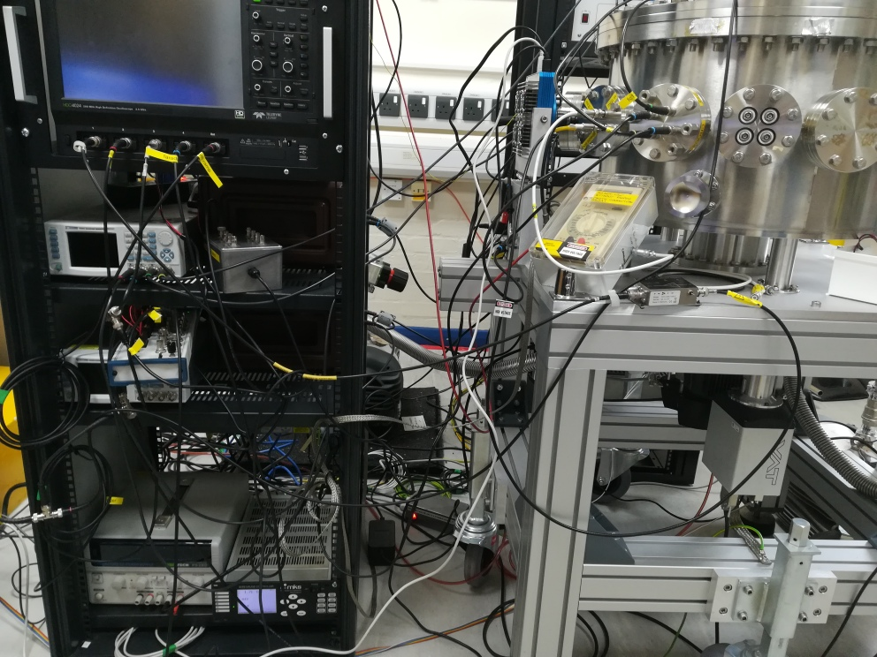
Past experiments on LPTs
Coherent motion
Excitation of dipole and quadrupole resonances
Study of how resonances interact at half integer tunes
Studying resonance crossing for FFAs*
Beam Halo and beam size growth
*https://doi.org/10.1103/PhysRevSTAB.18.034001

Slide 12
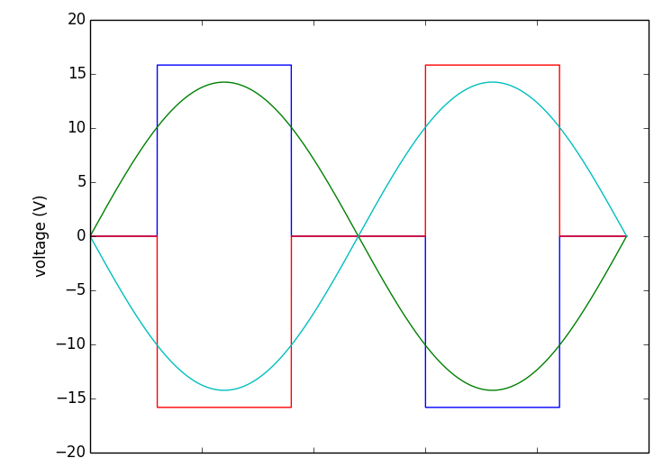
Experimental procedure
A simple FODO cell is created using a sine wave
  1 MHz
System scans across a large range of tunes
Ions are created at the optimal tune
Tune is then changed to the desired operating point by changing voltage
At this tune ions are stored for a given time (eg. 100ms)
Ions are then extracted onto an Micro Channel Plate (MCP) or a Faraday cup

Slide 13
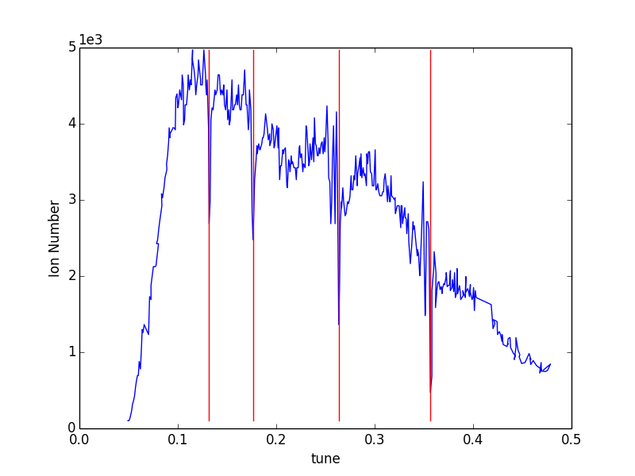
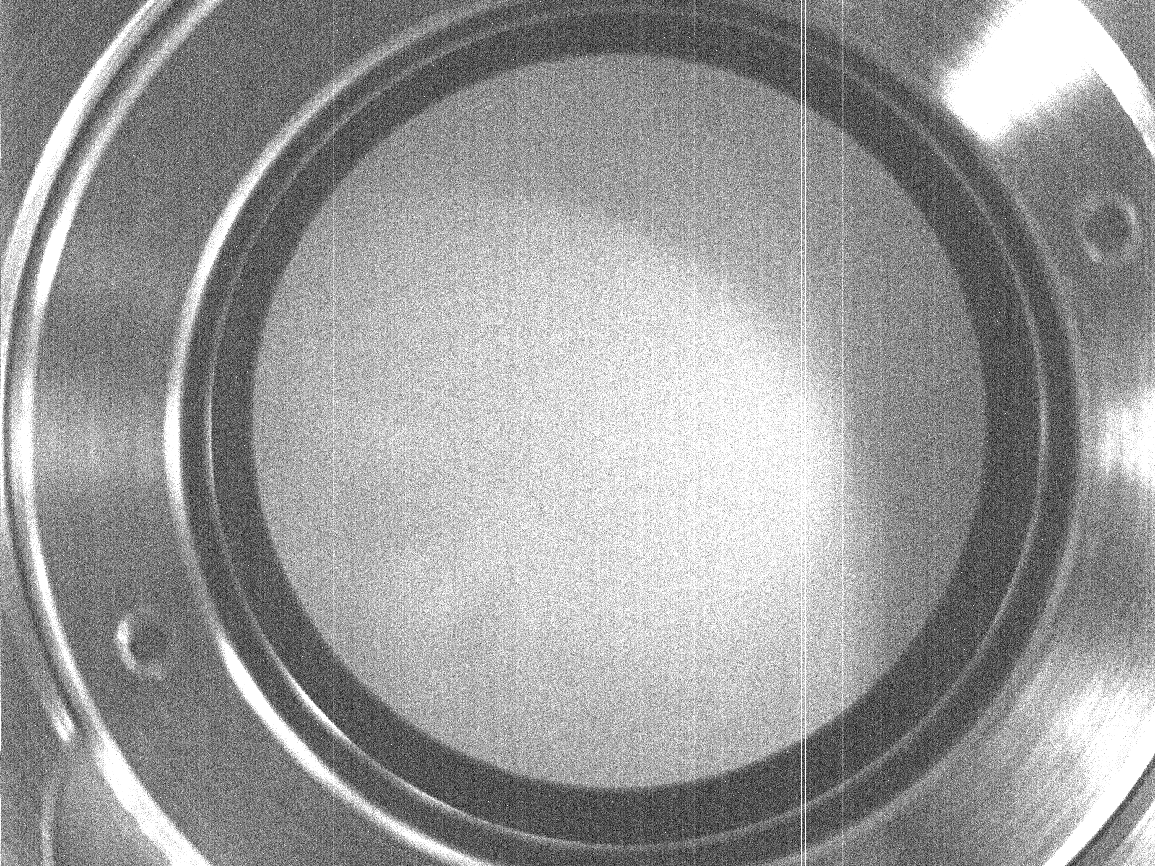
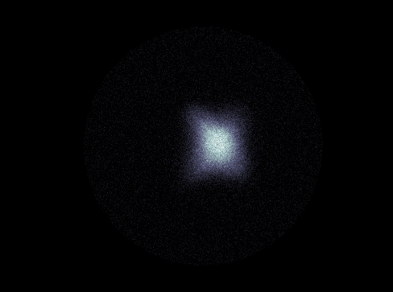
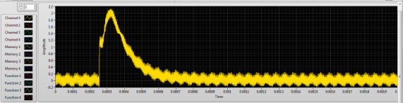
Diagnostics and Calibration
Tune scan takes ~ 2 hours
MCP image
17 mm
Faraday cup signal
200 μs
Cell tune

Slide 14
What can we discover using IBEX?
We want to know the location of (and understand!) dangerous resonances to help with the understanding and operation of current machines
We want to investigate novel schemes for storing high intensity beams

Slide 15
Resonant conditions
Incoherent resonant condition:
For a small multipole perturbation of order m with harmonic n
ΔQ = incoherent tune shift
Q₀ = tune set by accelerator (bare tune)
This too simple: In high intensity case beam size changes
Needs to be solved self consistently¹
Solutions for m=2 can be found from the envelope equations describing beam size
But more generally the system is solved using linearized Vlasov Poisson equations:
rms

Slide 16
rms
Index m = azimuthal and k = radial mode, m = k are rigid modes
Mode (m, k) is driven by terms x^{k−1} cos(nθ) with n ≈ mν
The dipole resonance C₁ = 0
C_{m} < 1 and C₁ < C₂< C₃ < C₄ …
In H. Okamoto and K. Yokoya’s² paper the theory is extended for SC driven resonances:
No smooth approximation is applied to the beta function
Aim to measure C_{m} factor for external and self field driven resonances
Theoretical values have been calculated (I. Hofmann 1998)
rms

Slide 17
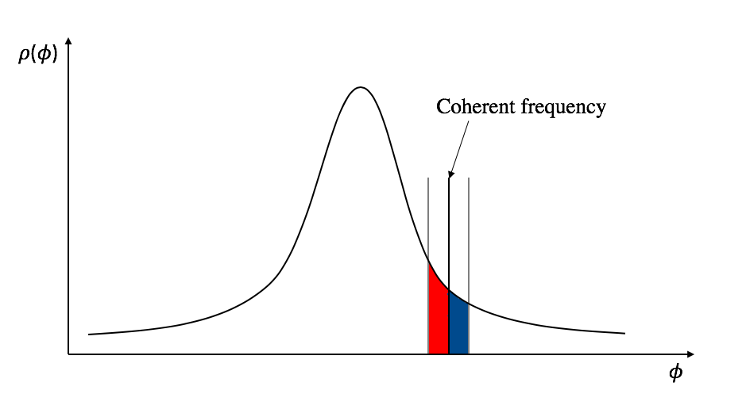
Controversial topic, coherent or incoherent?
Landau damping?
Red particles gain energy
Blue particles lose energy

Slide 18
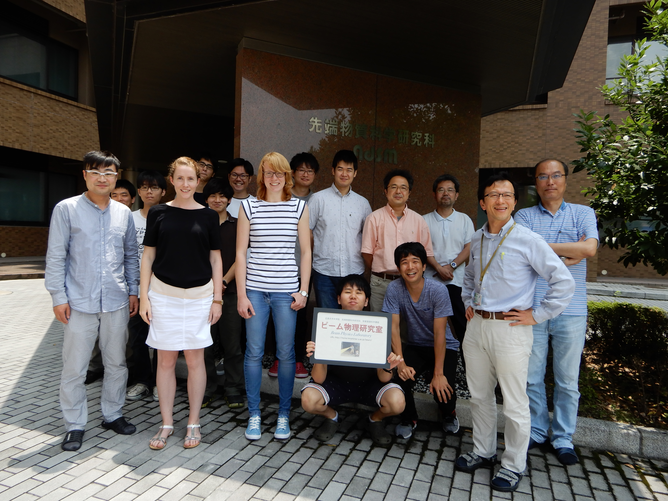
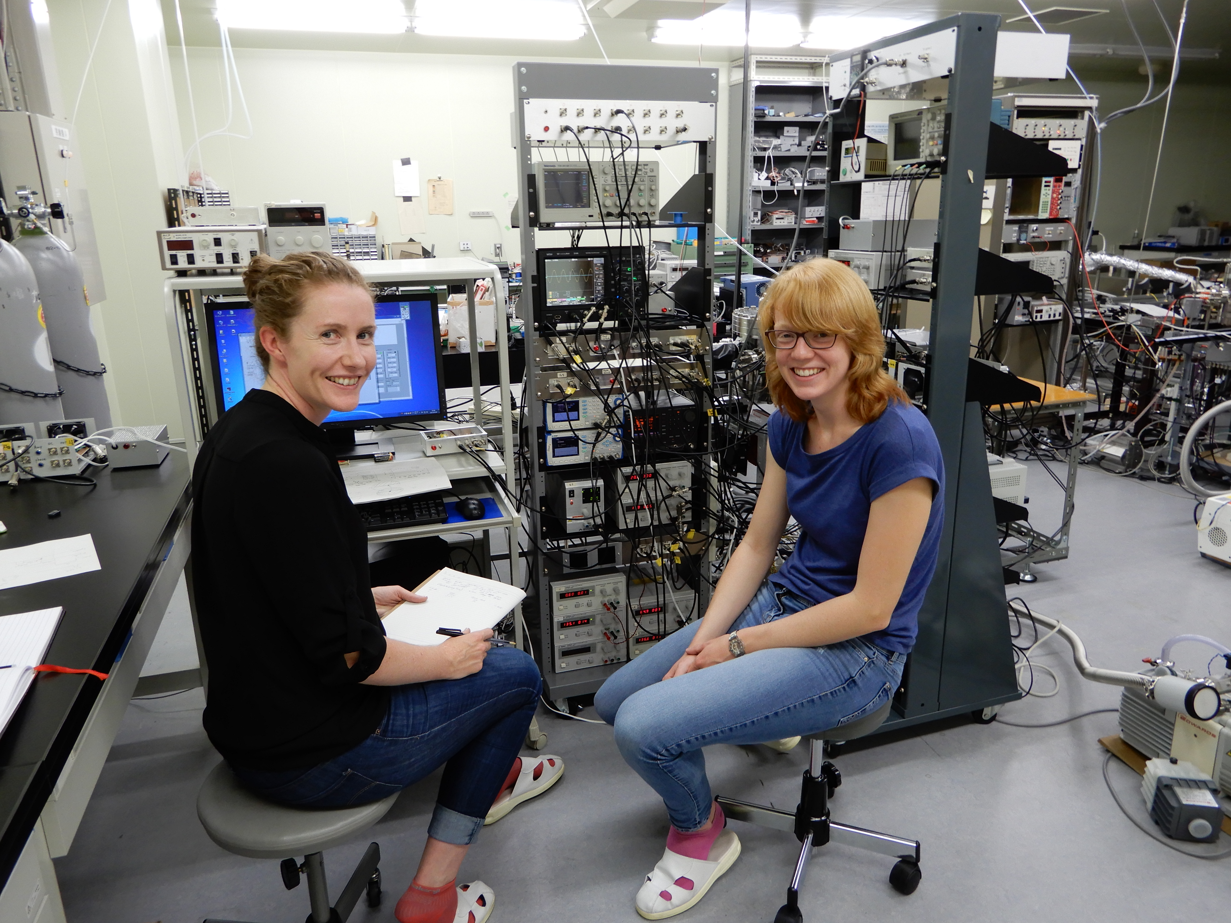
Experiments at Hiroshima University, Japan

Slide 19
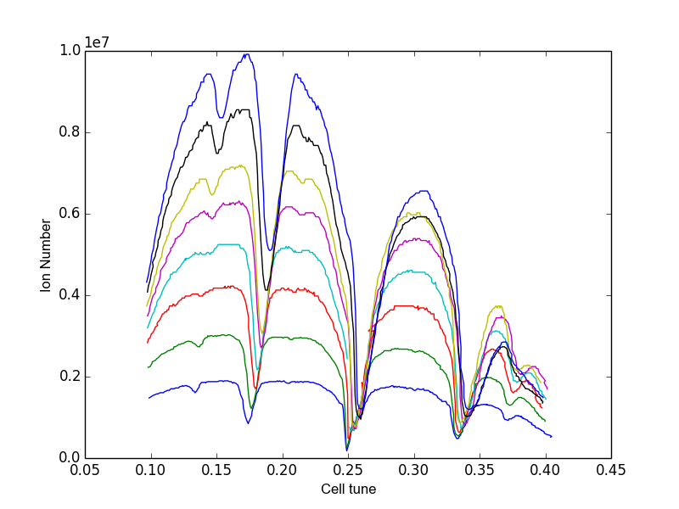
Identifying resonances…
SC = space charge driven
EF = external field driven
EF:
SC:
At cell tune ~1/5
SC n = 2, m = 5
EF n = 1, m = 5
At cell tune ~1/4
SC n = 1, m = 2
EF n = 1, m = 4
At cell tune ~ 1/6
SC n = 1, m = 3
EF n = 1, m = 6
At cell tune ~ 1/3
SC n = 1, m = 6
EF n = 1, m = 3
At cell tune ~ 1/8
SC n = 1, m = 4
EF n = 1, m = 8
At cell tune ~ 3/8
SC n = 3, m = 4
Cell tune

Slide 20
Incoherent (rms) tune shift
Gaussian distribution
y
Assume a cylinder of charge
Charges have Gaussian distribution
Calculate the first order tune depression
Motion in Paul trap is non relativistic
Can neglect the magnetic fields³
x
Defocusing
rms
λ_{RF} = the RF wavelength of the trap
N = Ion number
L = effective plasma length
ε = emittance

Slide 21
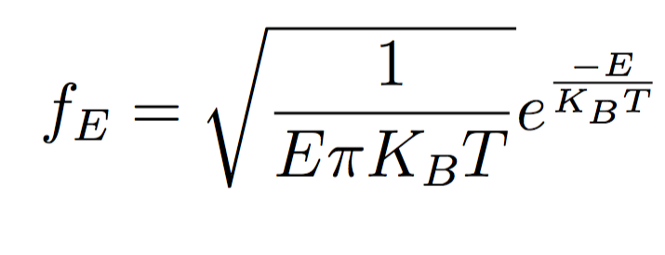

Temperature measurement -> Effective length
Ions
V

Slide 22
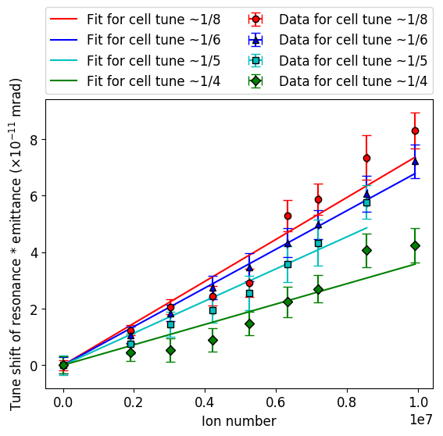
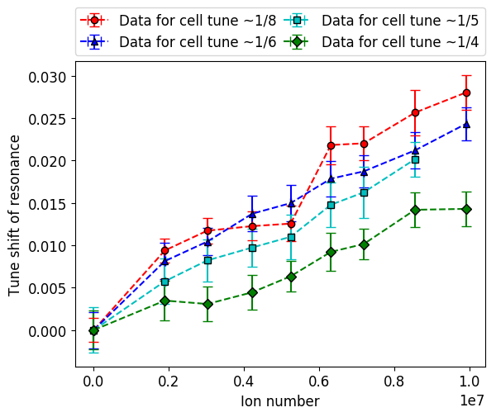
Coherent tune shift =
* C_{m}
Tune change from a cell tune of 0.15 (where the ions are collected) to the operating point, is adiabatic and no ions are lost – supported by simulation, but only to tunes lower than 0.25.

Slide 23
Simulation
Use the Particle In Cell code WARP
Create a 2d trap and apply voltages to the rods
Trap matched distribution of 2×10⁶ ions at a cell tune of 0.15 for 50 rf periods
Adiabatically change tune over 100 rf periods
Store at new tune for 550 rf periods
Study emittance growth
Saw no evidence of coherent motion for 1/6 and 1/3, saw coherent motion at 1/4
Looked at:
  Phase space
  Tune footprints
  Kurtosis – A measure of the “tailedness” (4th moment)

Slide 24
Simulation: tune = 0.25 ^{4, 5, 6}
a
b
c
d
Blue = x
Red = y
b
RAMP
c
a
d

Slide 25
Coherent shape and finite stopband width
Simulation:
Y tune
Emittance increase
1
2
3
Experiment:
Ion number
X tune
X tune

Slide 26
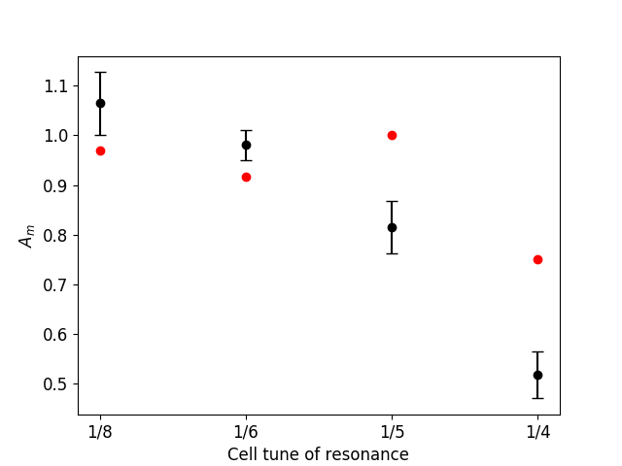
For the case where Q_{x} = Q_{y}
C₅
C₄
C₃
C₂
A_{m}
Theoretical C_{m} values for the lowest-order space-charge-driven resonance at each cell tune.

Slide 27
Interpretation
Resonances are in competition at each tune.
Peak in emittance growth did not occur at the location predicted by the C_{m} factors
Experimental C₂ factor < Theoretical C₂
This is due to by stop band width and 4th order
Experiment shows that for 1/8 and 1/6 shift in tune doesn’t differ from that predicted incoherently, suggesting coherent oscillations may be landau damped⁷
Simulation also showed no coherent excitation at 1/8 and 1/6 .

Slide 28
Similar experiments have since been performed on IBEX comparing equal and unequal tunes in the transverse directions⁸
Unequal tunes
Equal tunes

Slide 29
In conclusion
Paul traps are useful tools for accelerator physics
The transverse dynamics in the trap mirrors that of AG accelerator
Space charge forces are present in a Paul trap
We used SPOD to study coherent resonances
Experiments were designed and interpreted with the help of WARP
IBEX has been commissioned and can perform follow-up experiments

Slide 30
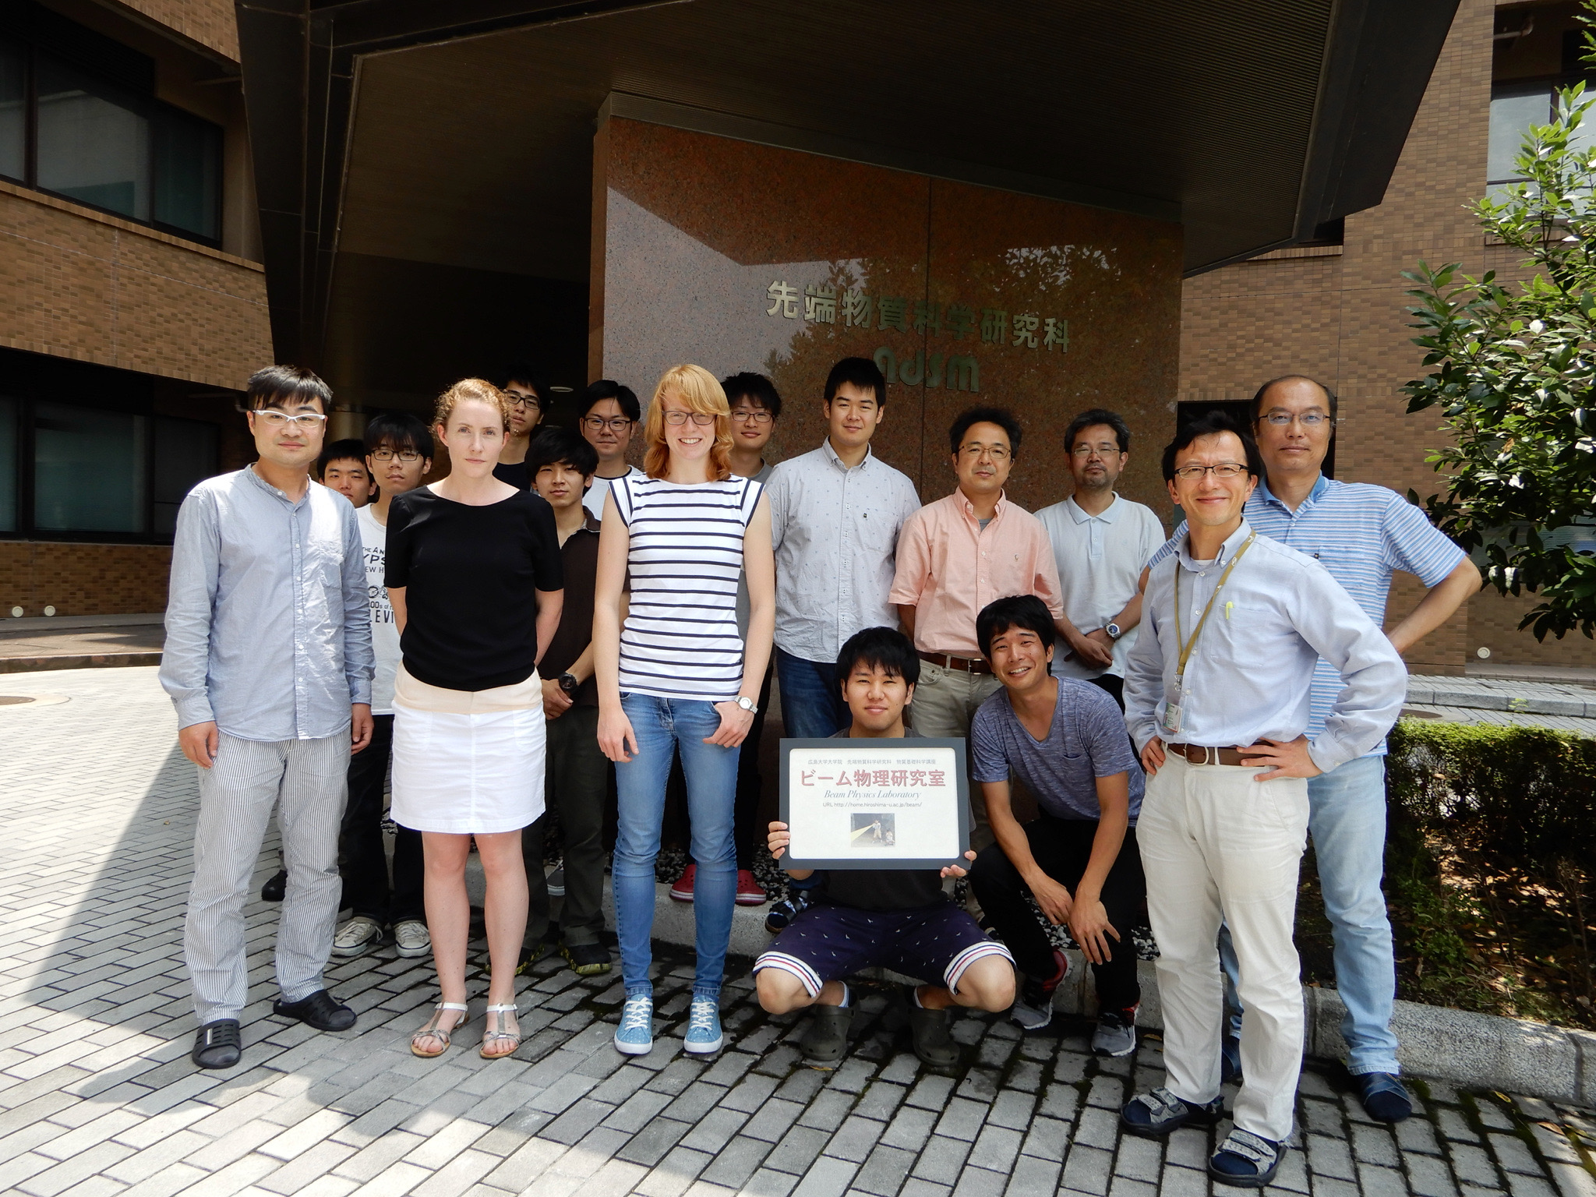
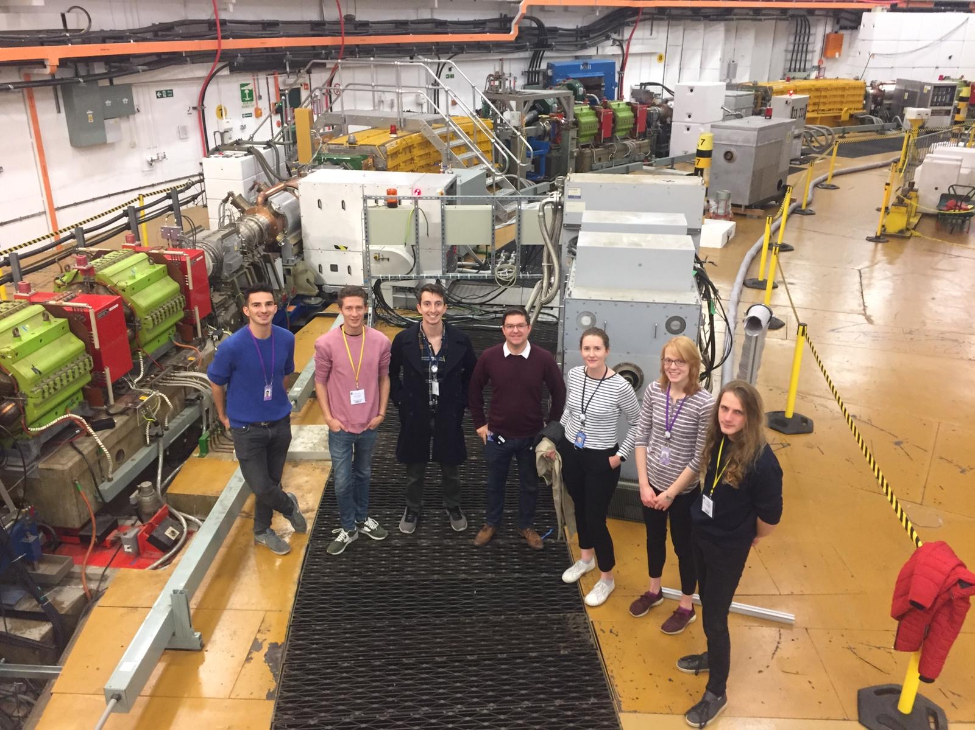
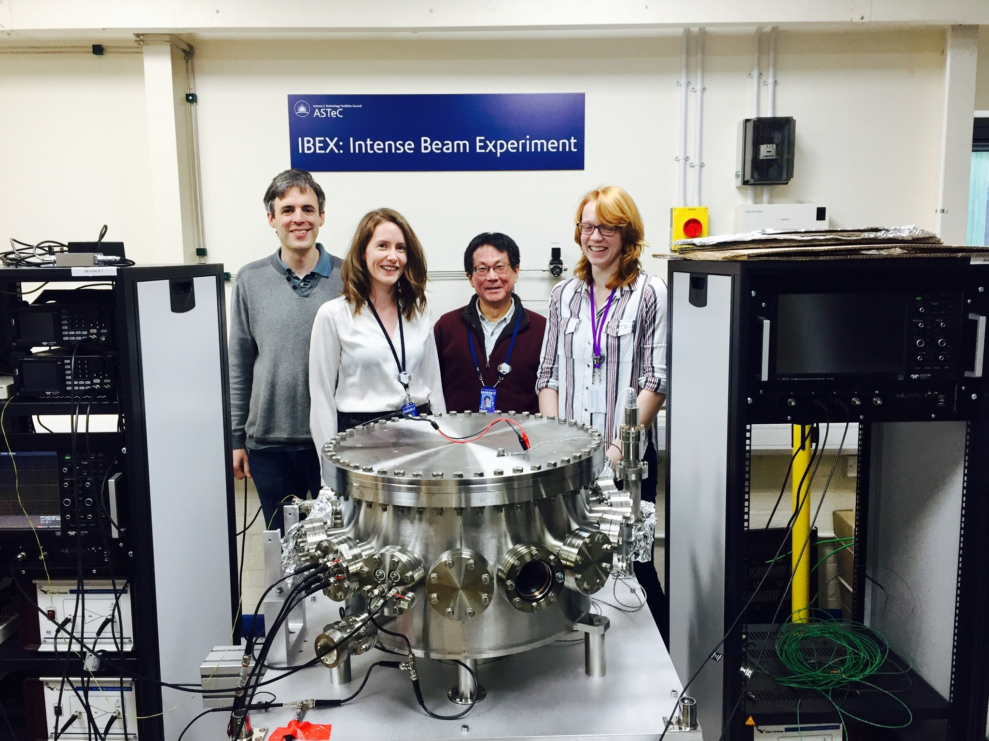
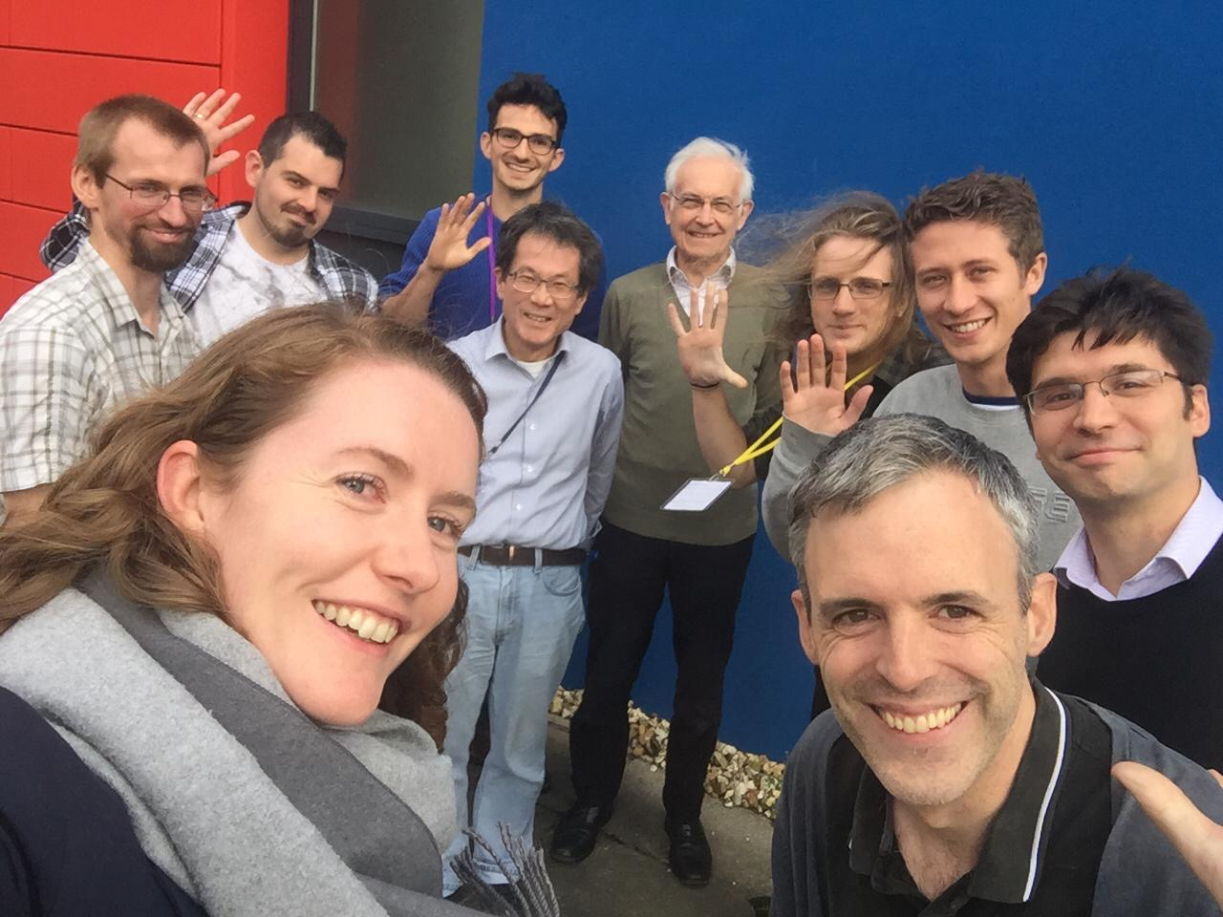
Thanks!
Thesis: https://ora.ox.ac.uk/objects/uuid:3a42465d-c0e9-4327-b9ff-4de634749d3a
Second talk:
Nonlinear Integrable Optics in a Paul Trap
Further IBEX work:
jake.flowerdew@physics.ox.ac.uk

Slide 31
References
Sacherer F 1968 Transverse Space-Charge Effects in Circular Accelerators Ph.D. thesis University of California, Lawrence Radiation Laboratory, Berkley, California
Okamoto H and Yokoya K, Parametric resonances in intense one-dimensional beams propagating through a periodic focusing channel, Nuclear Instruments and Methods in Physics Research Section A, Volume 482, Issues 1–2, 2002
Schindl K 2006 http://cds.cern.ch/record/941316
Hofmann I and Boine-Frankenheim O 2015 Physical Review Letters 115 204802
Jeon D, Groening L and Franchetti G 2009 Physical Review Special Topics - Accelerators and Beams 12
Li C and Zhao Y 2014 Physical Review Special Topics - Accelerators and Beams 17
Martin, L. K. et al., “A study of coherent and incoherent resonances in high intensity beams using a linear Paul trap” New J. Phys. 21 053023
Martin, L. K. et al., “Recent Studies of the Resonances at a Cell Tune of 0.25 Using the Ibex Paul Trap”, 2019, J. Phys.: Conf. Ser. (In Press)
Baartman R , “Betatron resonances with space charge Proceedings of Space Charge Physics in High Intensity Hadron Rings” (Shelter Island, New York, USA, 1998) vol 448 p 56

