Slide 1
Nonlinear Integrable Optics in a Paul Trap
Lucy Martin
FFA 2020

Slide 2
Introduction
How is a LPT useful for accelerator physics?
What is a linear Paul trap (LPT) and how do they work?
Which accelerator physics questions can we answer with a Paul trap?
Recap of tune, resonance and intense beams
Nonlinear integrable optics (NIO) - an interesting idea for high intensity
Can it be tested on a Paul trap?
Experimental progress towards NIO
Future work

Slide 3
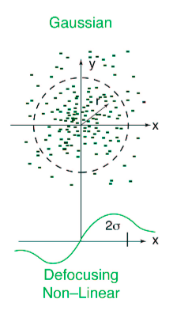
The problem with high intensity beams
I₁
+
+
I₂
F
P
P
P
P
F
Space Charge:
  Like charges repel
  Two like currents attract
Extra forces can lead to defocusing terms
Different tunes for different particles

Slide 4
Why is achieving high intensity difficult?
Why study these effects?
Tune in y
Why are they hard to understand?
Why not just use simulation?
Why not study resonances with an accelerator?
Tune in x

Slide 5
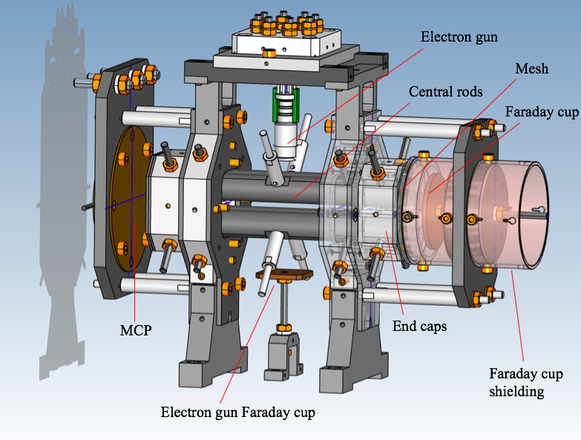
Linear Paul Trap
1. Argon gas introduced to vessel at ~10⁻⁷ mbar
2. Electron gun ionises Ar in trapping region
3. Ions confined transversely via 4 cylindrical rods
4. Ions confined longitudinally with end caps

Slide 6
What can we discover using IBEX?
We want to know the location of (and understand!) dangerous resonances to help with the understanding and operation of current machines
We want to investigate novel schemes for creating high intensity beams

Slide 7
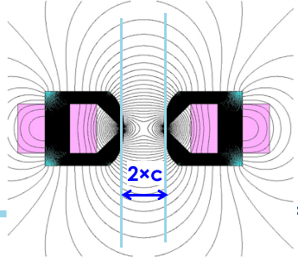

Future accelerators (Nonlinear Integrable Optics)
In linear accelerators the motion is integrable – it is known to be bounded
This is exactly what we want, the beam won’t be lost!
Susceptible to resonances
Realistically an accelerator can never be totally linear (errors + space charge)
Nonlinearities -> no longer integrable due to coupling between x and y
Require integrable system where small perturbations are allowed
At Fermilab they found such a system (Danilov & Nagaitsev 2010)
Unfortunately it requires a complicated potential

Slide 8
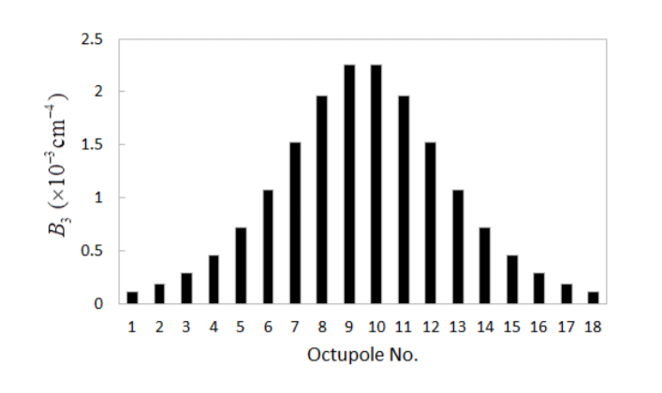
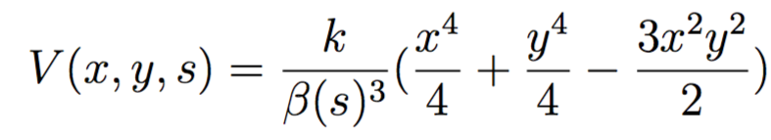
Non-linear integrable optics
Quasi-integrable version involves only octupoles
Octupole must vary in strength proportional to 1/β³
Can’t just have an octupole, need linear focusing
Requires round beams and nπ phase advance
  This is called a “T-insert”
Image from [12]
To test in a Paul trap we require 2 things:
To be able to create a good enough T-insert with the Paul trap
Create correct octupole potential independent of linear focusing

Slide 9
Why bother testing NIO in a Paul trap?
No dispersion
No chromatic effects
T-insert parameters are easily variable
Space charge effects easily included
Can sit on resonance to study stability and excite resonances at arbitrary frequencies
Already testing at IOTA and UMER – each facility has different advantages
Problem: Paul traps are not usually operated in this way!

Slide 10
1. Quadrupole + Octupole trap
Building on work from Hiroshima University

Slide 11
2. Design a T-insert
Constraints:
nπ phase advance in x and y
β_{x} = β_{y} in centre of drift
α_{x} = α_{y} = 0 in centre of drift
Max β_{x} and β_{y}
Phase advance close to 0.3 over drift
Bandwidth of amplifiers – pulses can’t be too short or too large
Try to avoid too much asymmetry – more susceptible to resonance at high intensity

Slide 12
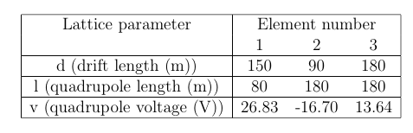

3. T-insert testing
Length₂ = Length₁ * $\frac{1}{\sqrt{k}}$
Voltage₂ = Voltage₁ * κ
We varied pulse strength and length
Created a short T-insert that was easier to correct
Looked at 3 different T-inserts scaling voltage and length
To minimise beta function operated at lower tune (0.5 + 0.135)
  UMER also looking to operate at this phase advance

Slide 13
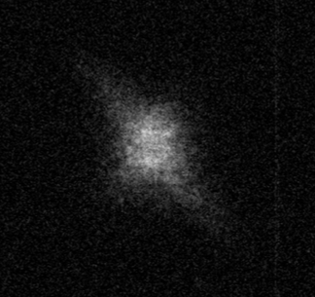
T-insert success!

Slide 14
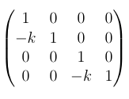
Warp simulations
Looked at dynamic aperture and tune spread over 1000 periods.
The T-insert is applied using a single matrix transformation.
Simulation 1
Simulation 2
…
…

Slide 15
Simulation 1
Perfect octupole
The colour bar shows the log of the change in tune over the simulation for particles within the dynamic aperture.
Grey regions are particles that survived but are outside of the dynamic aperture¹⁰.
Dynamic aperture is defined as the radius of the maximum circle in physical space, in which all particle survive the 1000 periods.
Dynamic Ap = 2.2 mm
Simulation 2
Realistic Octupole
Dynamic Ap = 2.25 mm

Slide 16
Conclusions and further work
IBEX is a useful tool for accelerator physics studies
Commission of IBEX has ended and we’re now capable of a range of interesting physics
To test quasi-NIO a number of often competing constraints should be met
However, it should be possible.
Further simulations of the new T-insert required
  Space charge
Octupole upgrade to the trap needed – must be well designed
Experimental testing of quasi integrable NIO
Potential to vary a wide range of experimental parameters.

Slide 17
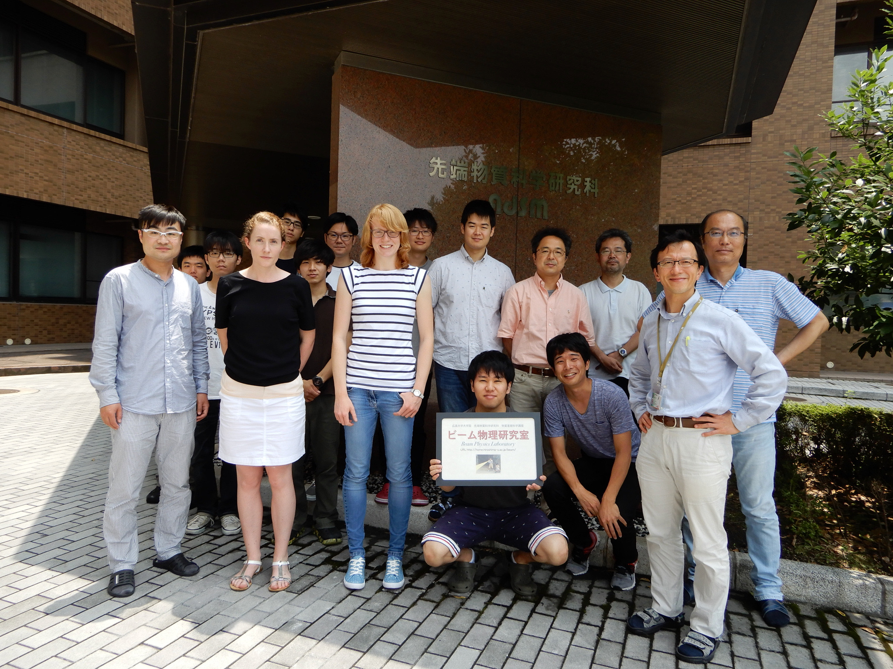
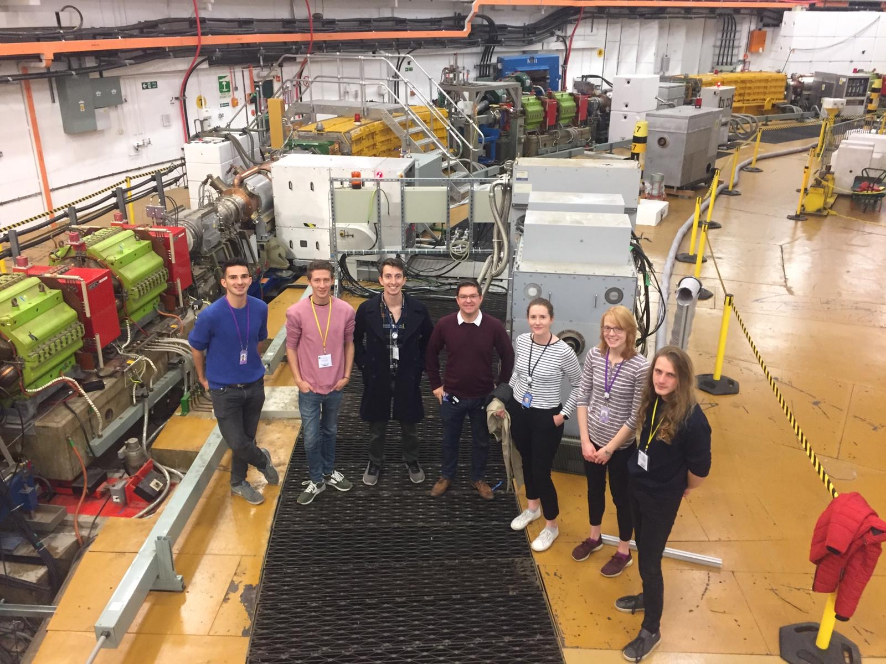
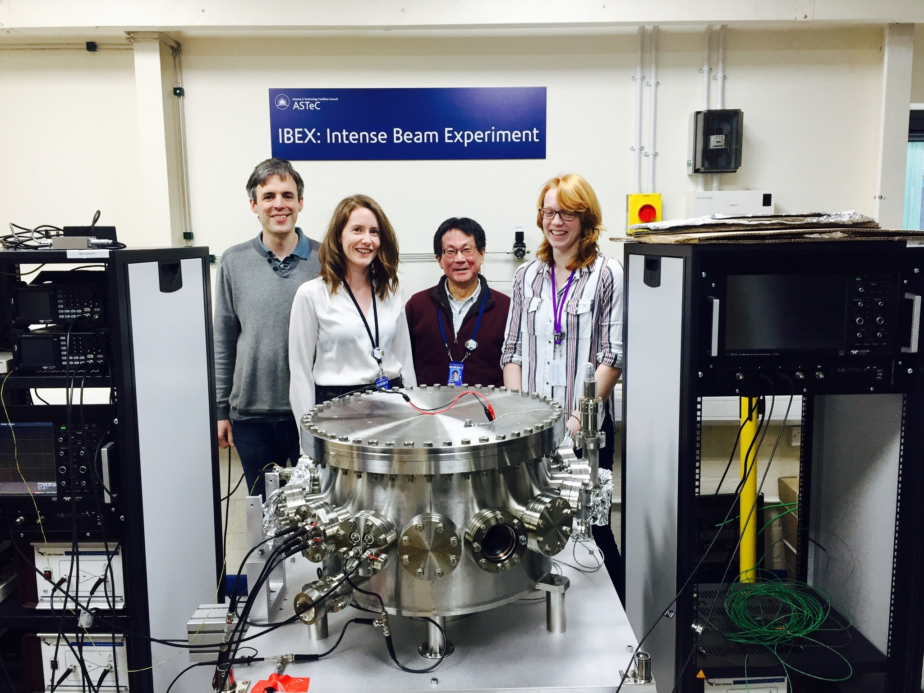

Thanks!
Thesis: https://ora.ox.ac.uk/objects/uuid:3a42465d-c0e9-4327-b9ff-4de634749d3a
Second talk:
Experimental Investigation of Accelerator Beam Dynamics with a Linear Paul Trap
Further IBEX work:
jake.flowerdew@physics.ox.ac.uk

Slide 18
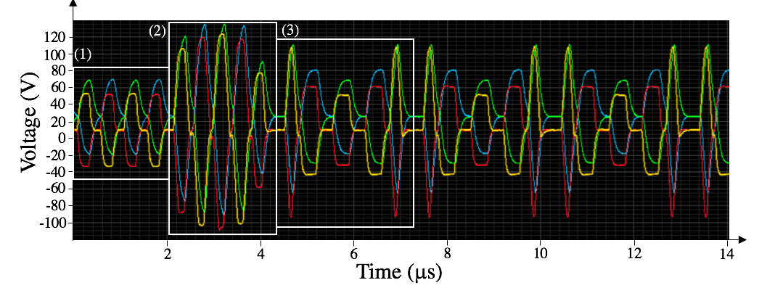
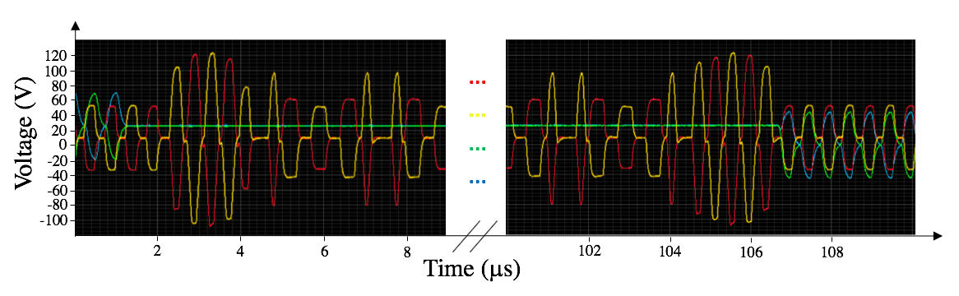
For the waveforms with larger voltages ran into problems with the amplifiers, especially those on the endcaps, with the lower band width:
Central rods
End caps
Decided to not apply the alternating voltage to the end caps and to match back to original waveform before extracting:

Slide 19
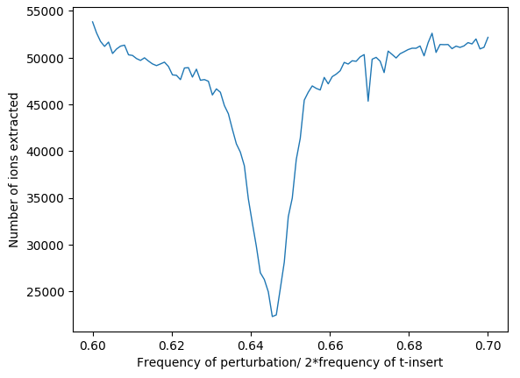
4. Quality control
See tune control of ~10⁻²
Blue = perfect rod and plate placement
Red = example with 20μm error on rod and plate location
R_{meas} = 3mm (from simulation)
For octupole only desired phase advance tolerance in IOTA is 10⁻² (reduction in DA of 10%).
Magnet tolerance is stated to be an ﻿integrated strength of harmonics relative to octupole field is less than 1% (100 units).

