Slide 1
A proposal for accelerating electrons in the future Electron Ion Collider (EIC) using either Energy Recovery Linac ‘ERL’ or Recirculating Linac Accelerator (RLA) where a single Fixed Field Alternating Linear Gradient (FFA-LG) beam line is transports multiple energy electrons back to the linac. The designs are based on experience from the Cornell University and Brookhaven National Laboratory Energy Recovery Test Accelerator – ‘CBETA’. Examples of EIC at Relativistic Heavy Ion Collider (RHIC) and of the CERN Large Hadron Collider - LHeC are presented. The FFA-LG design is a racetrack shape, where, as in the CBETA, the arc is matched by adiabatic transition to the multiple straight sections of the EIC in the RHIC tunnel or two straights in the LHeC. The combined function magnets are made of permanent Halbach type structures following success of the superb quality CBETA magnets but this time the horizontal aperture is open to allow radial dissipation of the synchrotron radiation. The straight sections are used to place the superconducting linacs or to match the existing RHIC tunnel.
Energy Recovery Linac-based Future EIC and FCC-ee
Dejan Trbojevic
Abstract:

Slide 2
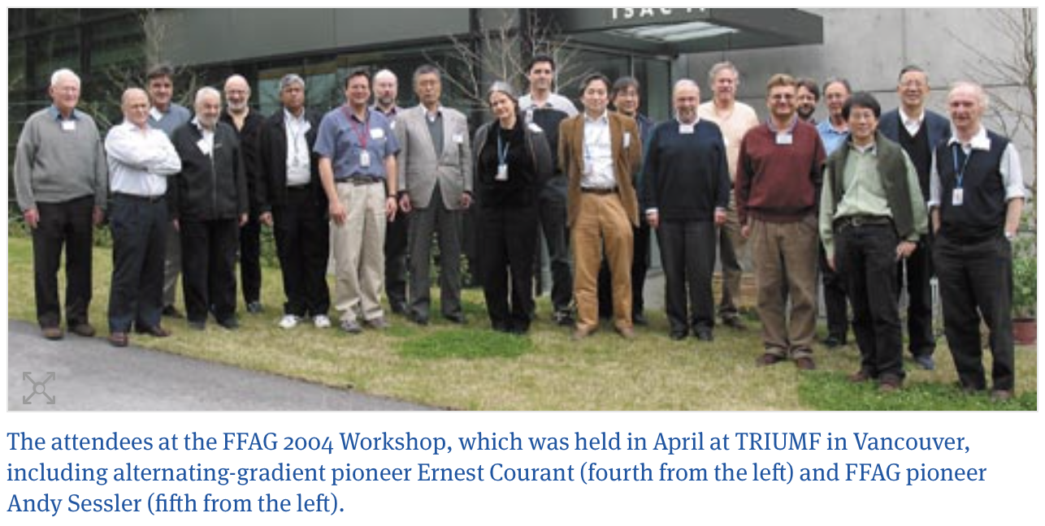
Sixteen Years ago in Vancouver: FFAG 2004

Slide 3
OUTLINES
SUMMARY: A new combination of the FFA accelerators with the ERL’s without the spreaders shows a novel and very promising combination for multiple applications: EIC, hadron cooling, nuclear physics experiments, etc.
Examples of the new FFA lattice designs for: EIC@RHIC with the 1.5 GeV linac, LHeC design, and PERLE lattice design, while the new FFA for the FCC-ee is just being investigated.
RLA or ERL’s advantages for EIC:
- Smaller beam-beam effect in a single pass during every collision,
- Reduced total synchrotron radiation power
- Disruption on electrons is not so important, lower operating and building cost.
- Lower cost with providing the lowest dump energy.
Proposal is based on:
- Already experimentally and theoretically shown examples CBETA, EMMA, ATF experiment
- Superb quality permanent combined function magnets
- CBETA proof of principle for the FFA adiabatic transitions.

Slide 4
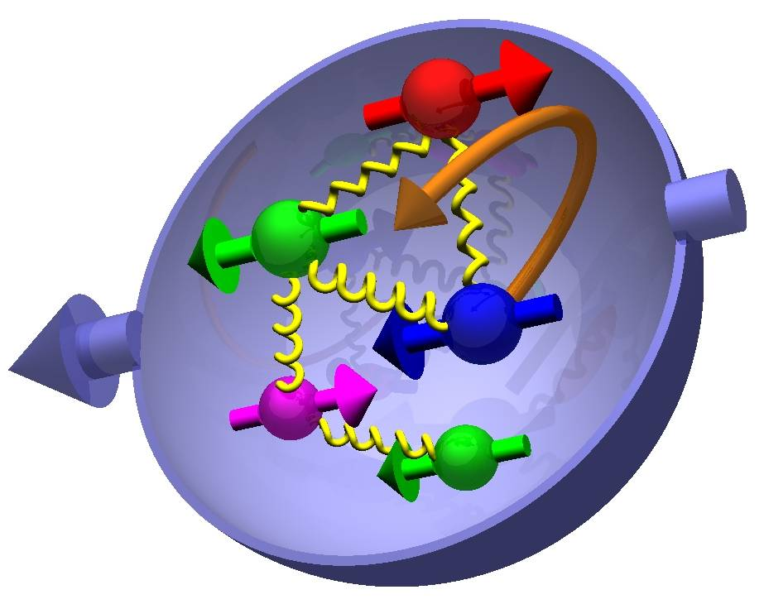
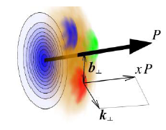

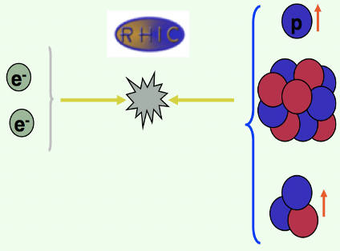
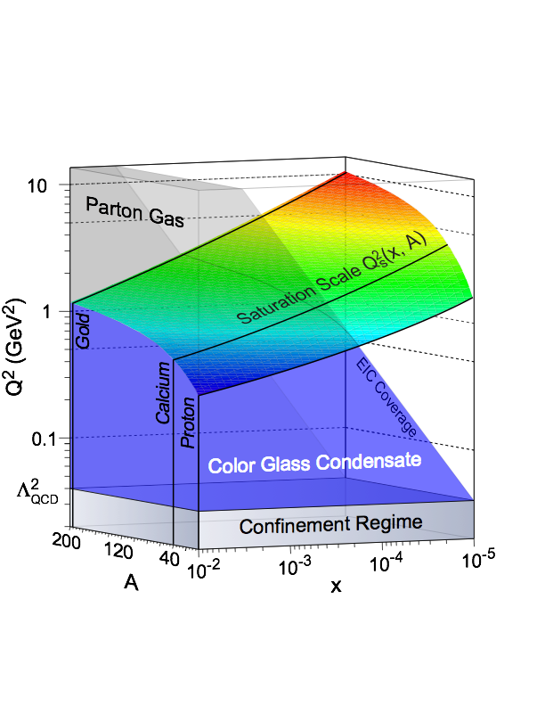
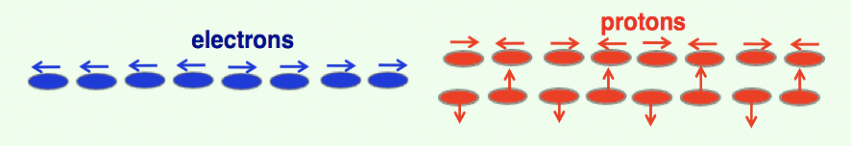
Elke Aschenauer: Most Compelling Physics Questions
WHY BUILD A NEW POLARIZED ELECTRON - PROTON/He³ AND HEAVY ION COLLIDER - EIC?
EIC with the center-of-mass collision energies ECM ranging between 29 GeV and 140 GeV is realized by proton energies that range from 41 to 275 GeV, and by electron energies that range from 5 GeV to 18 GeV.
spin physics
imaging
what is the polarization of gluons at
small x where they are most abundant
what is the spatial distribution of
quarks and gluons in nucleons/nuclei
Polarized protons 45-255 GeV
what is the flavor decomposition of
the polarized sea depending on x
understand deep aspects of gauge
theories revealed by k_{T} dep. distr’n
Polarized Electrons
5-18 GeV
Light Ions (d, Si, Cu)
Heavy Ions (Au, U)
10-110 GeV/u
determine quark and gluon contributions
to the proton spin at last
possible window to
orbital angular momentum
Polarized He3
17-184 GeV/u
physics of strong color fields
quantitatively probe the universality of
strong color fields in AA, pA, and eA
understand in detail the transition to the non-linear
regime of strong gluon fields and the physics of saturation
how do hard probes in eA interact with the medium
Dejan Trbojevic, FFA'20 Vancouver

Slide 5
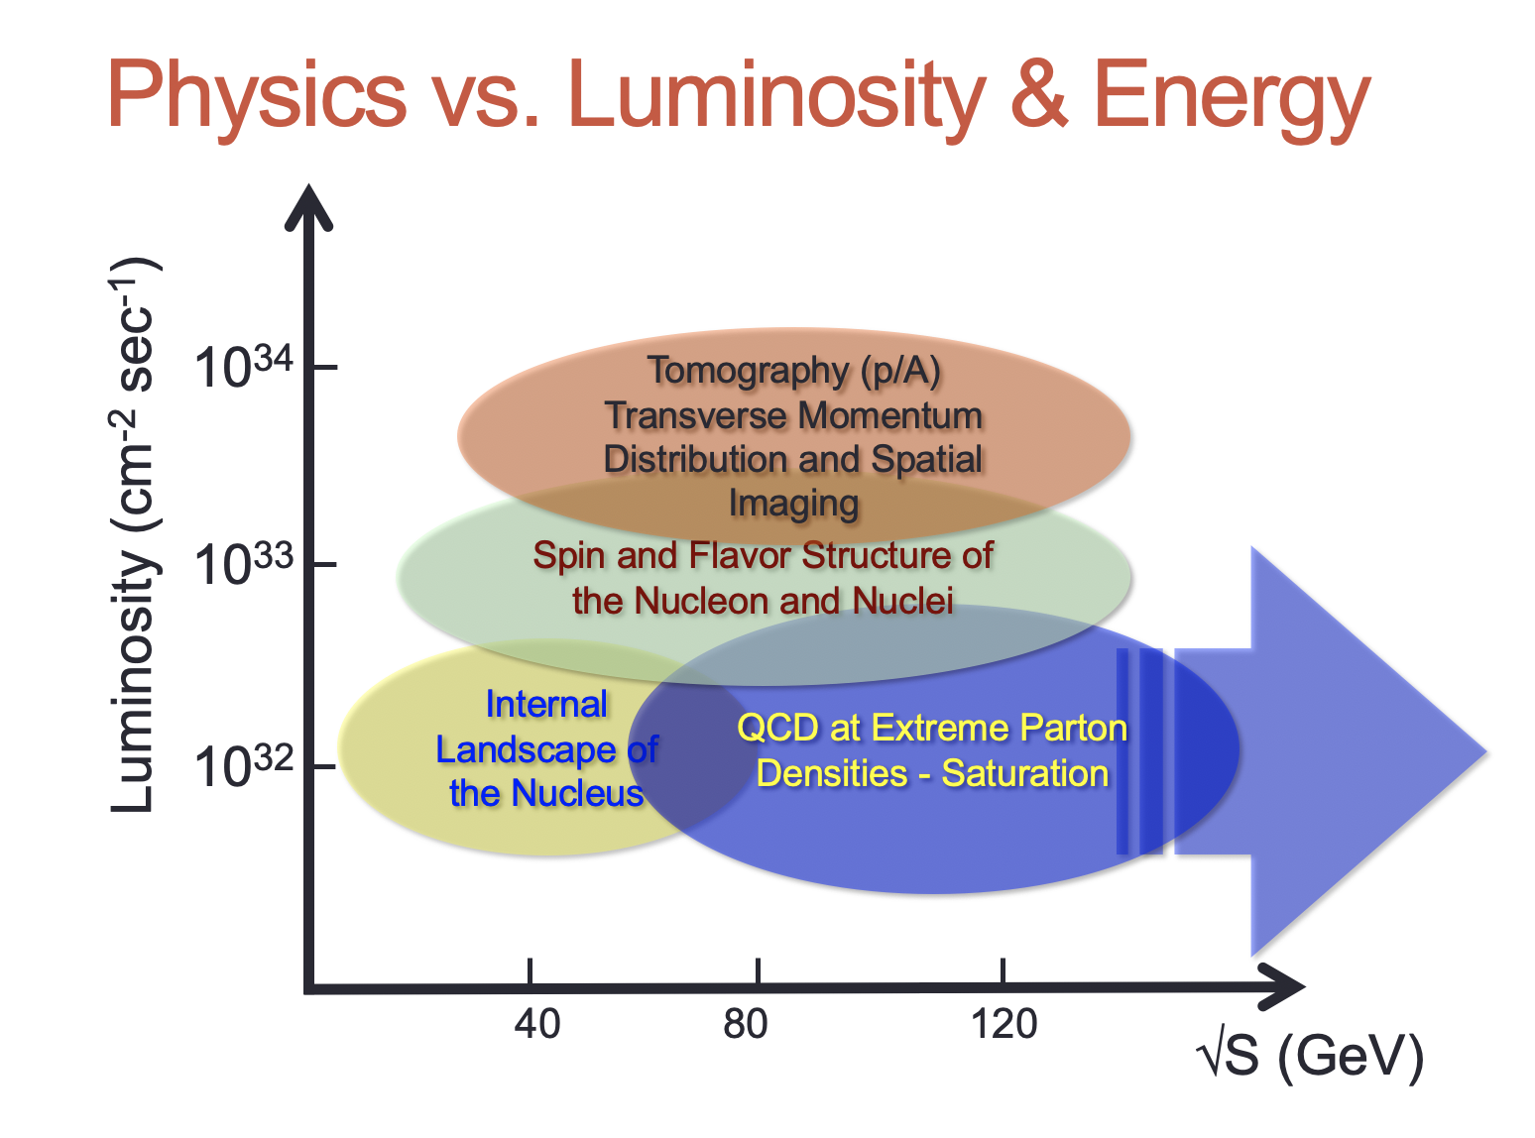
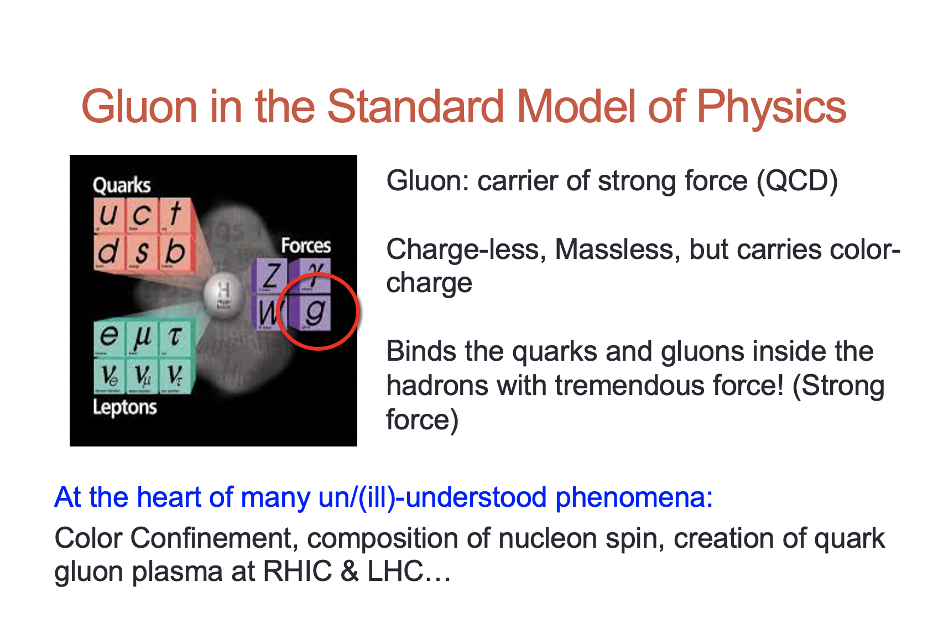
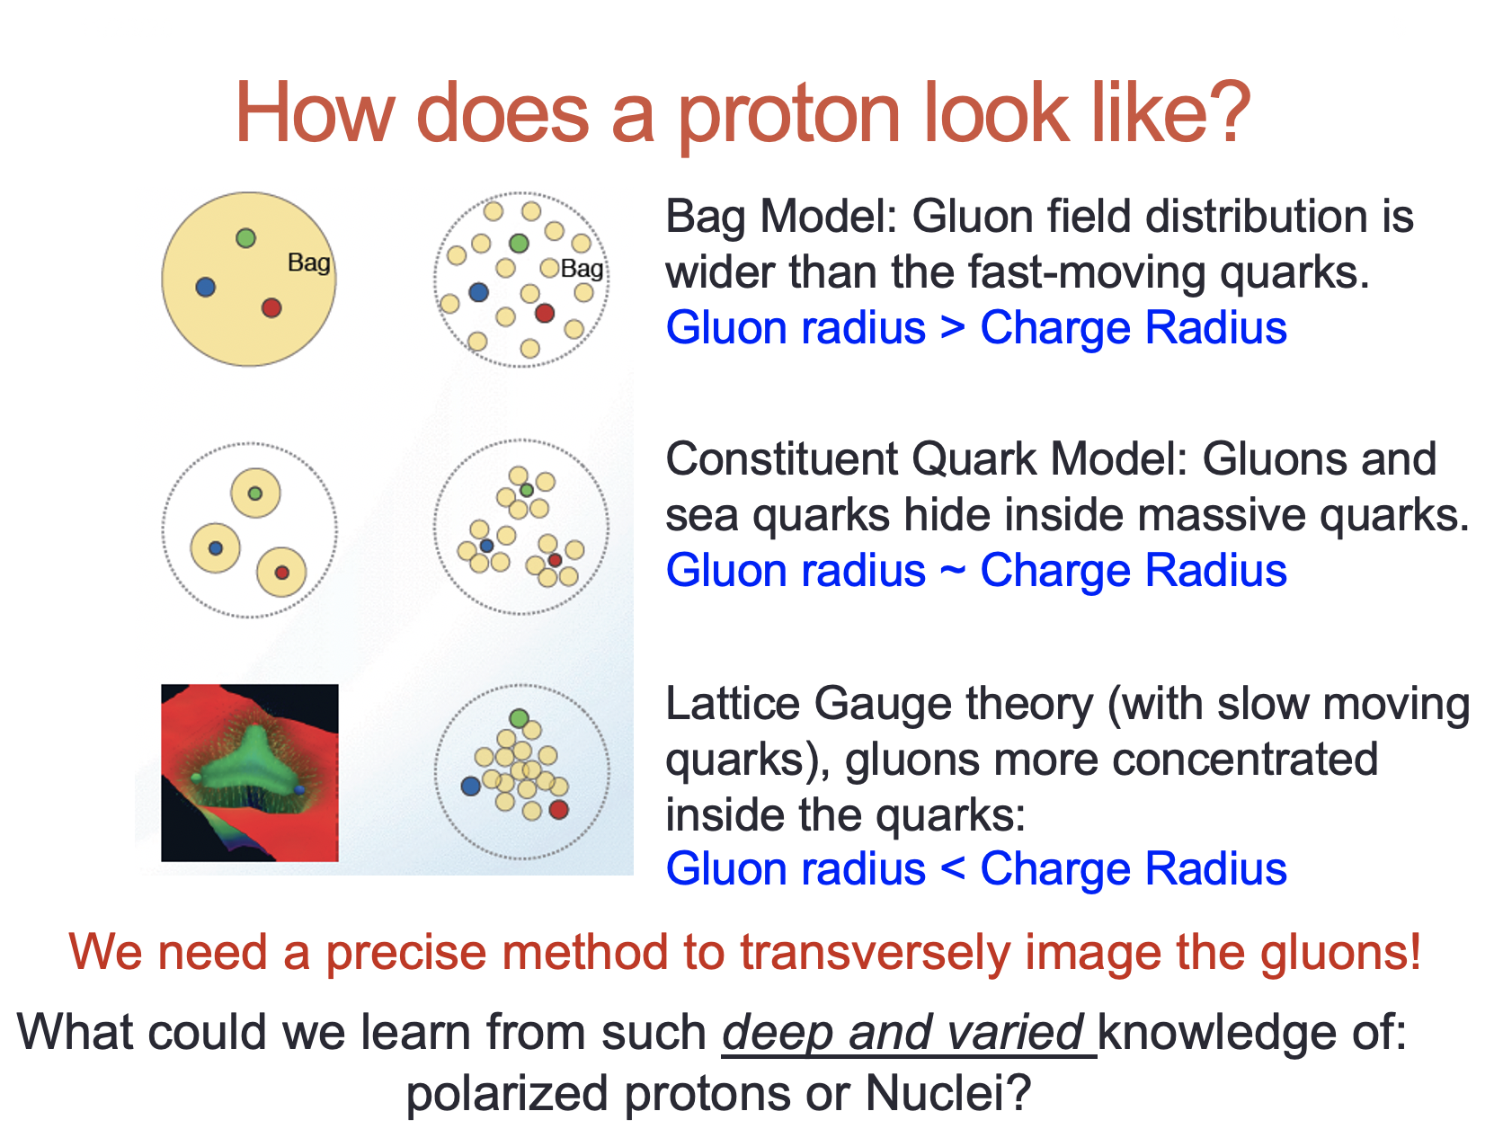
Elke Aschenauer: Most Compelling Physics Questions
WHY TO BUILD the EIC
Dejan Trbojevic, FFA'20 Vancouver

Slide 6
EIC design presently excludes the ERL:
Risk items in the LINAC-RING ERL type EIC collider:
  No polarized electron source with 40 mA beam
  ERL needs to show the high intensity electron beam operation
    2.1 High Order Modes (HOM’s) - JLAB people (Robert Rimmer) have a solution
    2.2 Beam loading?
    2.3 Coherent Synchrotron radiation
    2.4 Non-linear effects due to acceleration on the crest (third harmonic)
    2.5 Colliding electron beam needs to have high quality: low emittance, small energy spread
  3. FFA -Fixed Field Alternating Linear Gradient accelerator was considered as not proven technology. Multiple turns with spreaders require large number additional magnets to be placed in a very limited available space. CBETA has shown proven experimentally great confirmation of the concept. The RLA solution avoids high polarized electron intensity source and uses the JLAB concept.

Slide 7
Introduction:
Large Momentum Acceptance Fixed Field Beam Lines
A concept of Fixed Field Large Energy Acceptance Lattice
- Orbits in fixed field cells
- Tunes vs. energy
- Path length vs. energy
Adiabatic matching to the ERL Linac
Confidence of success comes from 3D OPERA fields tracking presented in the publication by Francois Meot
- High quality Halbach magnets
- Previous experiments in great results from 8 turns CBETA commissioning, ATF, and EMMA

Slide 8

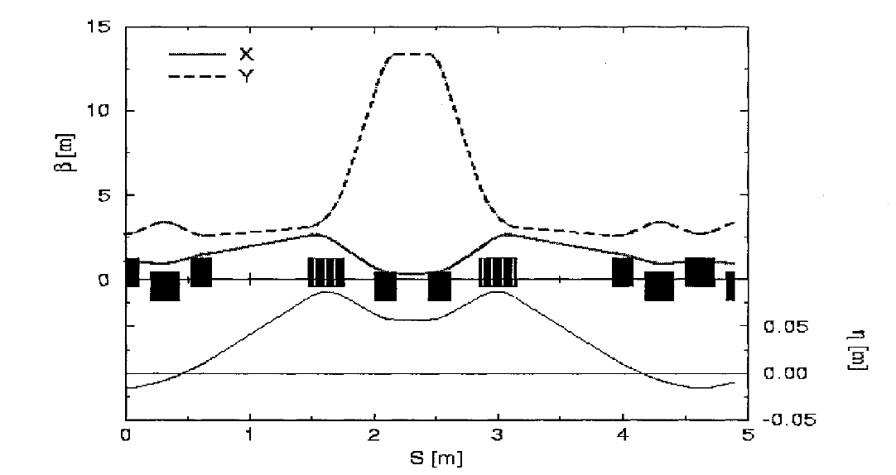
It started 20 years ago
“Colliders and collider physics at the highest energies: Muon colliders at 10 TeV to 100 TeV”: HEMC '99 Workshop, Montauk, New York, 27 September-1 October 1999, editor, Bruce J. King
Muon Acceleration with
-50% < Δp/p < 50%
15
10
β (m)
5
D_{x} < 8.6 cm
0
0.05
η (m)
D_{x} > -3 cm
0.00
-0.05

Slide 9
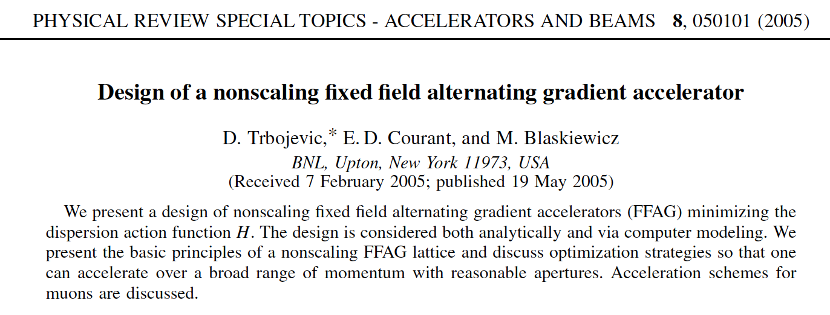
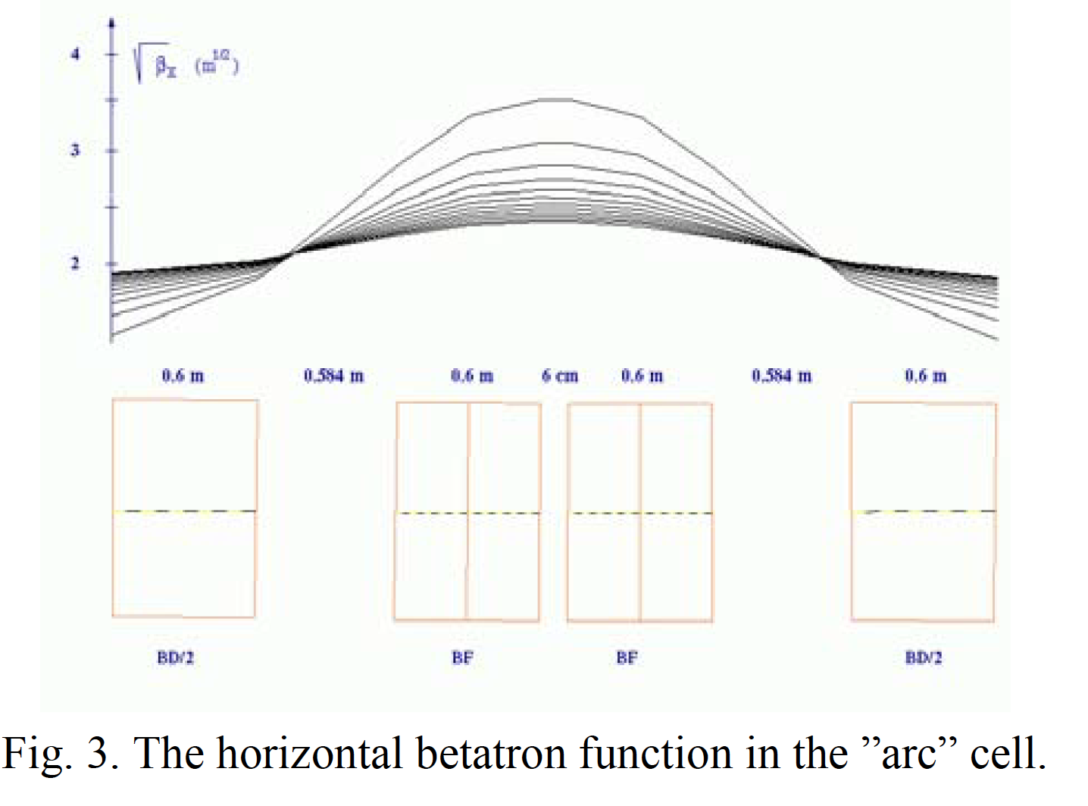
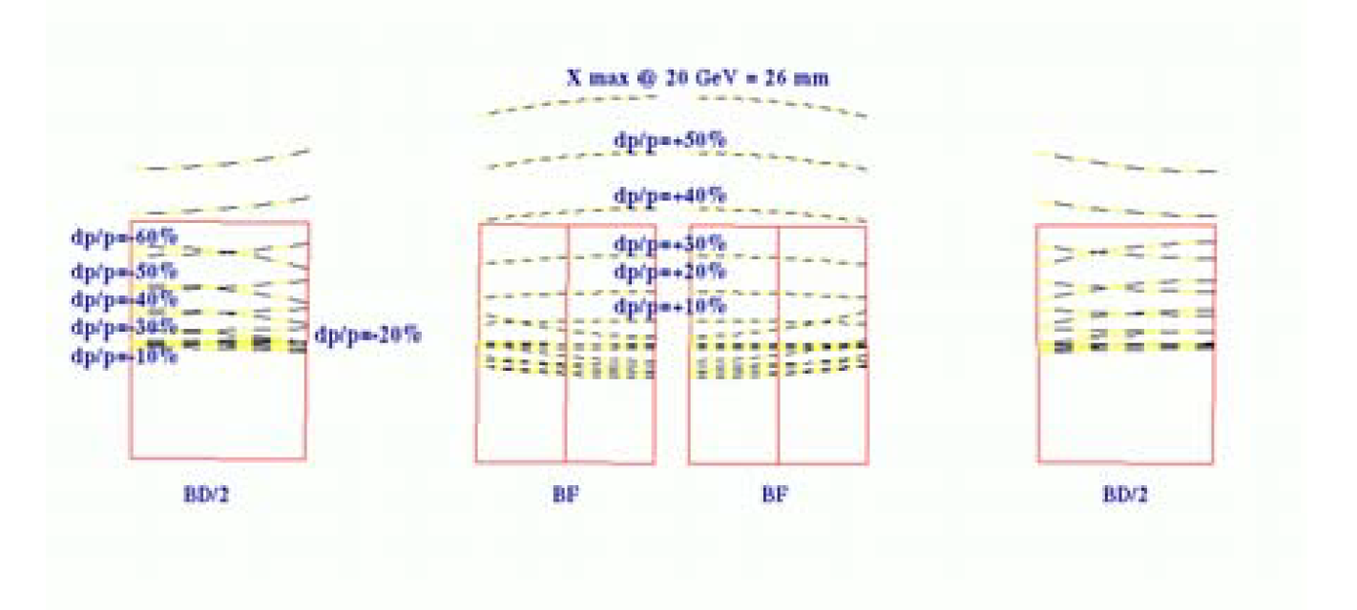
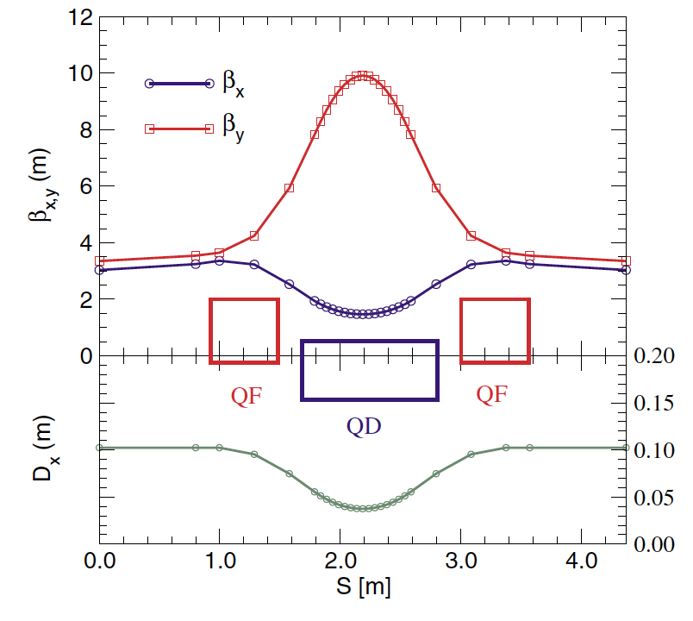
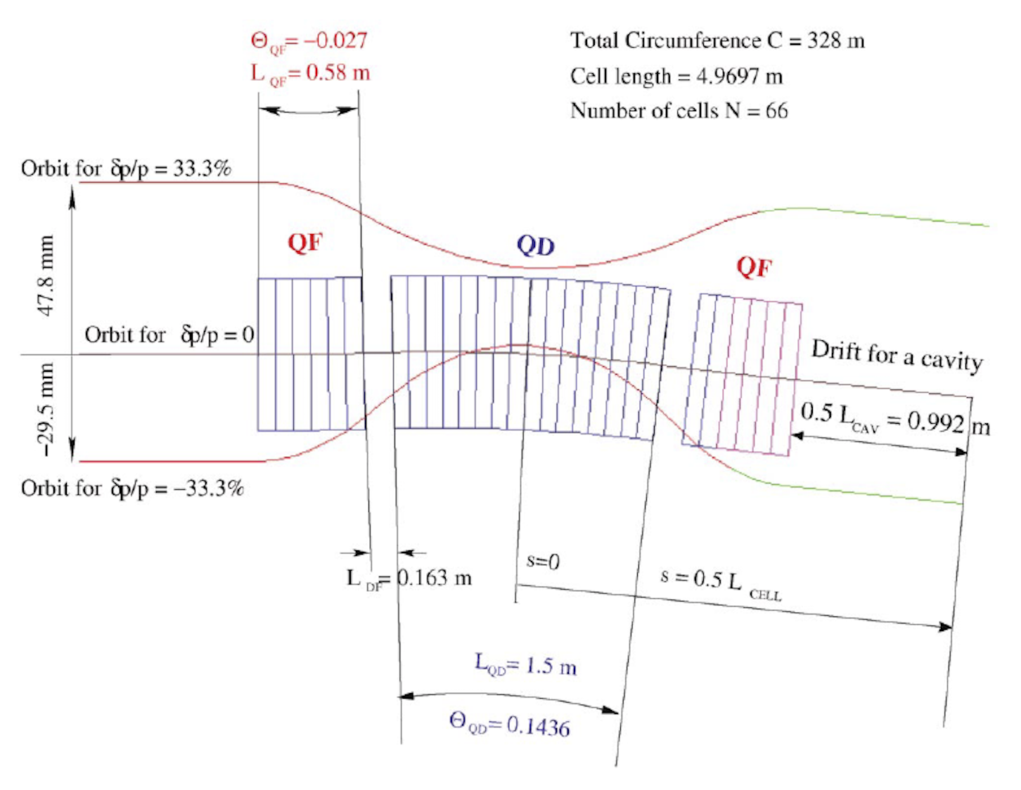
Proceedings of PAC07, Albuquerque, New Mexico, USA
“ACCELERATION OF ELECTRONS WITH THE RACETRACK NONSCALING FFAG FOR e-RHIC”
D. Trbojevic, S. J. Berg, I. Ben-Zvi, M. Blaskiewicz , V. Litvinenko, W. MacKay, V. Ptitsyn, T. Roser, and A. G. Ruggiero, Brookhaven National Laboratory, NY, Upton, 11973, USA

Slide 10
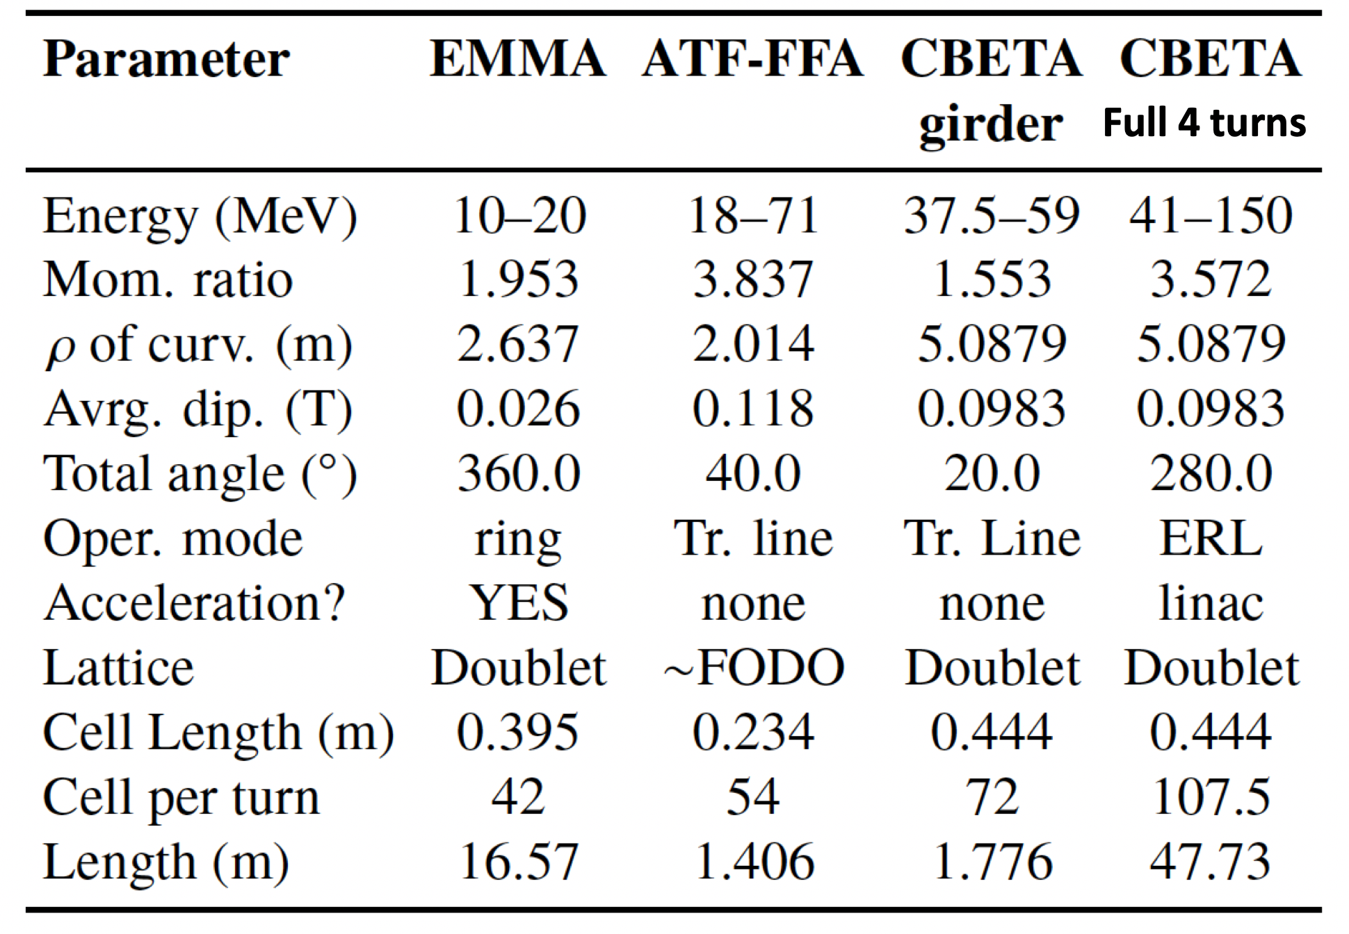
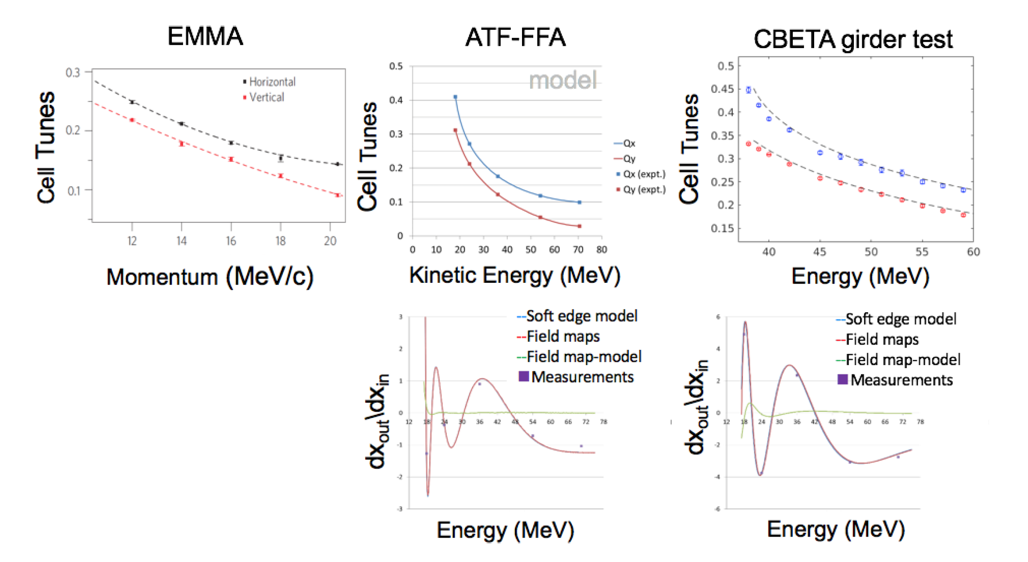
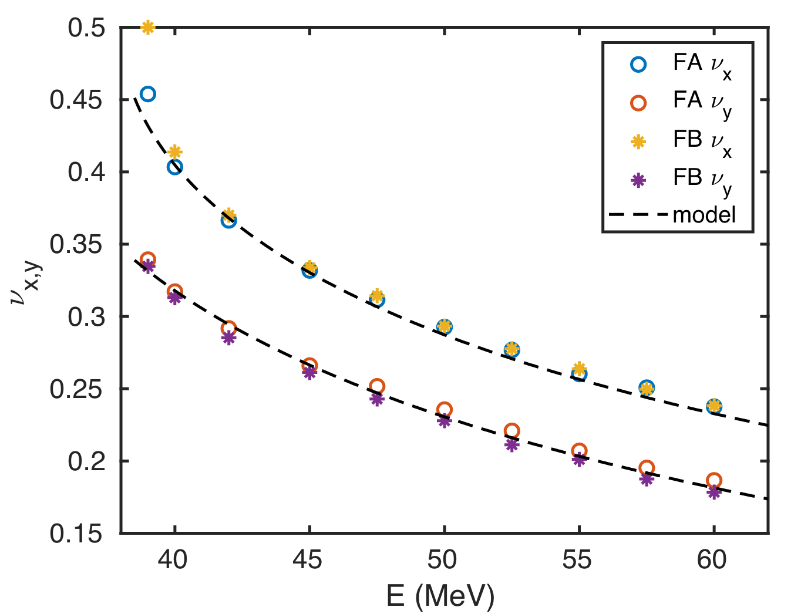
Multiple Experimental Confirmations that the FFA is REAL
CBETA Full First Turn test
FFA Tunes
Energy (MeV)

Slide 11
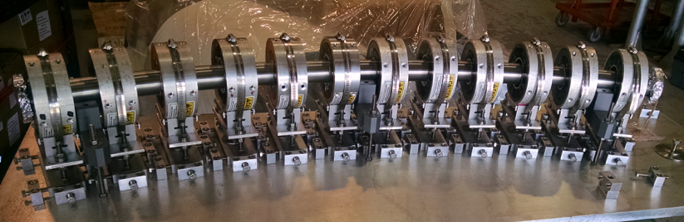
The Fixed Field Alternating Gradient Experiment with bending 40º already tested at BNL
Electron energies in the experiment :18, 24, 36, 54, and 72 MeV

Slide 12
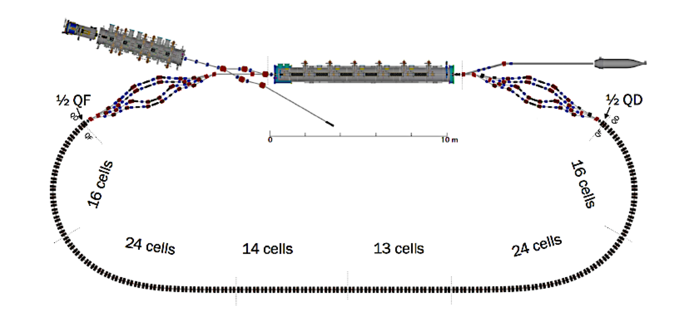
Properties of the linear fixed field large energy acceptance lattice for the CBETA project

Slide 13
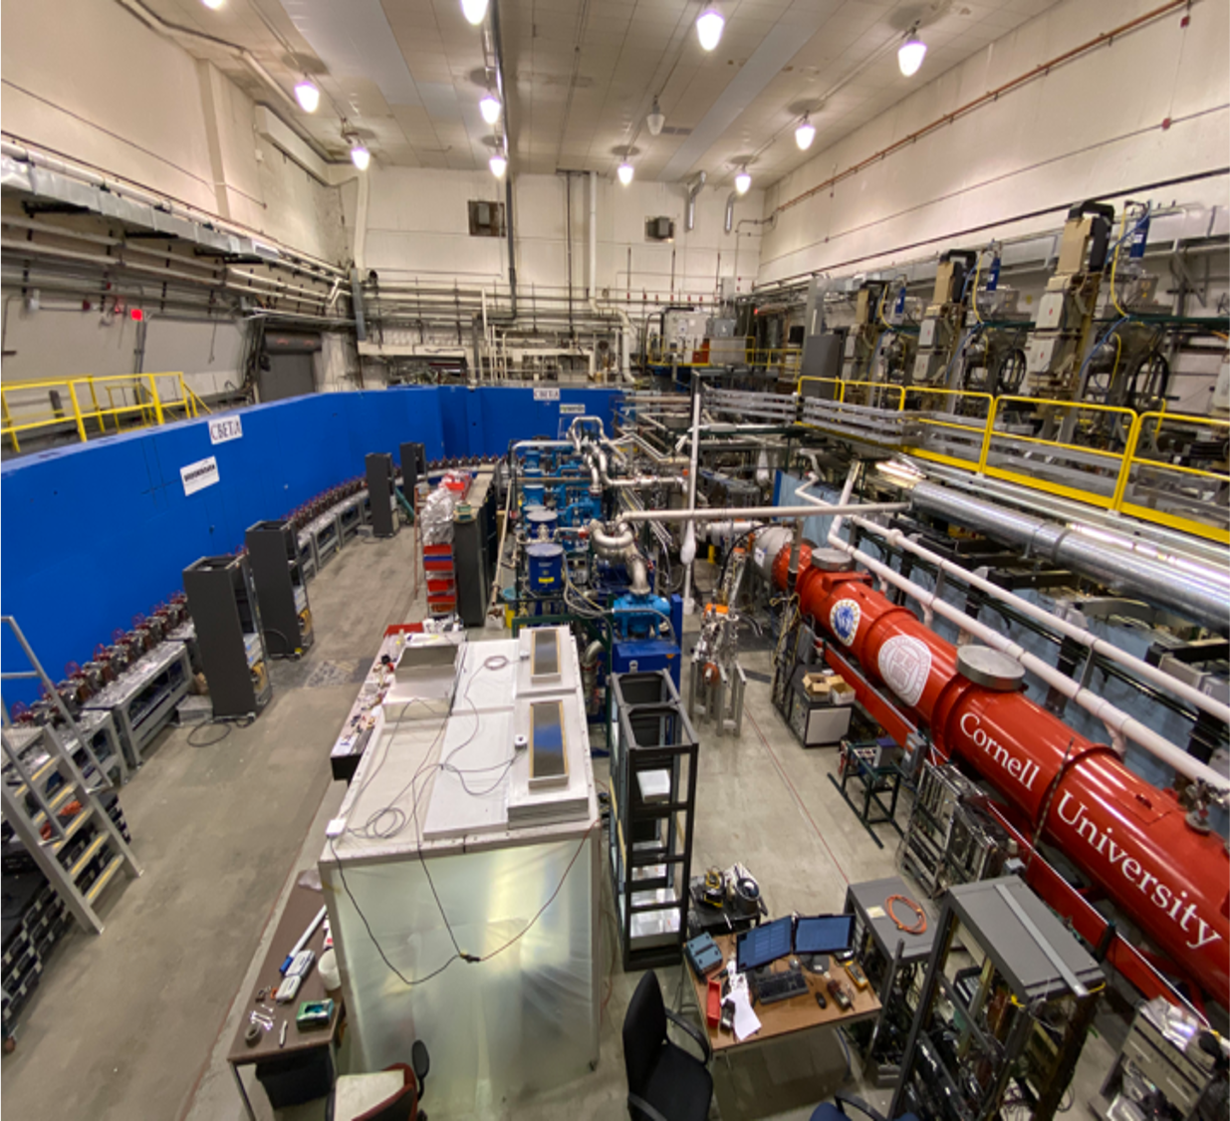
CBETA

Slide 14
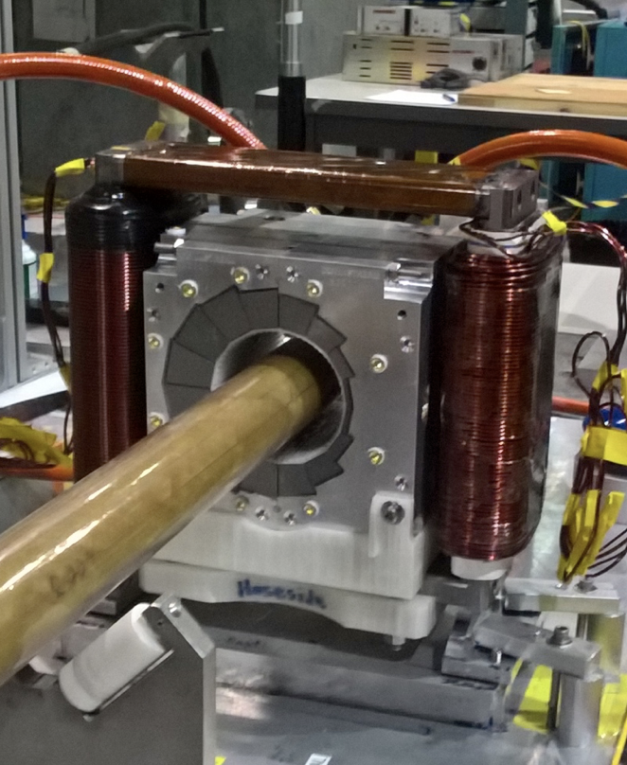
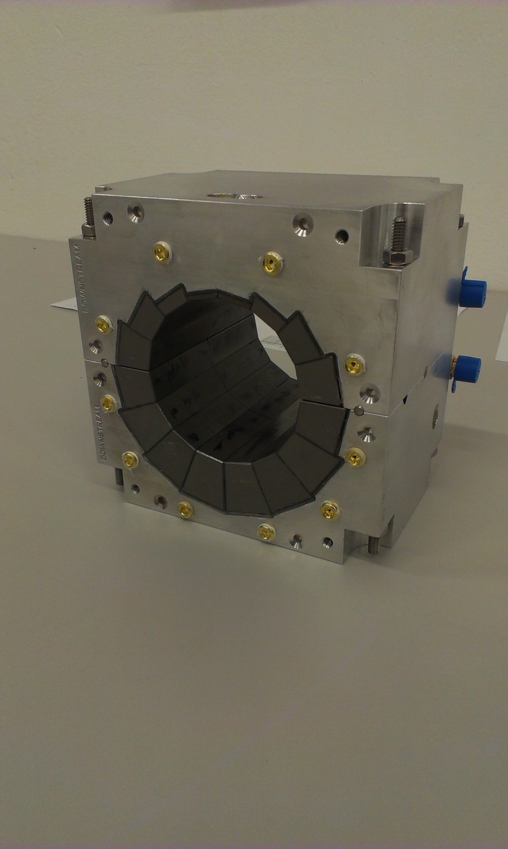
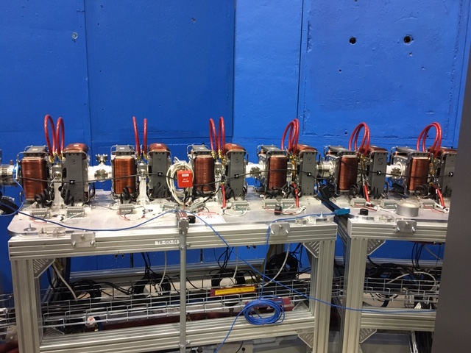
CBETA girder and Superb Quality Permanent Magnets

Slide 15
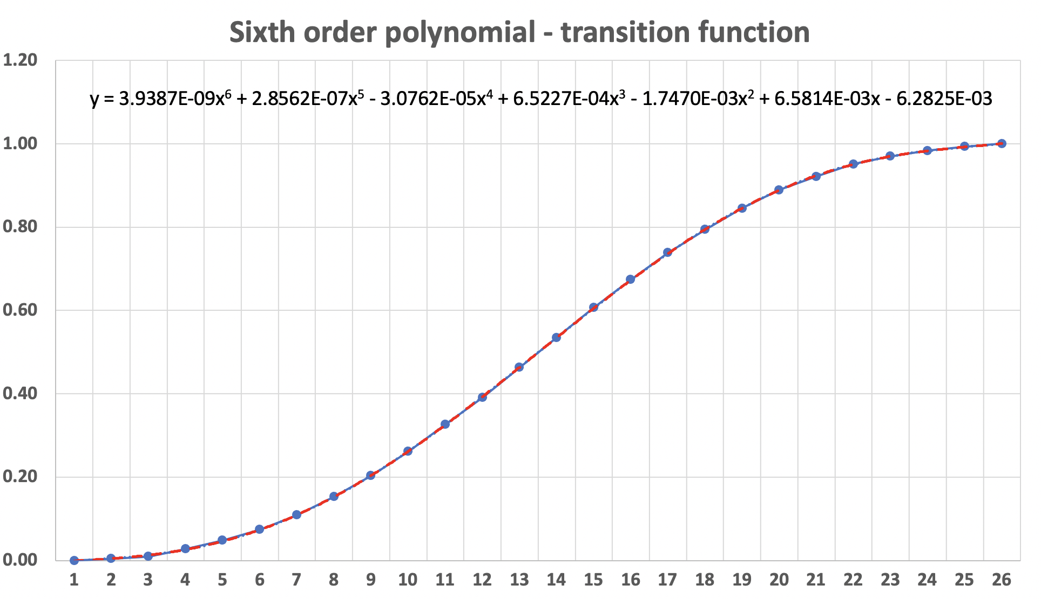
Adiabatic transition from the arc to the straight with expanding the transition cell lengths (Scott Berg)

Slide 16
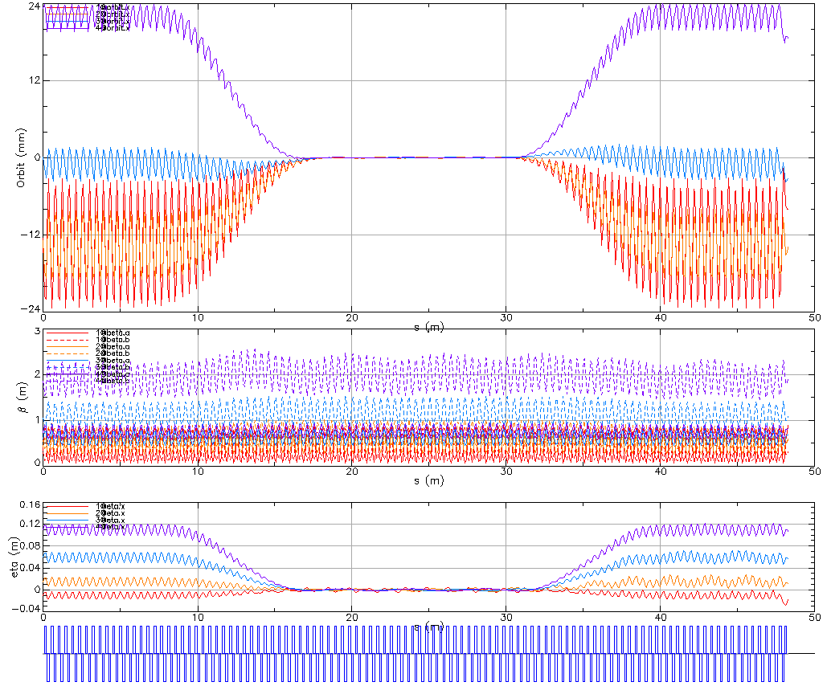
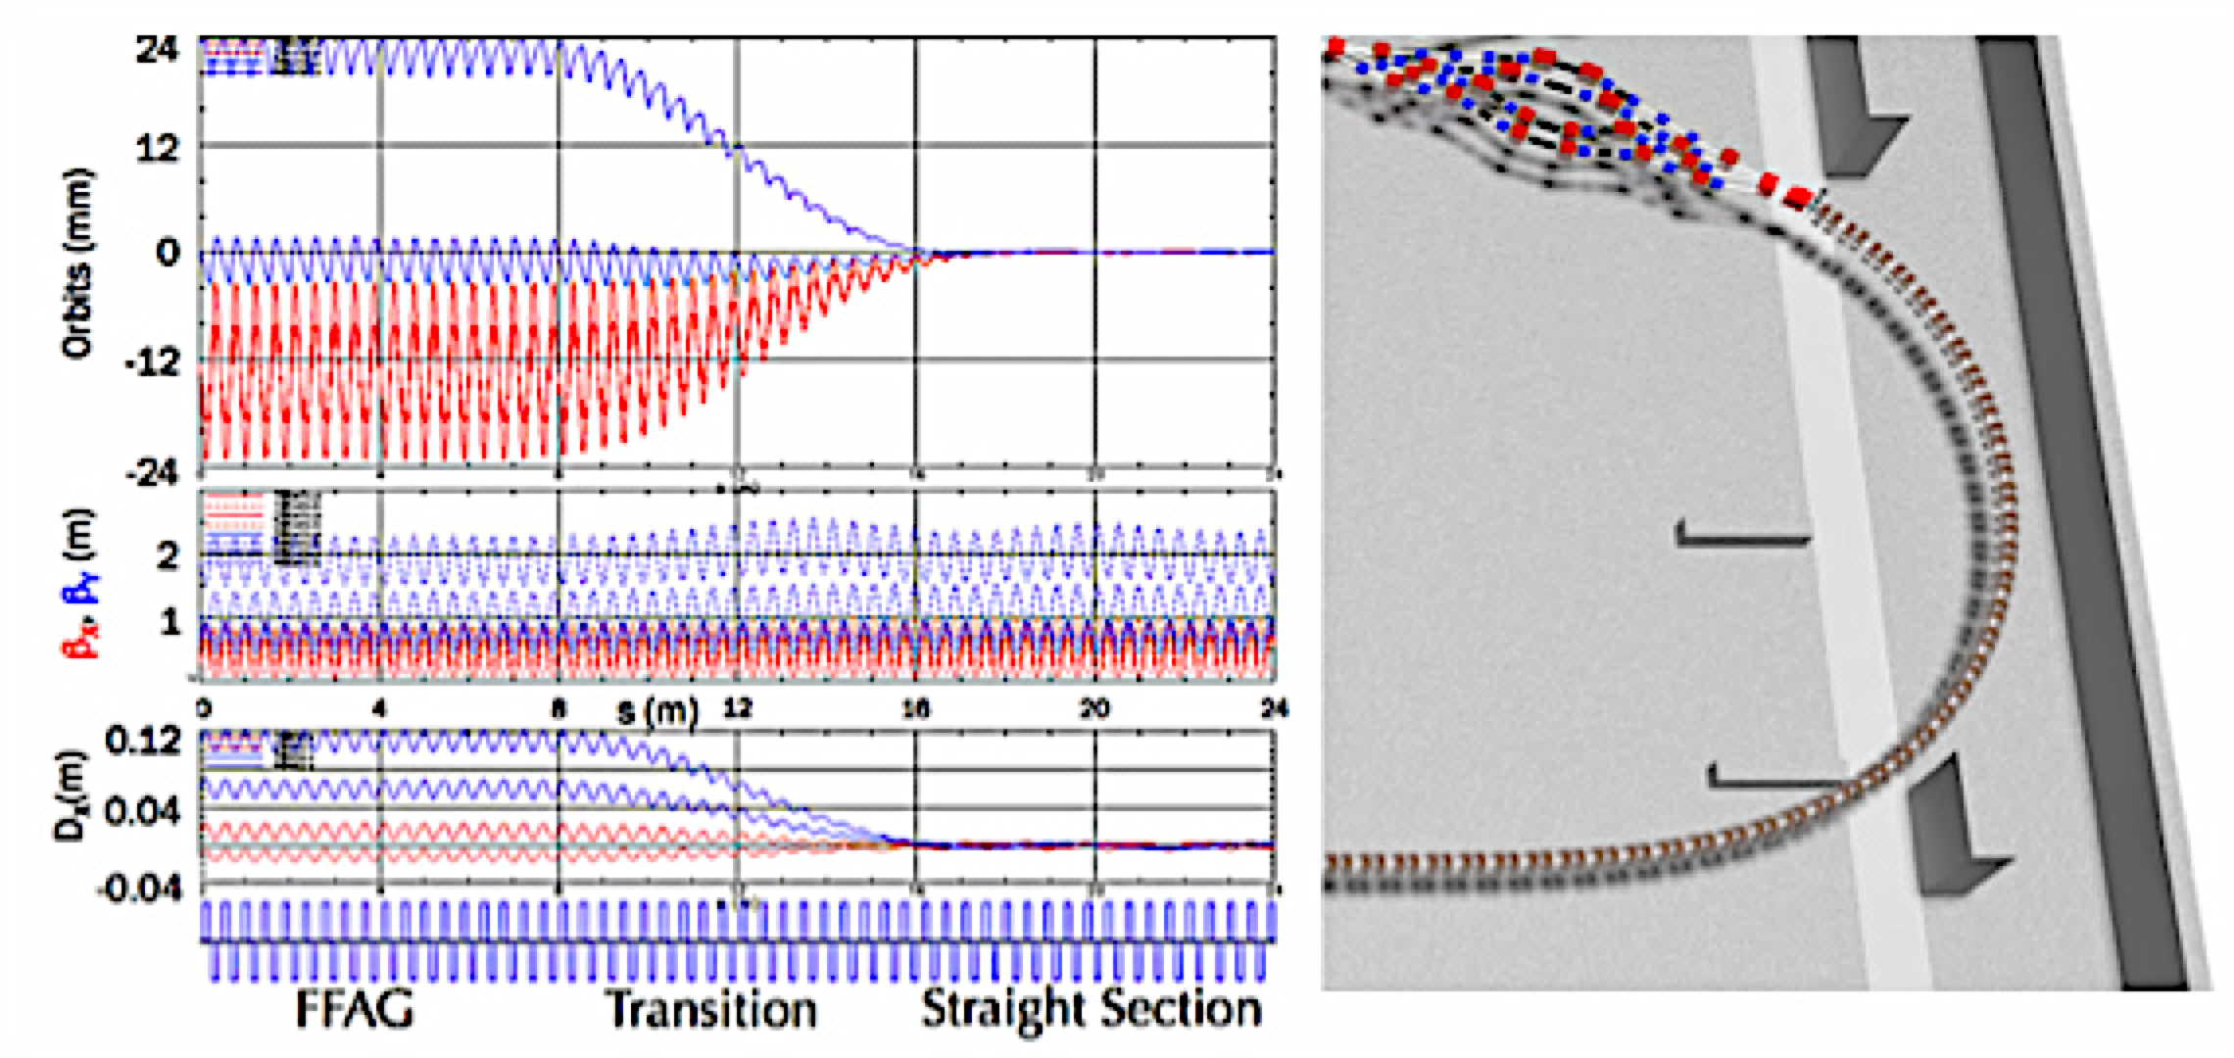
Merging of the orbits at the CBETA project
The orbits in the FFA Arc are Adiabatically merged into one

Slide 17
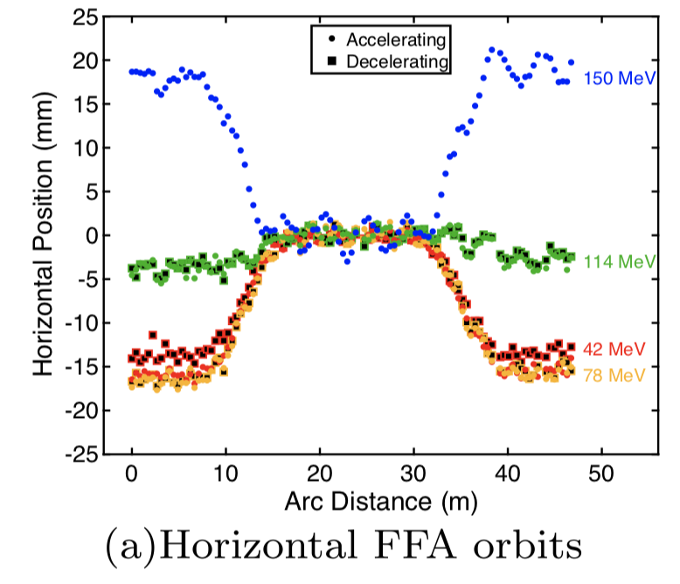
Measurements of Orbits in the CBETA FFA Cells
Dejan Trbojevic, FFA'20 Vancouver
17

Slide 18
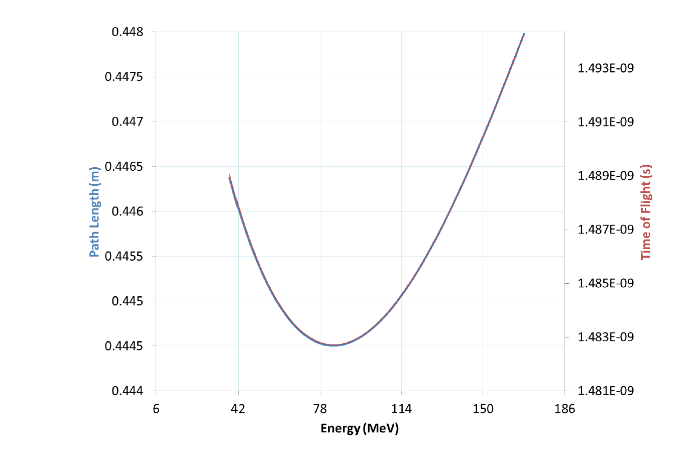
Path length and time of fight
in the CBETA arc cell as a function of energy.
3.5 mm
Dejan Trbojevic, FFA'20 Vancouver
18

Slide 19
Built and successfully tested Halbach type of magnet with a horizontal gap for the eRHIC ERL type of solution

Slide 20
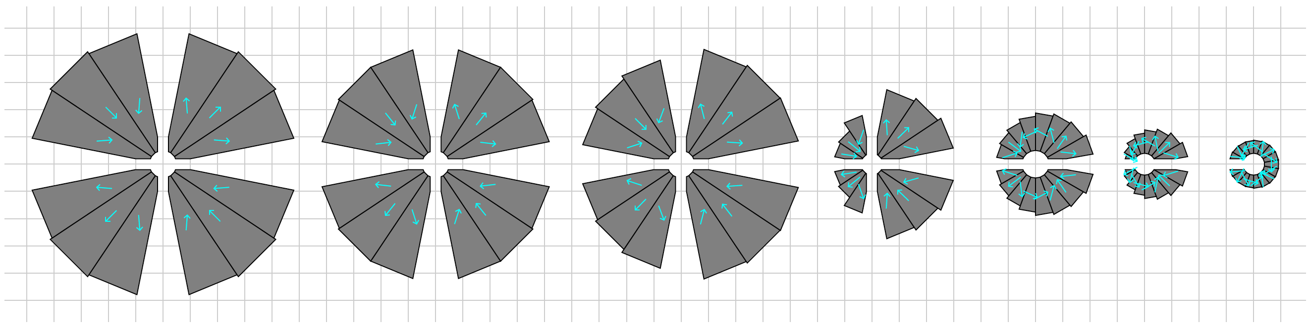
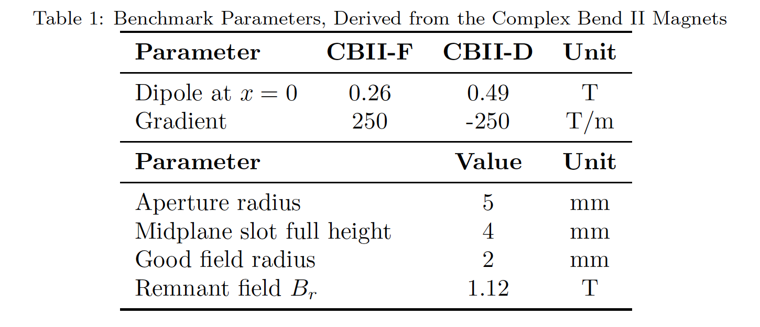
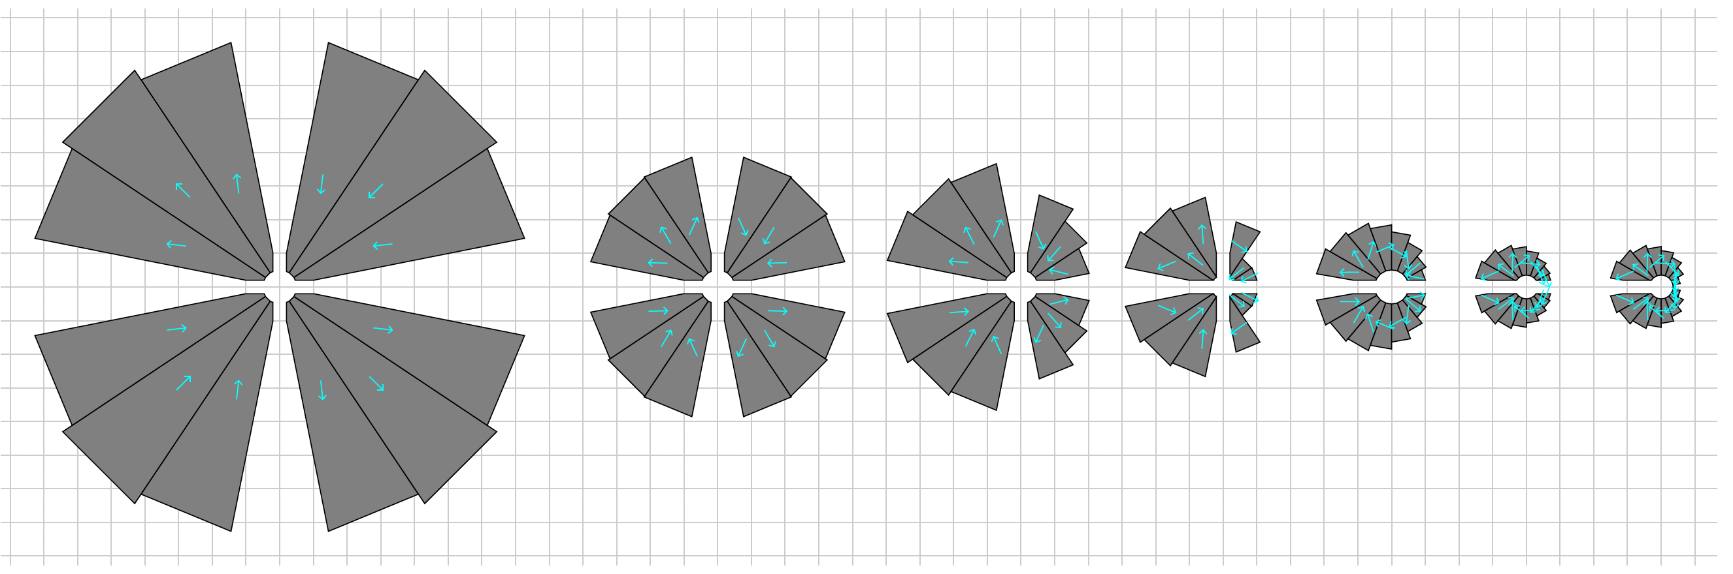
Newest Magnet Design results from Stephen Books
A square dimensions are 1 cm
Comparisons of the displaced Halbach with open gap with Combined Function Focusing magnet by keeping the beam more towards the center of the aperture
Comparisons of the displaced Halbach with open gap with Combined Function Defocusing magnet by keeping the beam more towards the center of the aperture

Slide 21
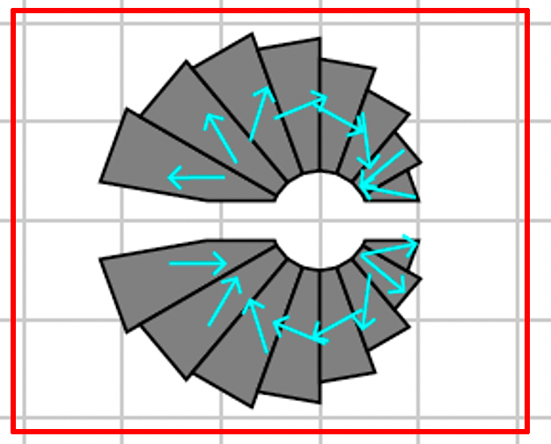
Defocusing magnet for NSLS II upgrade by Stephen Brooks
3 cm
5 mm
G_{D} = 250 T/m
B_{D} = 0.49 T
For eRHIC design
G_{D} = 224 T/m
B_{D} = 0.134 T
3.3 cm

Slide 22
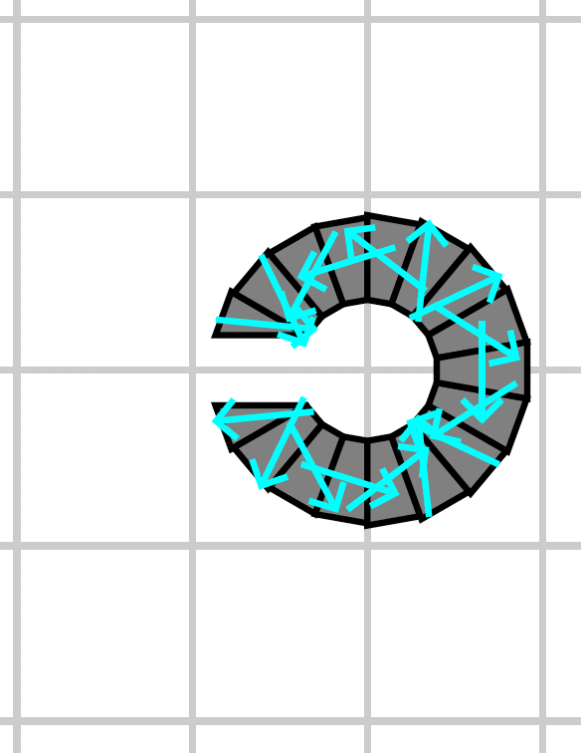
Newest Magnet Design results from Stephen Books
2 cm
G_{F} = 250 T/m
B_{F} = 0.26 T
5 mm
Beam Aperture
2d = 5 mm
1.8 cm

Slide 23
Advantages of the Fixed Field Large momentum lattice:
For multiturn ERL’s there is no other option but to use the fixed field permanent superb quality magnets as with the present technologies it is impossible to change the magnetic field in a very short time (ns)
Except for CBETA all ERL’s use multiple beam lines with the fixed magnetic field to bring the beam back to linacs.
The fixed field large momentum acceptance beam lines show multiple advantages in the multiple pass ERL’s:
  Multiple beam lines are replaced with one
  Electron beam polarization is preserved
  Operation is simplified

Slide 24
We are presenting an example of a novel approach in using the Fixed Field single beam line with large energy acceptance connected by an adiabatic transition to the ERL linac:
This allows additional passes through the linac, this reduces the size of the linac
Eliminates spreaders and combiners
Simplifies the operation
Significantly reduces the overall cost of the whole project

Slide 25
EIC @ RHIC with a single FFA-LG arc
Could be built by staging with 0.75 GeV Linac
#1 0.75 GeV
#1 1.50 GeV
#2 2.25 GeV
#3 3.00 GeV
#4 3.75 GeV
#5 4.50 GeV
#7 5.25 GeV
#8 6.00 GeV
#9 6.75 GeV
#10 7.50 GeV
#11 8.25 GeV
#12 9.00 GeV
Linac 1.5 GeV
#2 3.0 GeV
#3 4.5 GeV
#4 6.0 GeV
#5 7.5 GeV
#6 9.0 GeV
#7 10.5 GeV
#8 12.0 GeV
#9 13.5 GeV
#10 15.0 GeV
#11 16.5 GeV
#12 18.0 GeV
#1 1.250 GeV
#2 1.875 GeV
#3 2.500 GeV
#4 3.215 GeV
#5 3.750 GeV
3.75/1.25=3x energy
#1 1.5 GeV
#3 3.0 GeV
#5 4.5 GeV
4.5/1.5=3x energy

Slide 26
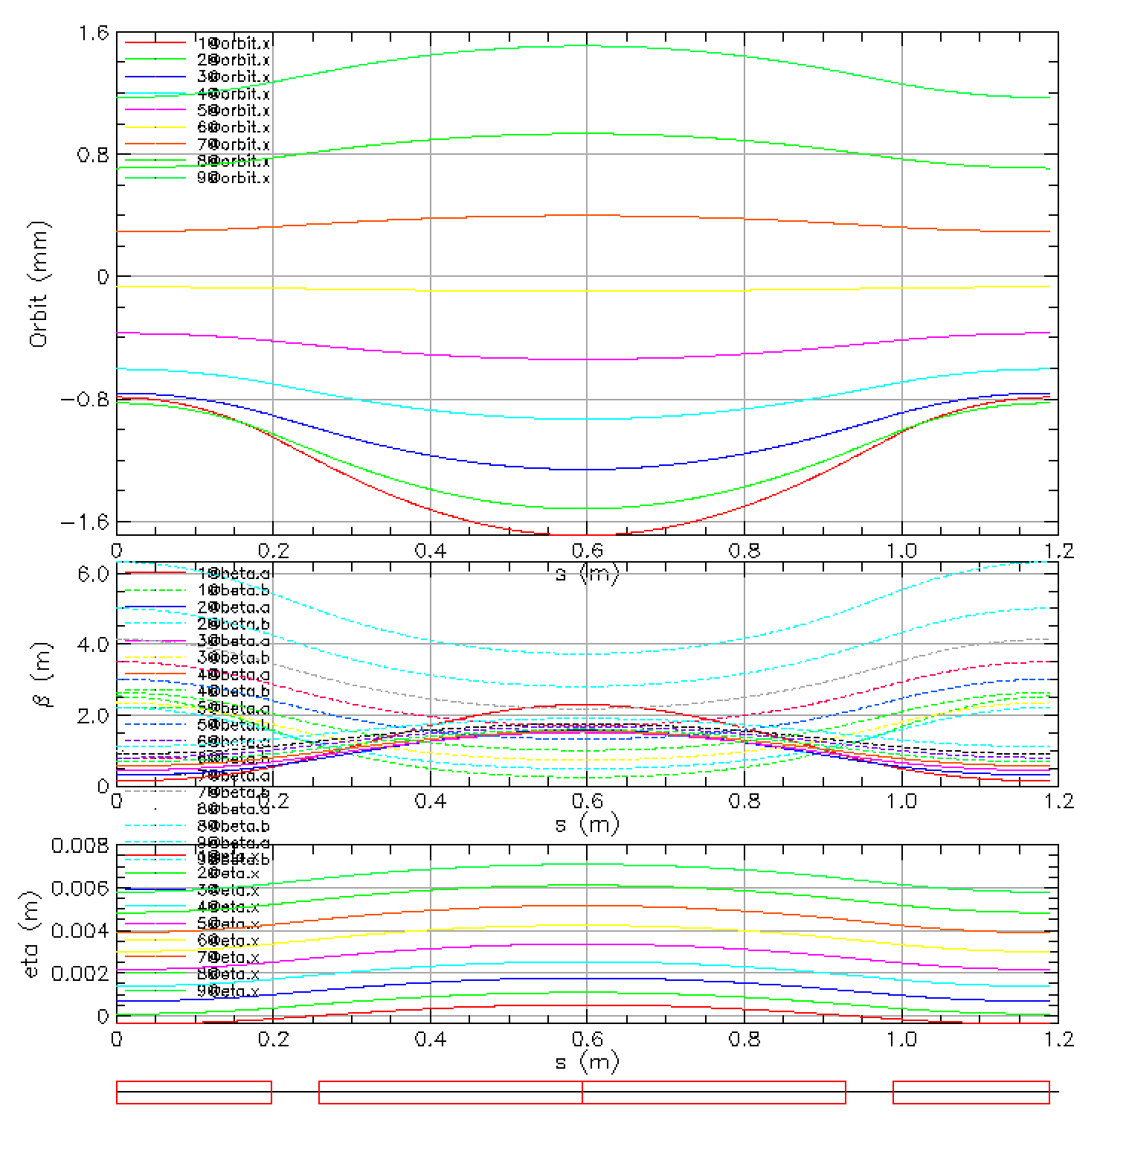
High Energy 6 -18 GeV EIC@RHIC FFA-LG Cell
Max orbit offset =1.6 mm
Magnet Properties:
Defocusing magnet
L_{BD} = 0.3957 m
G_{D} = 224.11 T/m
B_{D} = 0.134001 T
B_{Dmax} = 0.3683 T
Focusing magnet
L_{QF} = 0.6720 m
G_{F} = -154.368 T/m
B_{F} = 0.134001 T
B_{Fmax} = 0.3667 T
18 GeV
6 GeV
1.6 mm
Dispersion is in
millimeters!

Slide 27
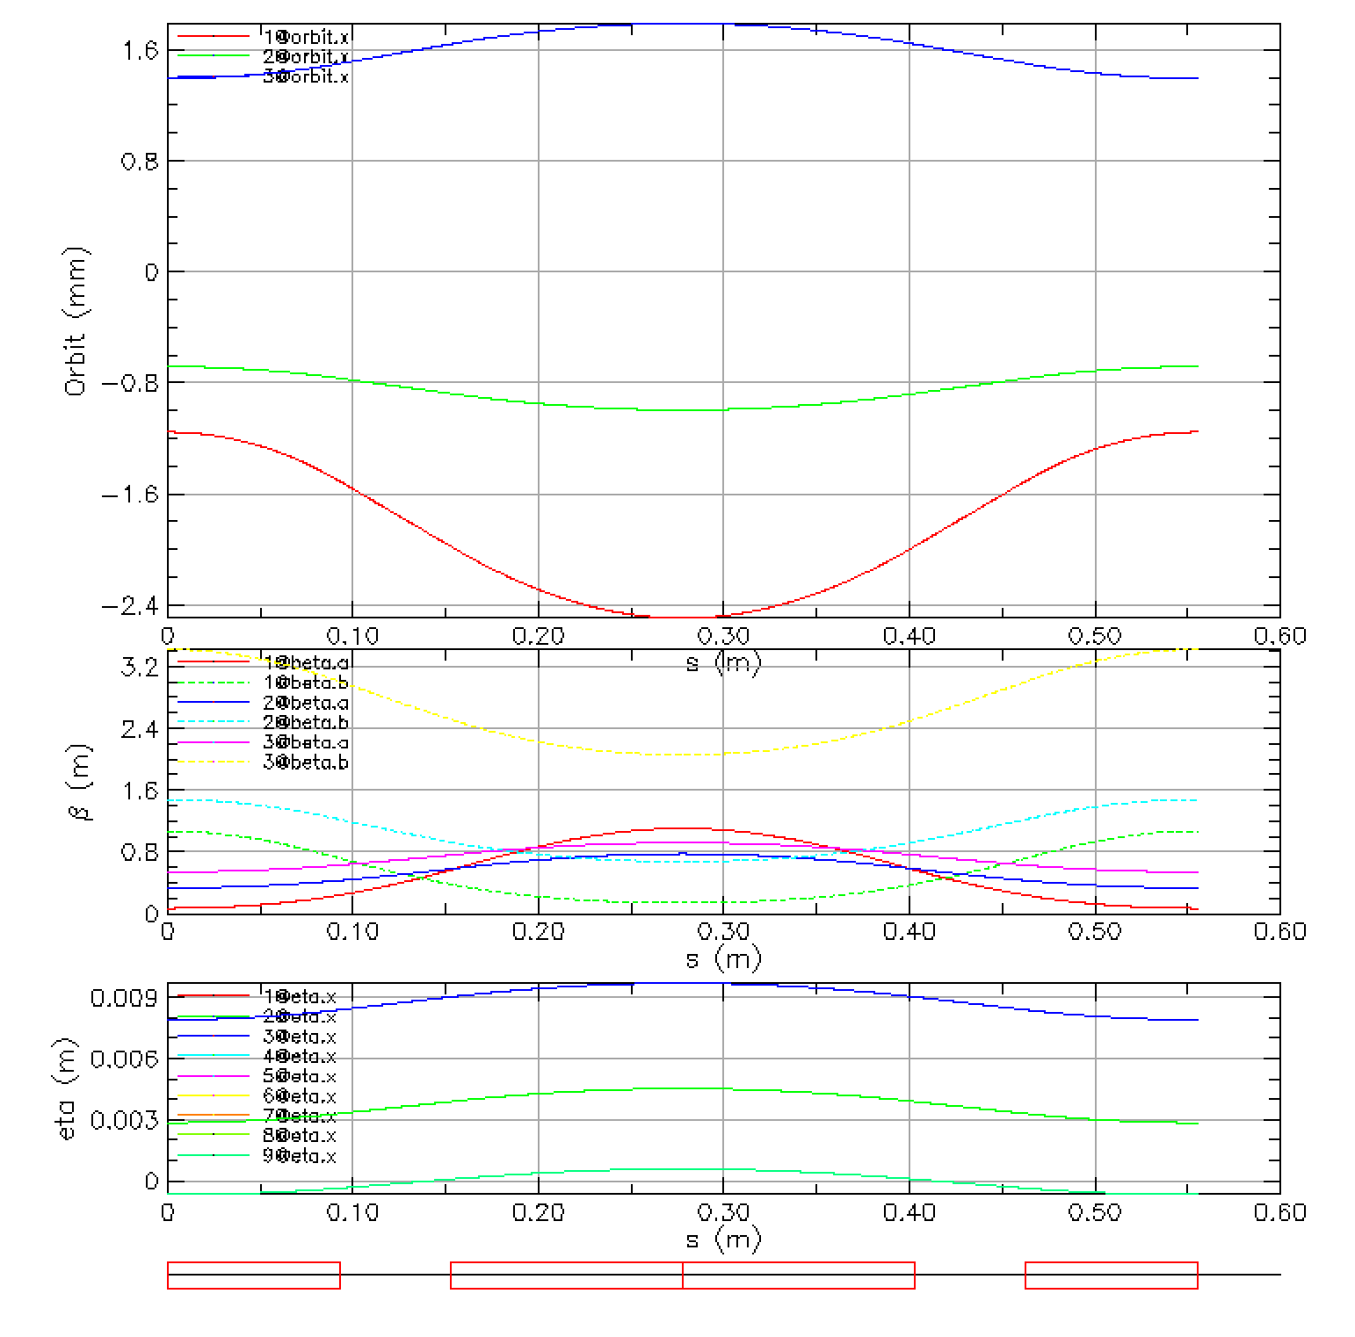
Low Energy 1.5 - 4.5 GeV EIC@RHIC FFA-LG Cell
Max orbit offset =1.6 mm
4.5 GeV
Magnet Properties:
Defocusing magnet
L_{BD} = 0.1856 m
G_{D} = 222.3713 T/m
B_{D} = 0.2406 T
B_{Dmax} = 0.57583 T
Focusing magnet
L_{QF} = 0.25 m
G_{F} = -195.8831 T/m
B_{F} = 0.2406 T
B_{Fmax} = 0.5907 T
3.0 GeV
1.5 GeV
-2.4 mm
Dispersion is in
millimeters!

Slide 28
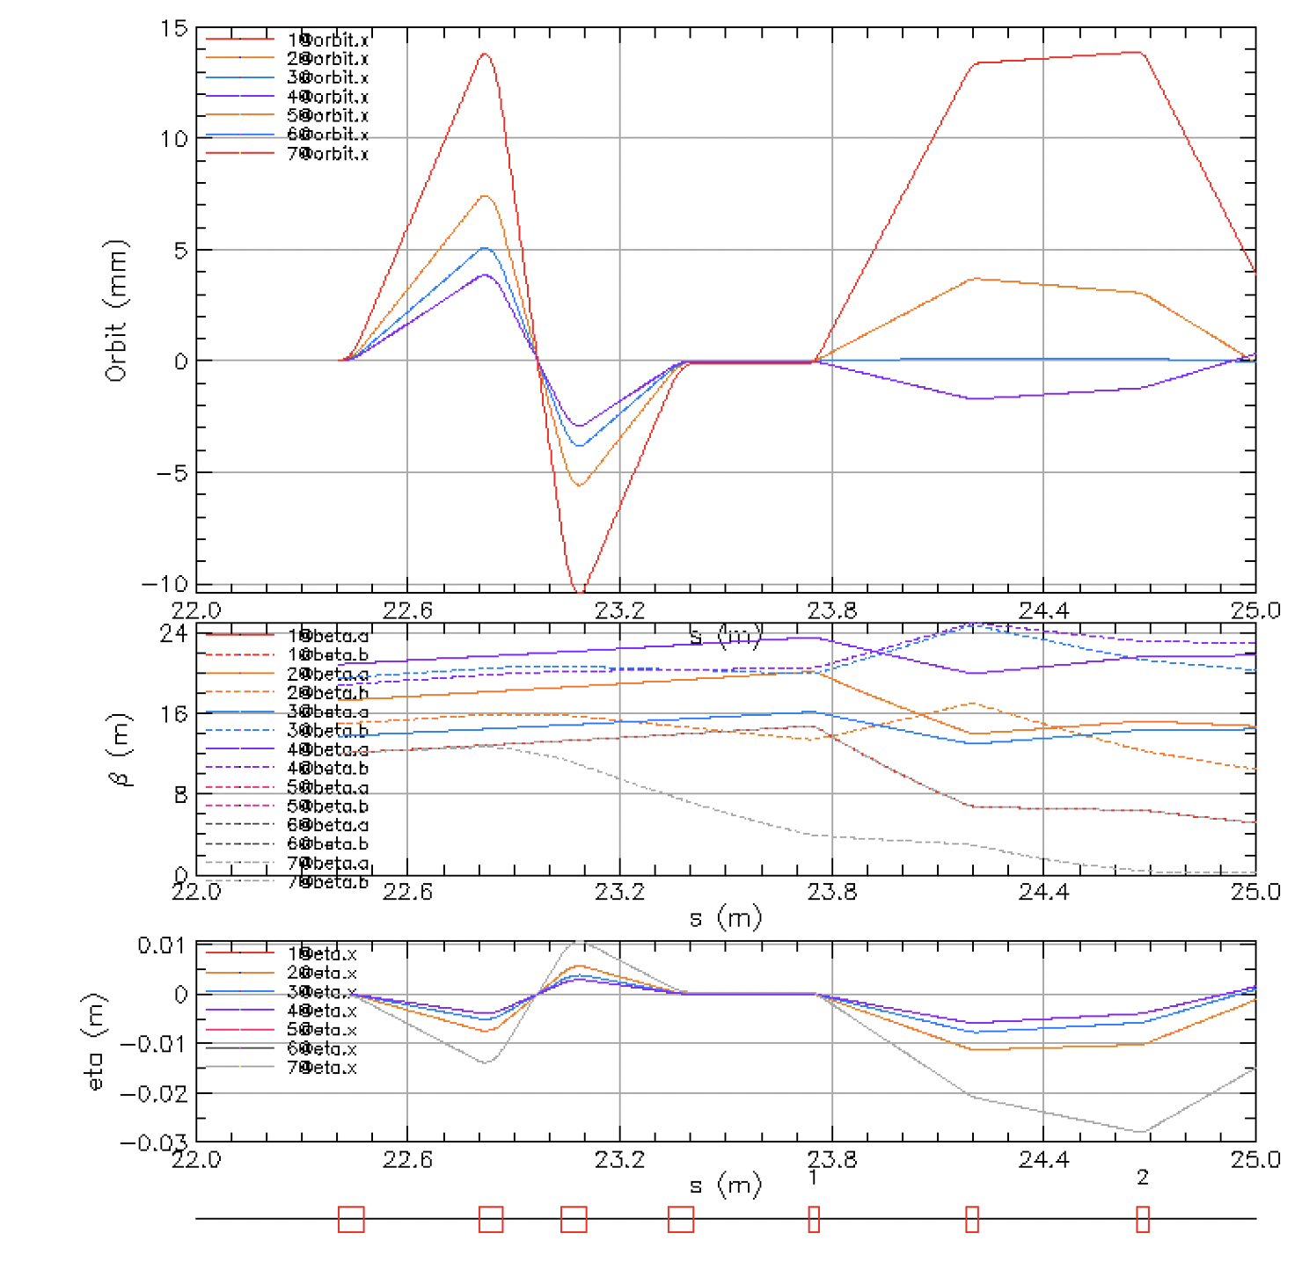
Injection and Extraction from Linac to the dump
5
300 MeV
θ =0.28 rad = 16º
6 GeV
5.6 cm
1.86 cm
18 GeV
4 m
L=0.4 m
B=0.7 T

Slide 29
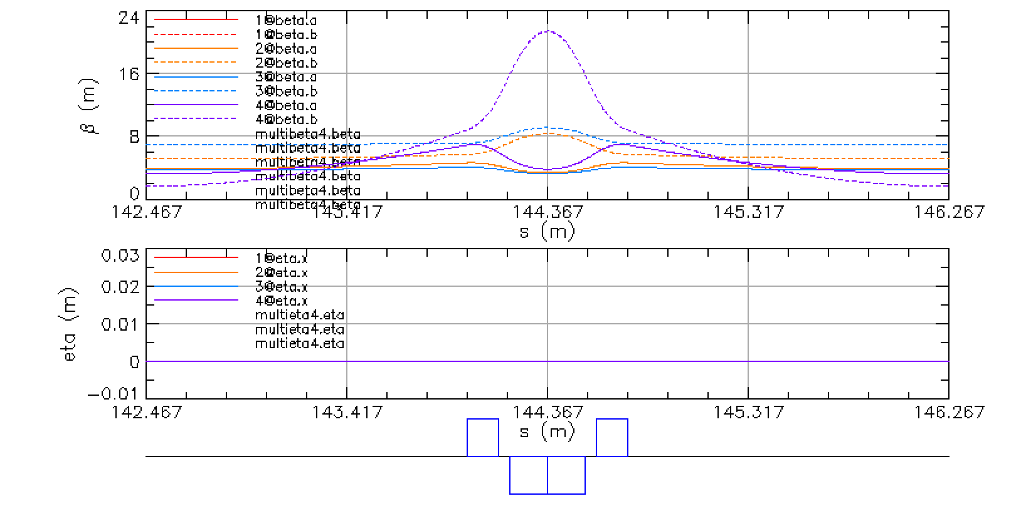
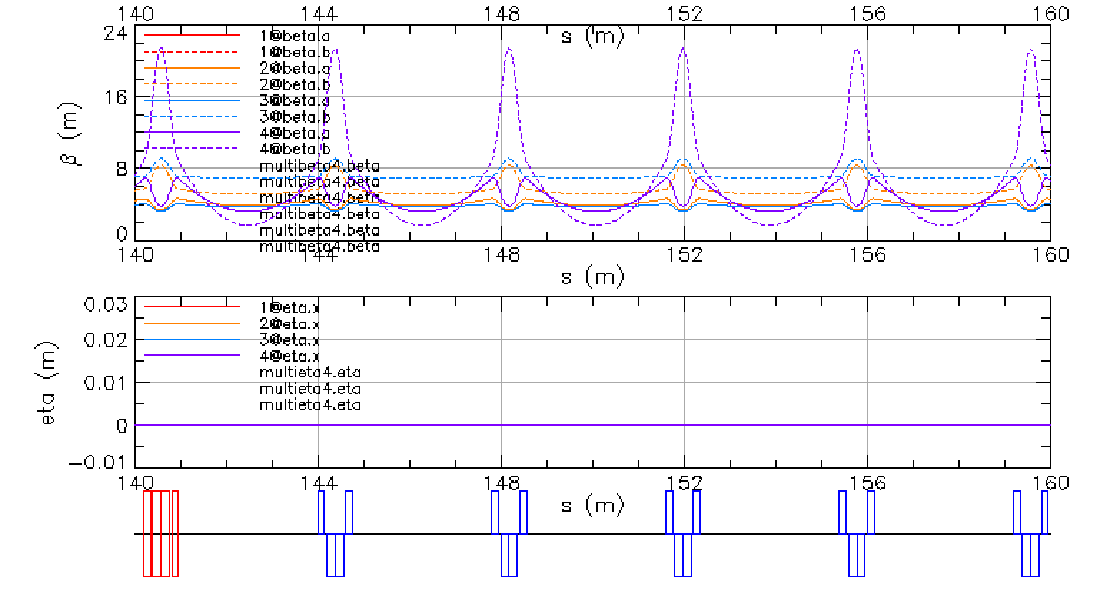
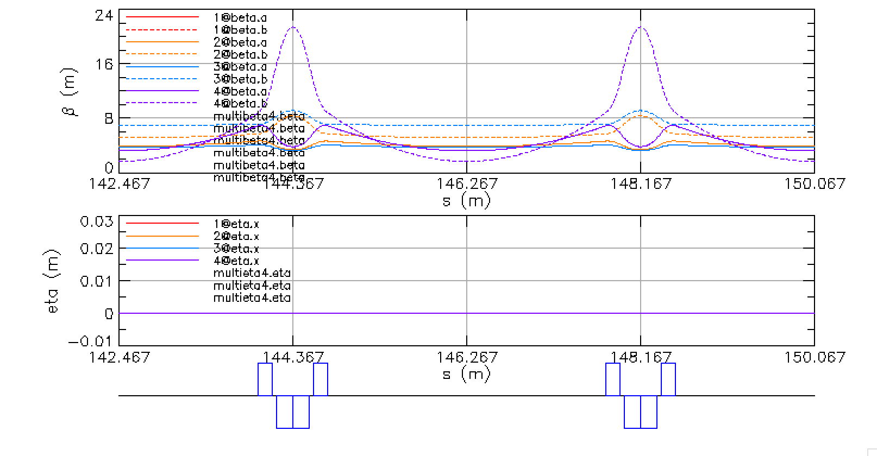
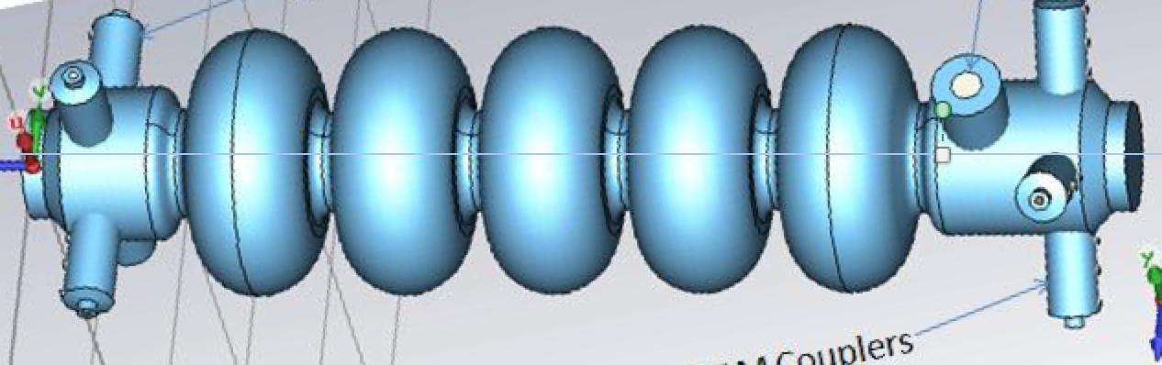
Straight Section Cells
2.8m
3.8 m
3.8 m
3.04 m
3.8 m

Slide 30
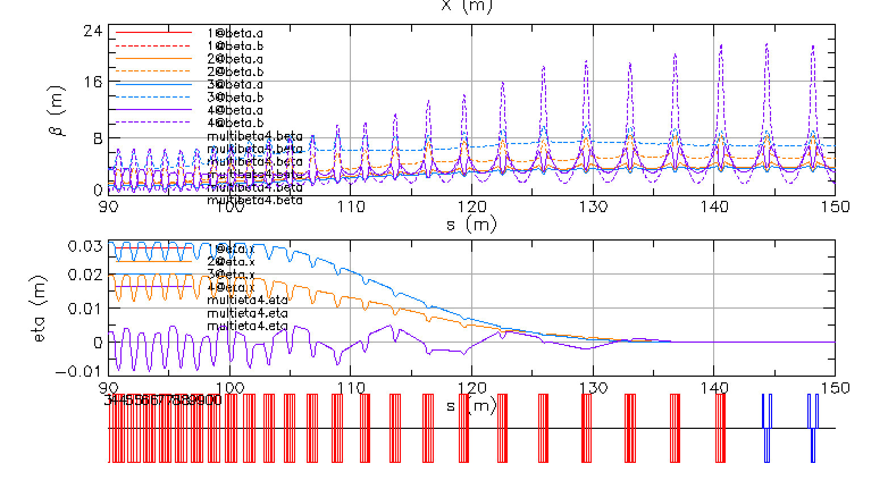
Matching Transition From the FFA-ARC to the Straight
0.009
0.007
0.005
0.003
0.0

Slide 31
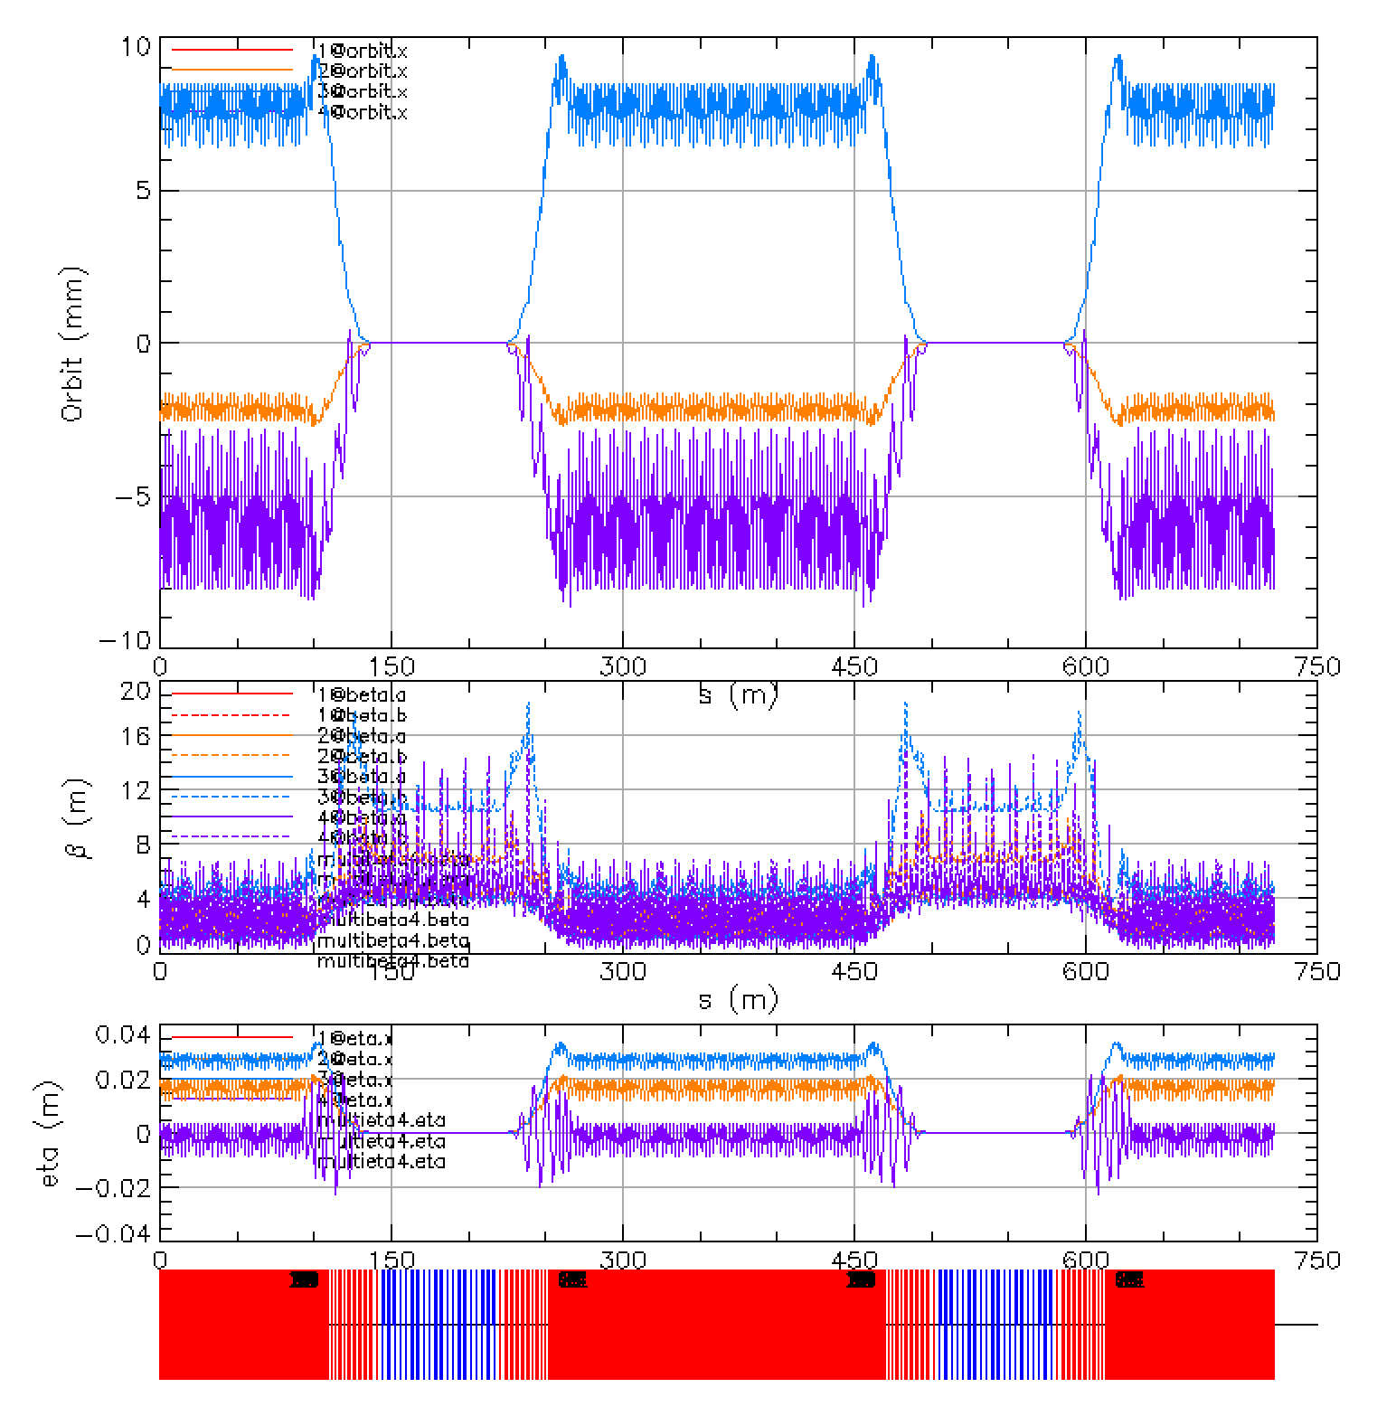
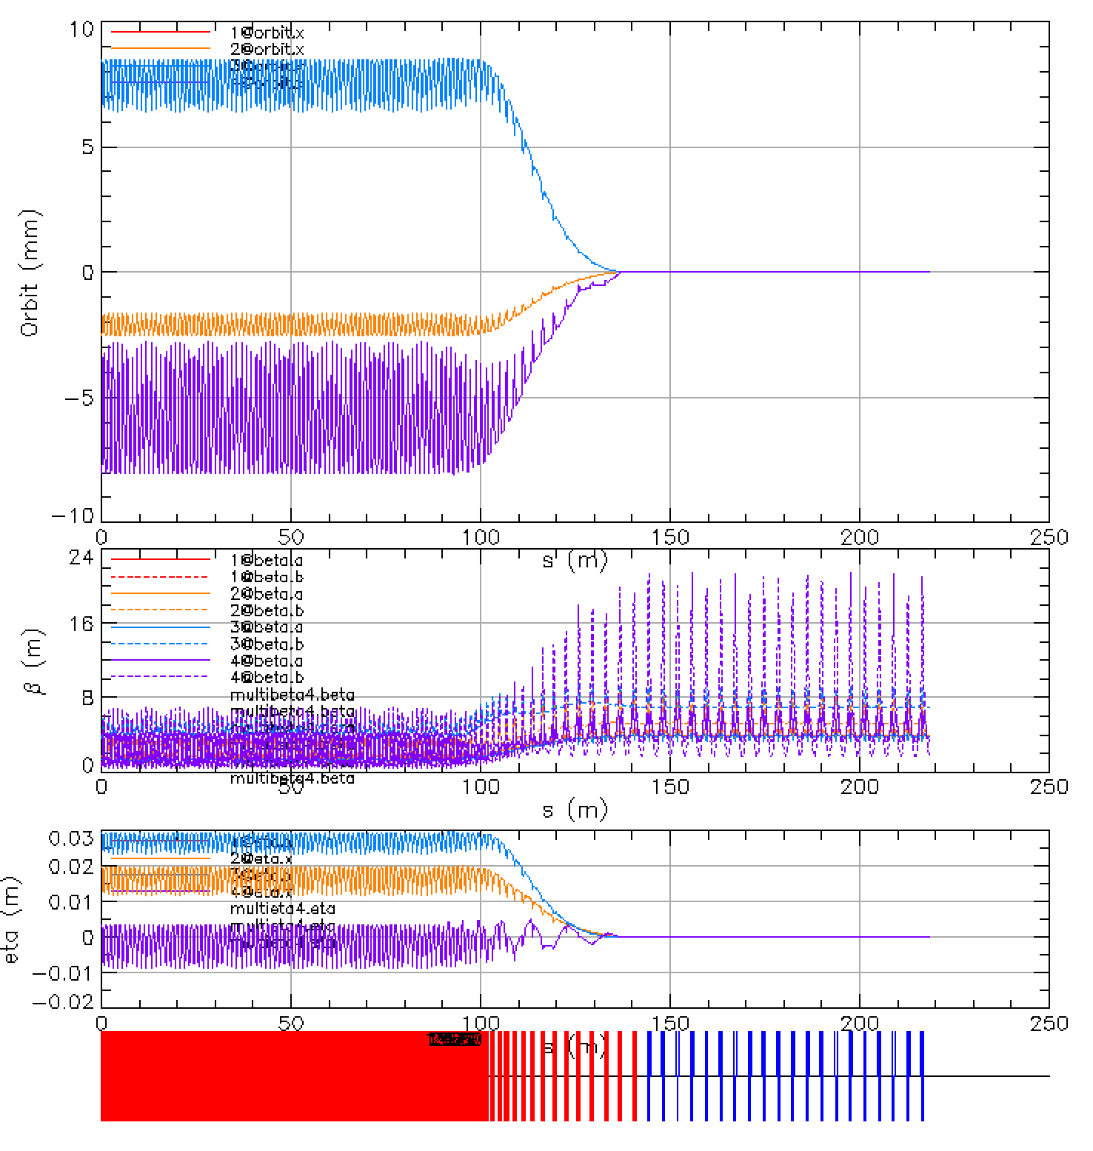

1.5 GeV Linac for eRHIC Linac-Ring Solution
1.6
1.6
1.6
0.8
0.8
-0.8
-1.6
-1.6
0.009
0.007
0.005
0.003

Slide 32
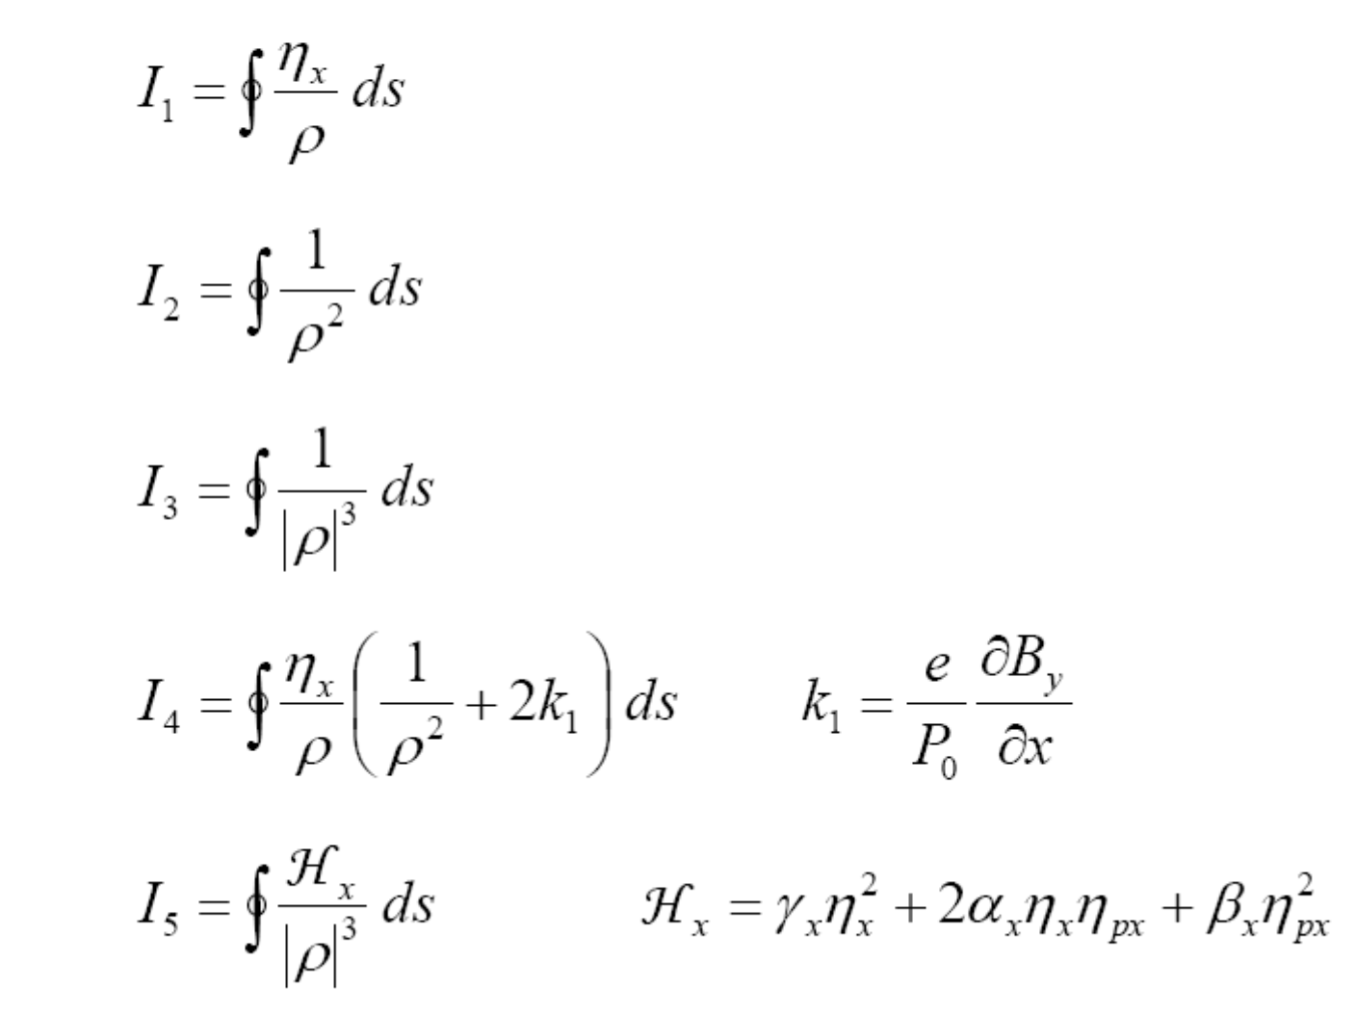
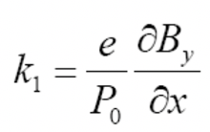

Radiation Integrals and Equilibrium Emittances
= 0.284E-09

Slide 33
Time of flight adjustments by courtesy of Stephen Brooks

Slide 34
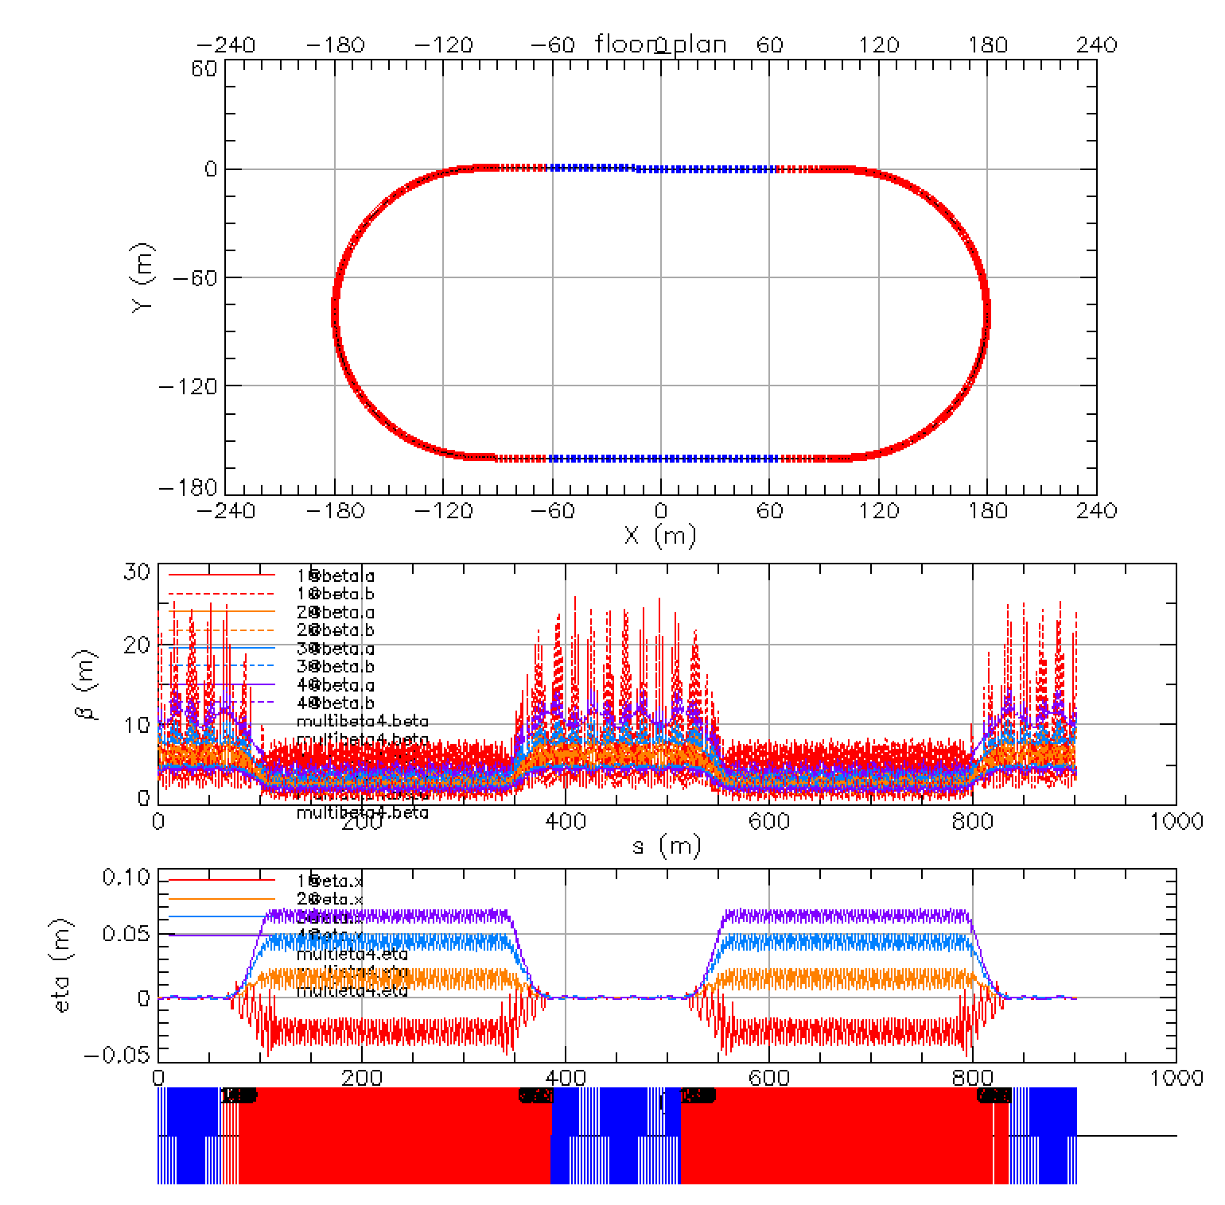
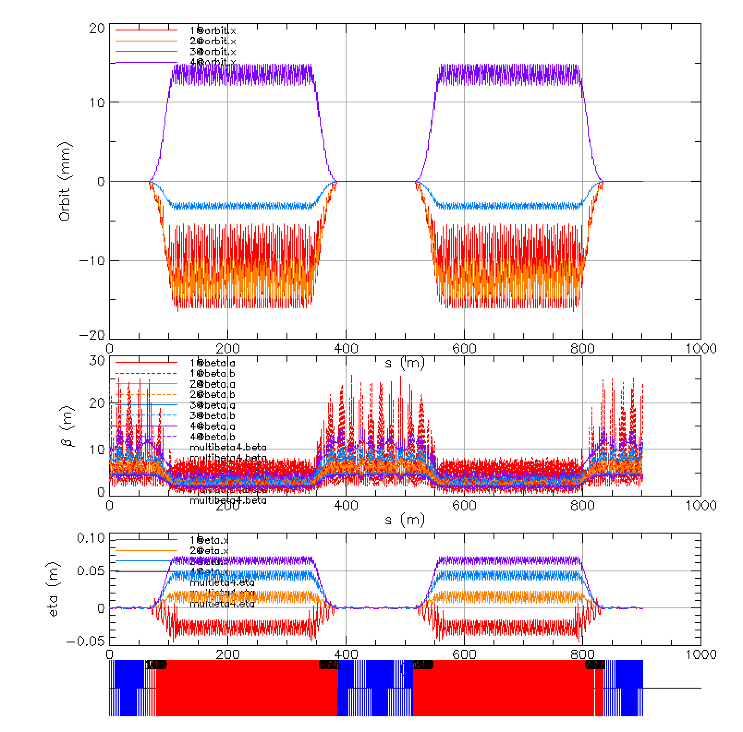
Fixed Field racetrack with linac
Linac
0.01

Slide 35
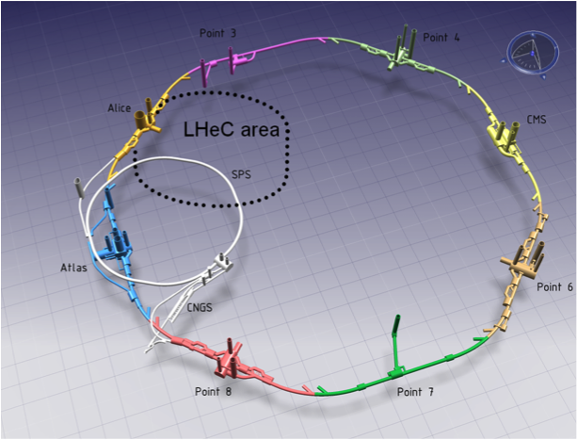
Layout of the LHeC-LHC-SPS
From Oliver Brüning

Slide 36
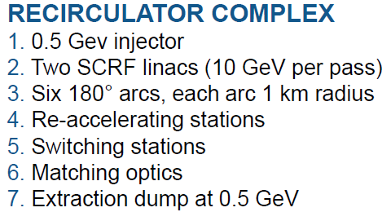

Linac-Ring Option − LHeC Recirculator
total circumference ~ 8.9 km
© F. Zimmermann
The baseline 60 GeV ERL option proposed can give an e-p luminosity of 10³³ cm⁻²s⁻¹ (extensions to 10³⁴ cm⁻²s⁻¹ and beyond are being considered)

Slide 37

FFA-LG LHeC Recirculator with Energy Recovery
Linac 2
5 GeV
Dump
Recovery:
55 GeV
45
35
25
15
60 GeV
IP
10 GeV
Linac 1
5 GeV
5 GeV
Injector
Acceleration:
  15 GeV
  25
  35
  45
  55
The 2 x 10 GeV linacs in LHeC design are reduced to 2 x 5GeV linacs
LHC
37

Slide 38
FFA-LG LHeC Recirculator with Energy Recovery
IP
LHC
60 GeV
Linac 1
5 GeV
Linac 2
5 GeV
10 GeV
Dump
Injector 150 MeV
Local FFA 5 GeV loop
Recovery
55 GeV
45
35
25
15
Acceleration
15 GeV
25
35
45
55
3.7 x energy
The LHeC design with 2 x 10 GeV linacs is reduced to 2 x 5GeV linacs
38

Slide 39

Lattice Function in the LHeC FFA arc
2 mm
Magnet Properties:
Defocusing magnet
L_{BD} = 0.609 m
G_{D} = 241.253 T/m
B_{D} = 0.157 T
B_{Dmax} = 0.481 T
Focusing magnet
L_{QF} = 1.05 m
G_{F} = -158.8124 T/m
B_{F} = 0.157 T
B_{Fmax} = 0.476 T
0 < D_{x} < 9 mm
39

Slide 40
Synchrotron Radiation in LHeC with 2 x 5 GeV linacs
Maximum Collision Energy 60 GeV
E(GeV) | Total Power (MW) 8.87 mA | Total Power (MW) 6.6 mA
50 | 7.5779 | 5.6383
40 | 4.2080 | 3.1310
30 | 1.3902 | 1.0344
20 | 1.2881 | 0.9584
10 | 0.5359 | 0.3987
TOTAL | 15.000 | 11.1608

Slide 41

“PERLE” Present Design

Slide 42

Fixed Field Arc for PERLE – A solution like CBETA

Slide 43
Fixed Field single arcs for PERLE – new proposal as previously described with the triplet magnets between the 5 RF cell units
44.6 m
16 m
12.6 m
16 m
Linac 150 MeV
NS-FF #2
305 MeV
605 MeV
905 MeV
NS-FF #1
155 MeV
455 MeV
755 MeV
16.00
5 MeV
Injector
Linac 150 MeV

Slide 44


Fixed Field Arc for PERLE 155-755 MeV – similar to CBETA
755 MeV
A single right-side arc covering the energy range between 155-755 MeV with the betatron and dispersion functions for all three energies
Orbit Offsets and Lattice functions for the single right side arc cell.
605 MeV
Magnet Properties:
Defocusing magnet
L_{BD} = 0.050 m
G_{D} = -236.761 T/m
B_{D} = 0.2525 T
B_{Dmax} = 0.619 T
Focusing magnet
L_{QF} = 0.065 m
G_{F} = - 198.507 T/m
B_{F} = 0.2525 T
B_{Fmax} = 0.769 T
455 MeV
305 MeV
155 MeV

Slide 45


Fixed Field Arc for PERLE 305-905 MeV– similar to CBETA
4
Y(m)
8
12
16
x(m)

Slide 46
Future High Energy Circular e⁺e⁻ Collider using Energy-Recovery Linacs
Vladimir N Litvinenko, Thomas Roser and Maria Chamizo Llatas
Submitted to ARXIV.
In this paper we present alternative approach for Future Circular electron-positron Collider. Current 100 km circumference design with the top CM energy of 365 GeV (182.5 GeV beam energy) is based on two storage rings to circulate colliding beams [1-2]. One of the ring-ring design shortcomings is enormous power consumption needed to compensate for 100 MW of the beam energy losses for synchrotron radiation. We propose to use energy recovery linac located in the same tunnel to mitigate this drawback. We show in this paper that our approach would allow a significant – up to an order of magnitude – reduction of the beam energy losses while maintaining high luminosity in this collider at high energies. Furthermore, our approach would allow to extend CM energy to 500 GeV (or above), which is sufficient for double-Higgs production.

Slide 47


Slide 48


Slide 50
RATIO: 140.24 / 37.7 = 3.72
in CBETA the FFA accepts 4 energies :
42, 78, 114, 150 MeV or 3.57 ratio
We are looking on a possibility for replacement
of 12 magnet rings with two FFA loop.
163.12 / 61.02 = 2.67
25.25 / 14.45 = 1.747
Here we are looking for a possibility on replacing 16 rings with 4 FFA loops

Slide 51
CONCLUSION
New permanent magnet design by Stephen Brooks reduces significantly the magnet size and the required beam aperture to within diameter of 5 mm
FFA-LG Lattice solutions are developed for EIC @ RHIC, PERLE and LHeC are developed
A new proposal could replace the fast-cycling synchrotron with 1.5 GeV SFR linac with 12 passes preserving the polarization. This is a cost-effective solution.

