Slide 1
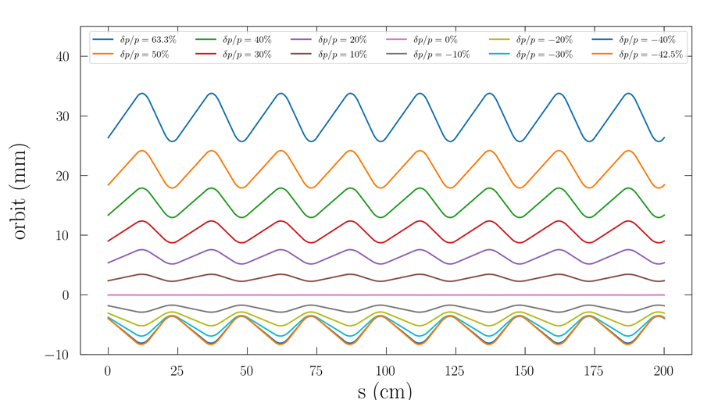
OPTIMISING GANTRY DESIGNS FOR HADRON THERAPY
BY ELODIE HIGGINS h
ACCELERATOR PHYSICS GROUP,
THE UNIVERSITY OF MELBOURNE
.
UNDER THE SUPERVISION OF SUZIE SHEEHY

Slide 2
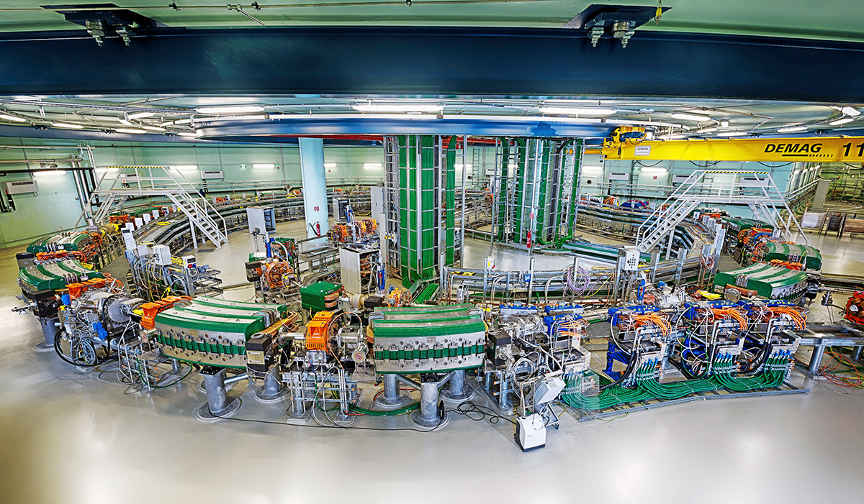
OVERVIEW
Advantages and limitations of hadron therapy
Gantry designs
Project description
Overview of accelerator physics & beam line optics
Results
Summary
MedAustron, Austria
Pronton/carbon ion synchrotron

Slide 3
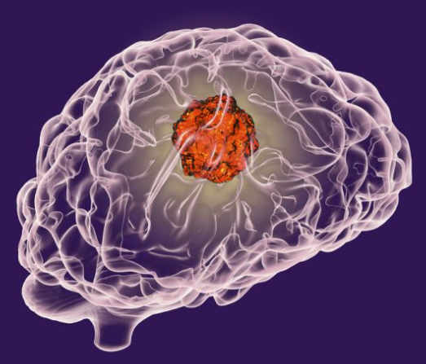
CANCER TREATMENTS
17 million/yr diagnosed with cancer
~50% will receive radiotherapy treatment
External ‘beam’ Radiotherapy
High energy photons
Electrons
Hadrons
Deposit dose over tumour
Minimise damage to healthy cells
Accessible to suitable patients
1

Slide 4
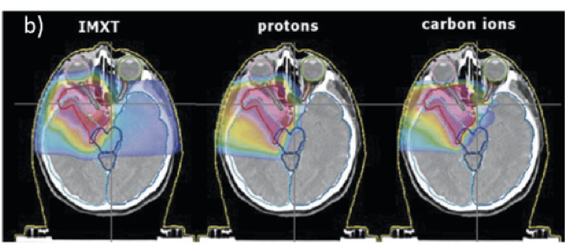
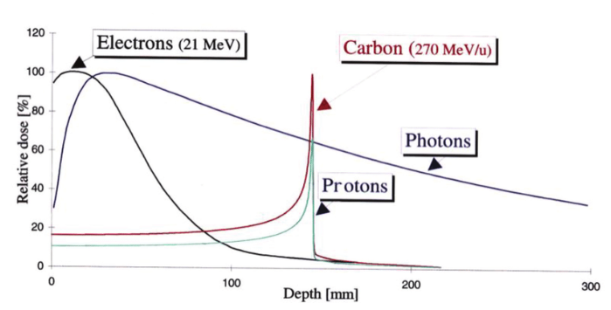
ADVANTAGES OF HADRON THERAPY
Bragg peak → Precise depth and position control
Good dose conformity and increased RBE
Peak depth increases with energy
Carbon ions have higher RBE than proton ions
Reduces:
Overall toxicity
Long term side effects
Smaller energy required for same depth of Proton ions
2

Slide 5
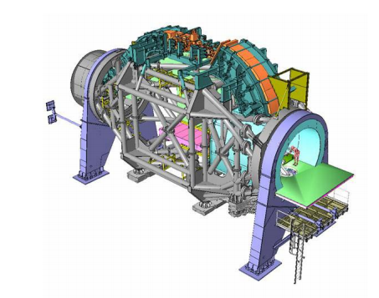
OPPORTUNITIES & LIMITATIONS
Could improve therapeutic outcomes of 15-20% patients receiving radiotherapy
Only reaching 20,000/yr (80% proton ions)
Delivery must be very precise to minimise toxicity
Rotating gantry around patient:
Very expensive
Massive facilities
Long and difficult to run
Heidelberg Carbon ion gantry
3

Slide 6
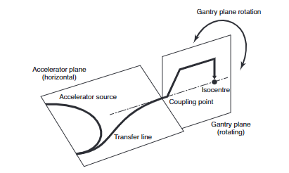
GANTRY DESIGNS
Normal magnets: Heidelberg gantry: 25m in length, 13m in diameter and an overall mass of 600 tonnes.
Superconducting (SC) magnets: NIRS gantry: 13m in length, 11m in diameter and an overall mass of 200 tonnes.
Fixed Field Alternating gradient (FFA) optics with normal or SC magnets:
Multiple energies
Smaller size: FFA SC gantry proposed by Dr Trbojevic: diameter ~8 m, mass ~30 tonnes.
Rigidity: 𝑅=𝐵𝜌=$\frac{p}{q}$
4

Slide 7
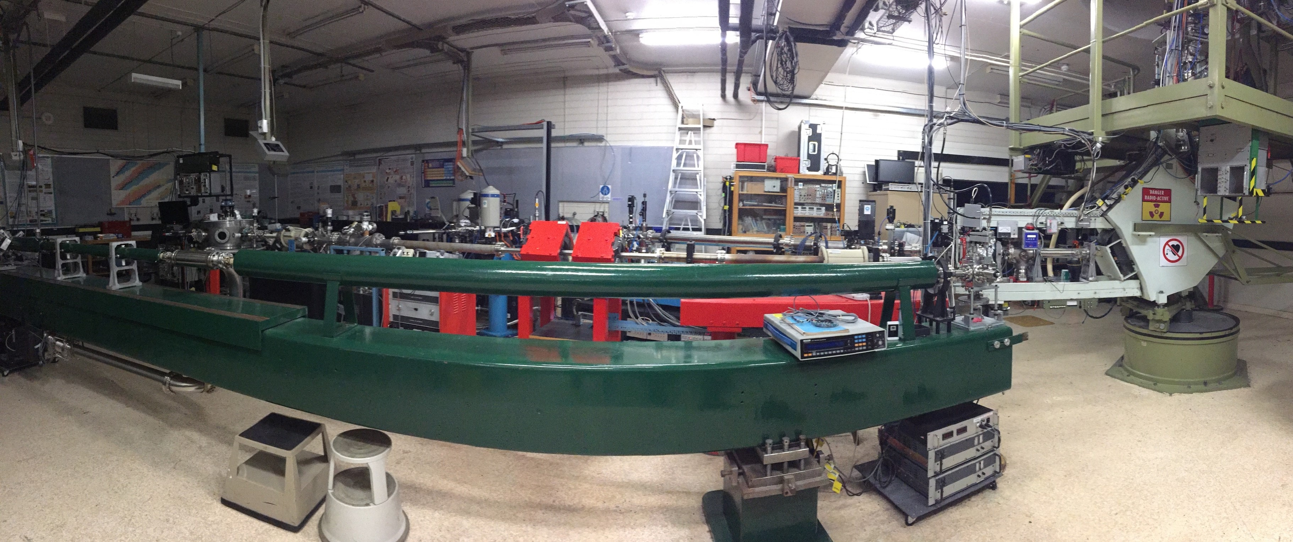
PROJECT OUTLINE
Design an FFA bend to accept the energy range of 0.5 – 4 MeV proton accelerator, the Pelletron beam, without changing magnet strength
This test beamline will be the first built of its kind
Considerations:
Optimise the beam envelope for entire energy range:
Optimise the cell configuration
Have reasonable magnet strengths
Lattice size must fit in the space available (< 2m)
Ensure a reasonable magnet aperture (5-10cm)
5

Slide 8
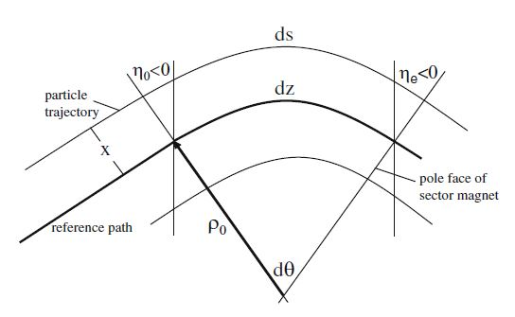
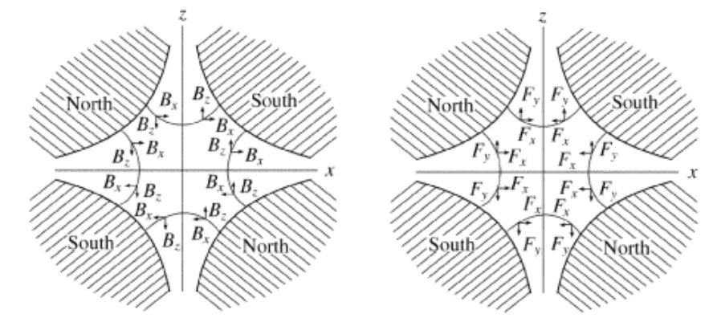
CELL COMPONENTS
A lattice is a sequence of repeating cells.
Dipoles:
Bend the beam, $ρ(m)$
Quadrupoles:
$k(m^{−2})=\frac{1}{Bρ}\frac{ⅆB_{z}}{dx}$
Q_{F} focuses, Q_{D} defocuses
6
Drifts: empty space

Slide 9
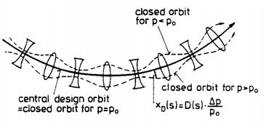
DEFINING ACCELERATOR PHYSICS TERMINOLOGY
Orbit function
Betatron Function ($β_{x}$, $β_{y}$)
Dispersion ($η_{x}$ or $D_{x}$)
Hill’s equation:
$$x^{′′}(s)+\left(\frac{1}{ρ^{2}\left(s\right)}−k\left(s\right)\right)x(s)=0$$
7
ALL THREE COMPONENTS CONTRIBUTE TO MAGNET APERTURE SIZE
Solution to Hill’s equation:
$$x\left(s\right)=\sqrt{β_{x}\left(s\right)ε}\cos{(φ\left(s\right)+φ_{0})}$$

Slide 10
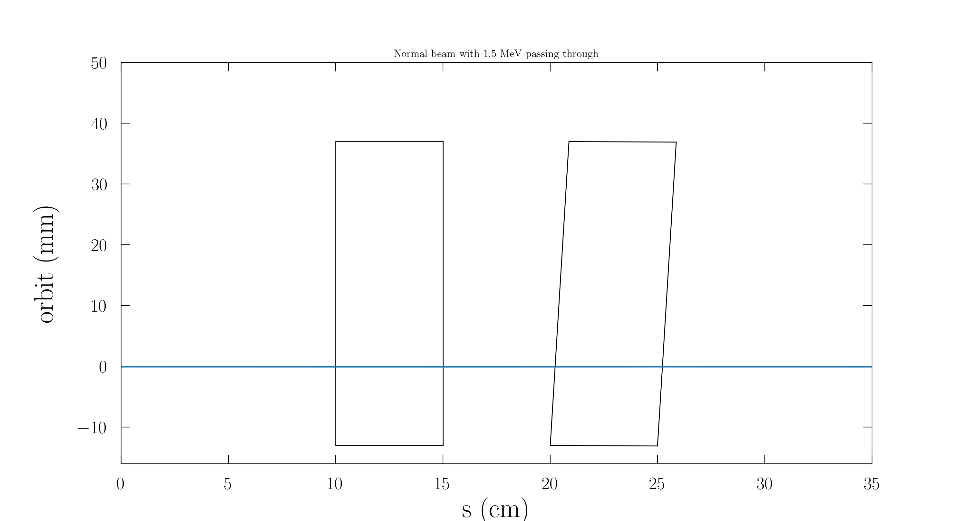
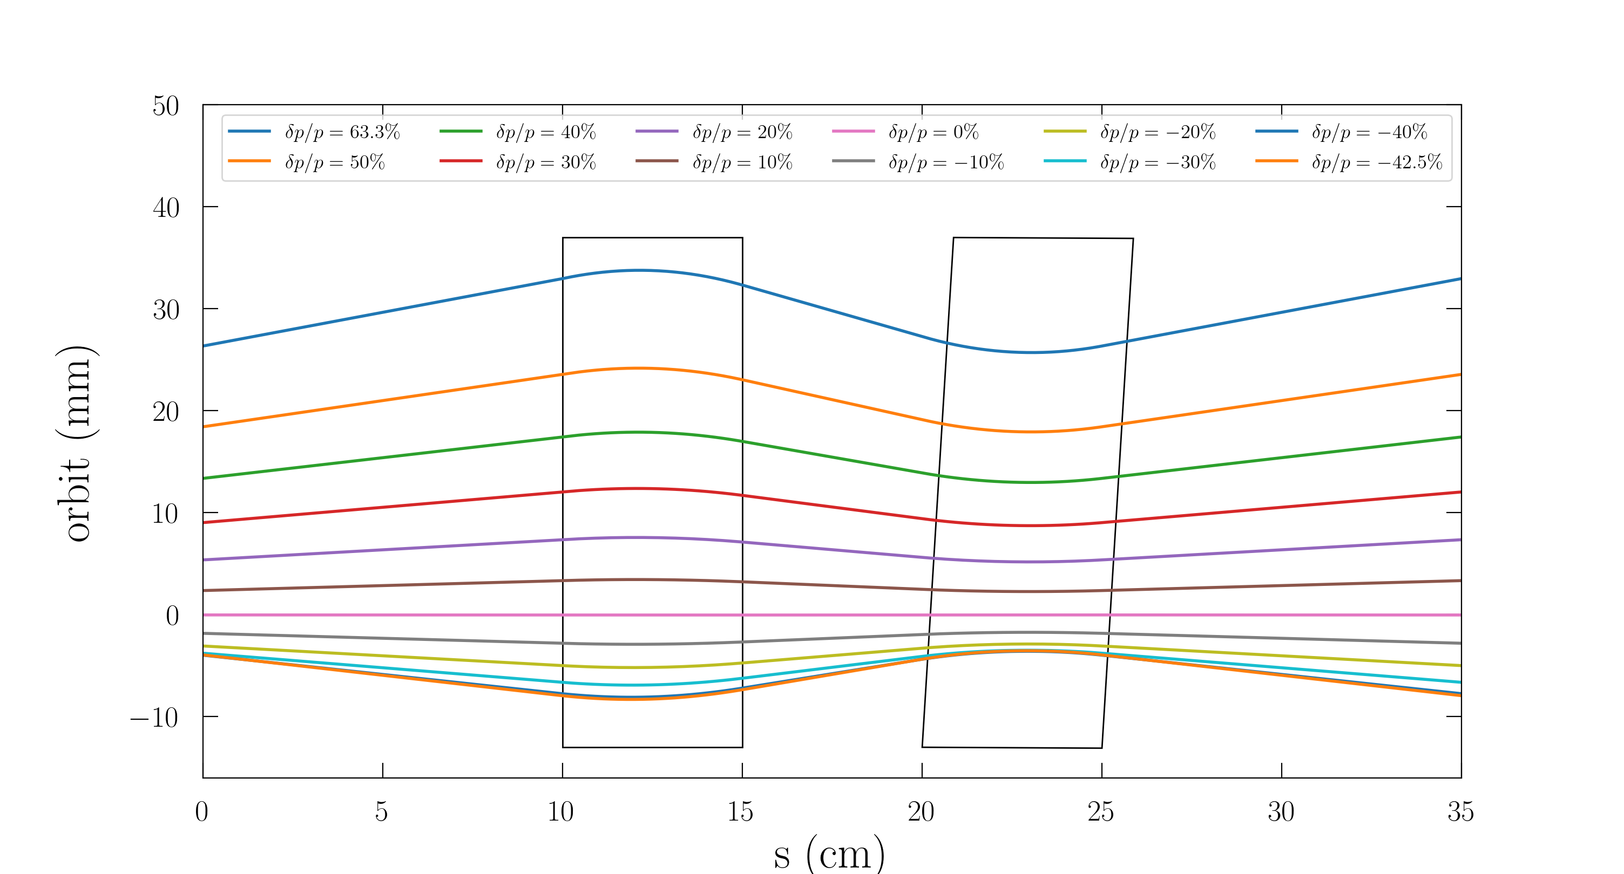
NORMAL vs. FFA BEAMLINE COMPONENTS
Normal beam line: Same for all energies until particle is lost
$$k(m^{−2})=\frac{1}{Bρ}\frac{ⅆB_{z}}{dx}$$
FFA beam line: Different energy particles adopt a different physical path. Particles focused/defocused for the reference energy magnet strength
8

Slide 11
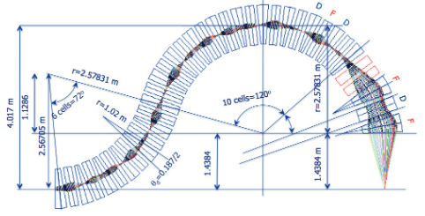
FFA OPTICS
Large energy acceptance:
Various energies allowed through beamline components
WITHOUT ramping magnets
Permanent magnets can be used:
Cheaper and smaller
Easier to run
9

Slide 12
METHOD
BMAD: “object oriented, open source, subroutine library for relativistic charged particle dynamics simulations in accelerators”
2. Constructed stable focusing bends
Constructed stable quadrupole lattices:
FODO
Doublet
Triplet
10

Slide 13
1
1
COMBINED MAGNETS (45◦, $k=±190m^{−2}$)
3. Constructed stable focusing bends with combined magnets
Less magnets in the lattice (reduces cost and weight)
Quadrupole magnet placed off axis
Magnetic field gradient created adds a dipole field
$$k(m^{−2})=\frac{1}{Bρ}\frac{ⅆB_{z}}{dx}$$
FODO
Doublet
Triplet

Slide 14
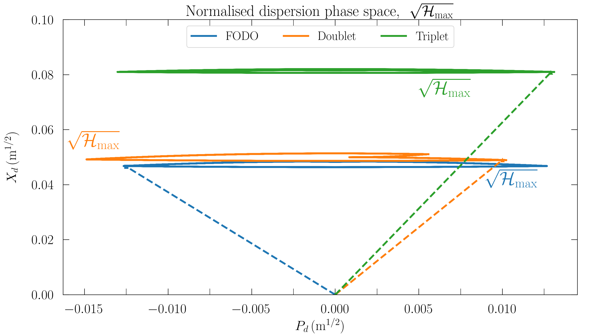
SELECTING CELL CONFIGURATION
The smallest normalised dispersion minimises the dispersion and betatron function of the lattice
H $=X_{d}^{2}+P_{d}^{2}$
$$X_{d}=\frac{D}{\sqrt{β_{x}}}$$
$$P_{d}=\frac{α_{x}D+β_{x}D^{′}}{√β_{x}}$$
1
2

Slide 15
DOUBLET CONFIGURATION
Doublet configuration selected:
Space for beam line components
Parameters that were configured
Focusing/Defocusing ($±$k) strengths
Position of reference energy
Length of components and drift spaces
Defines the dipole strength for specific bend
1
3

Slide 16
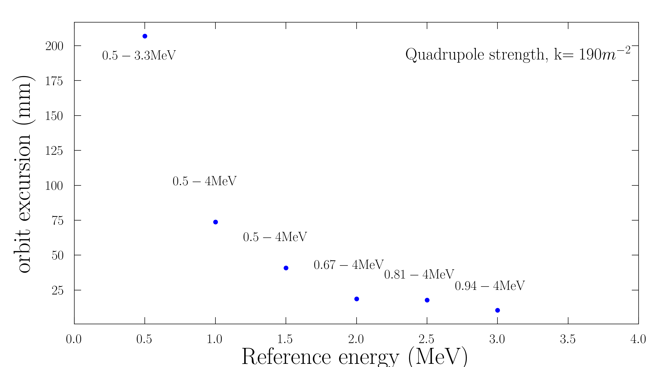
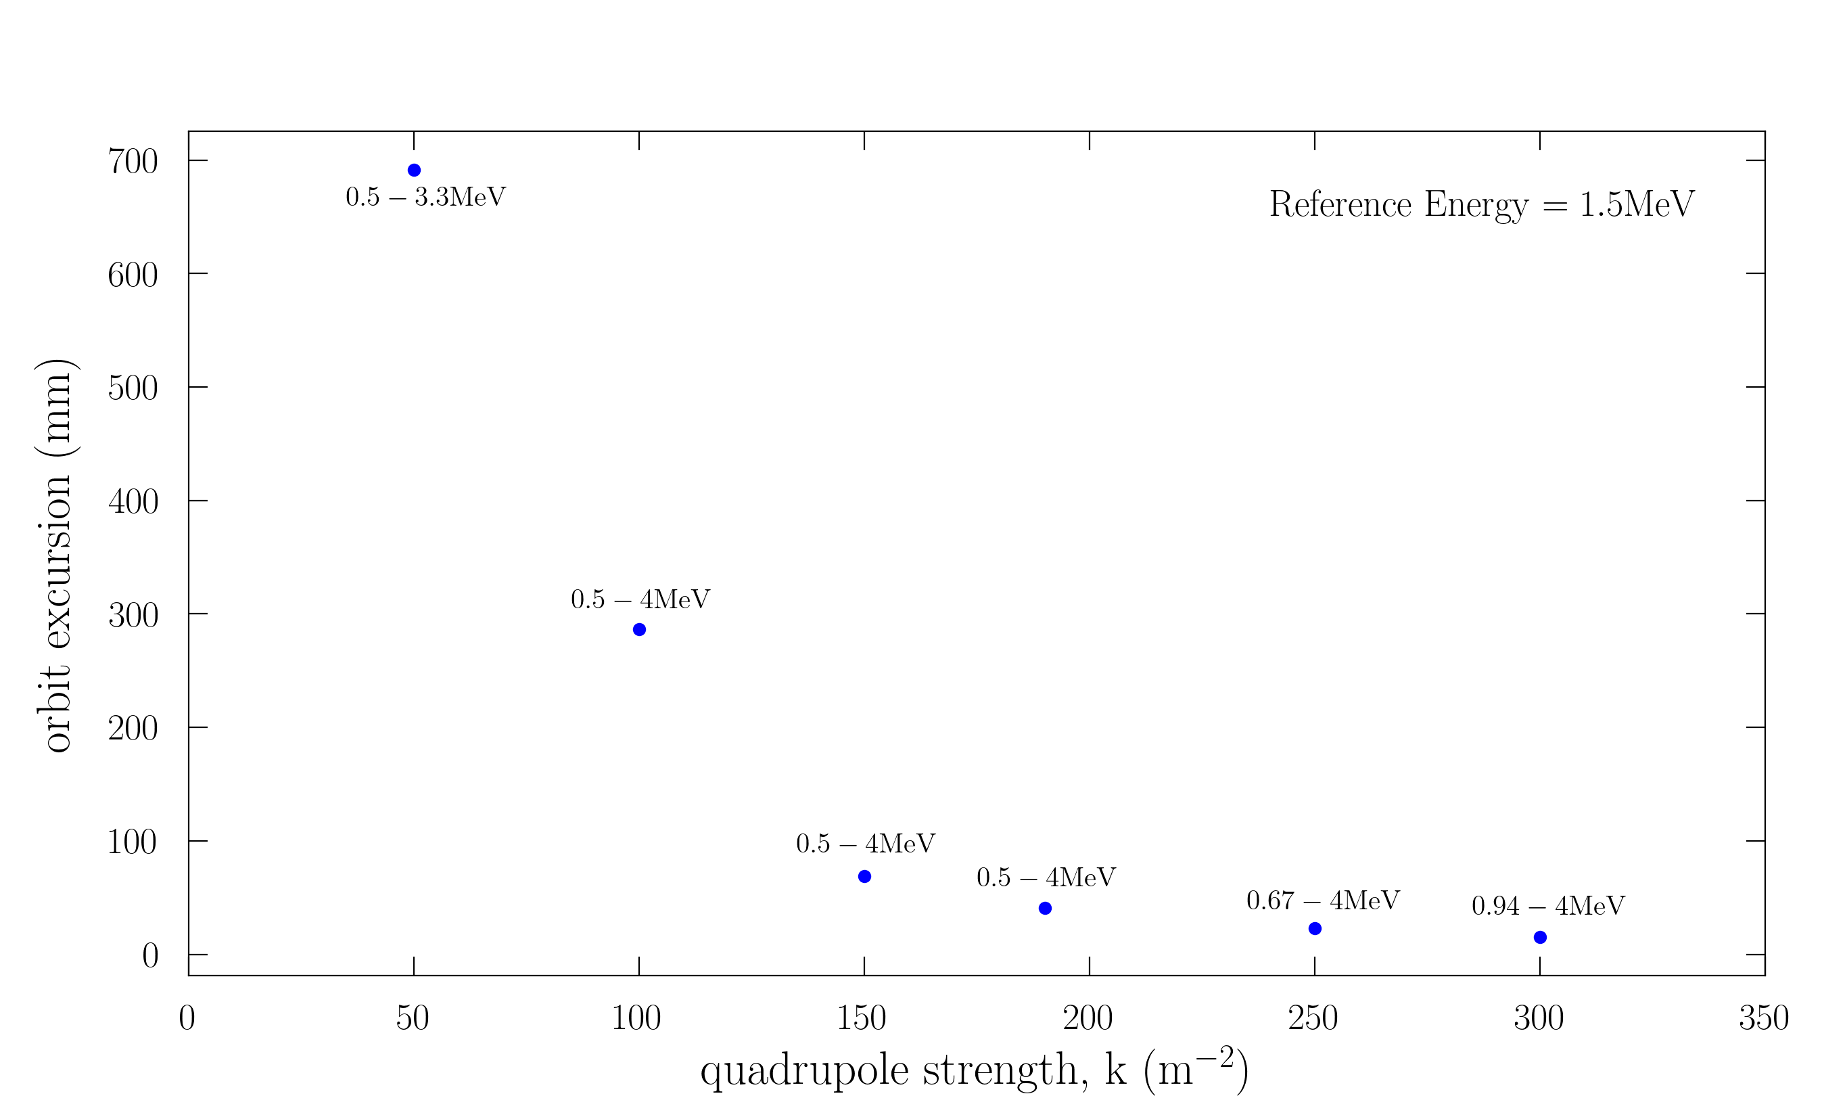
PARAMETERISATION
Ref E is the energy the magnets will be scaled to:
Higher ref E → smaller orbit excursion → smaller relevant energy range
Orbit excursion of 40.91 mm and full Pelletron energy range (0.5-4MeV) selected:
Ref E = 1.5 MeV, k = $±190m^{−2}$
Focusing/defocusing strength:
Higher k → smaller orbit excursion → smaller relevant energy range
1
4

Slide 17
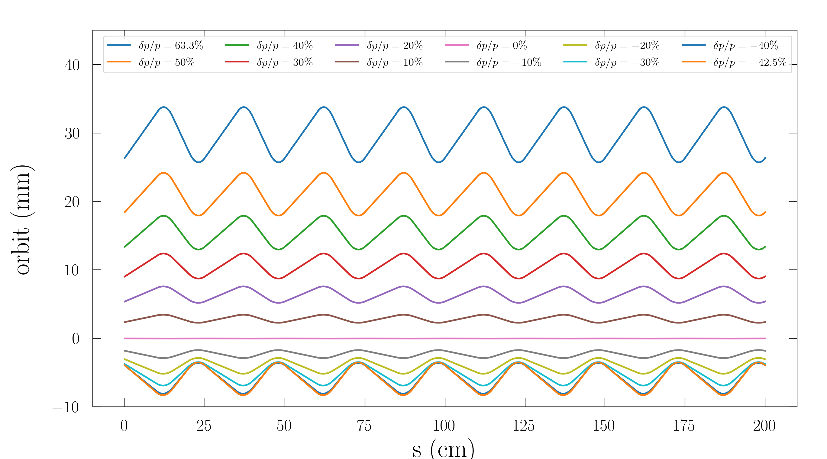
ORBIT OFFSET RESULTS
REFERENCE ENERGY = 1.5 MeV, k=$±190m^{−2}$
$\frac{δp}{p}$ = fractional energy change of particles from the reference energy
$\frac{δp}{p}=63.3 \%$ Relates to: 4 MeV
Orbit offset max: +33.0 mm from Ref E
$\frac{δp}{p}$= -42.5 % Relates to: 0.5 MeV
Orbit offset max:
-7.9 mm from Ref E
1
5

Slide 18
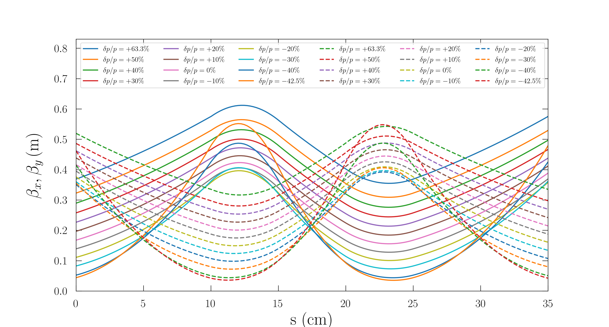
KEY RESULTS
Orbit excursion = 40.9 mm (offset max = 33.0 mm; min = -7.9 mm)
Amplitude of oscillation = $\sqrt{βε}=0.00501$m
𝜖=8 𝜋 mm mrad*
Betatron oscillation = 5.013 mm
$∴$Magnet aperture required = 50.94 mm
1
6

Slide 19
NEXT CHALLENGES
Implementation into the Pelletron:
Optimise a matching section
Scaling the system to therapeutic energies:
Simulate a bend accepting:
50-200 MeV proton ions
1101-4632 MeV carbon ions
1
7

Slide 20
SUMMARY
1.5 million patients could benefit from hadron therapy
Considered novel FFA technology
FFA bend successfully simulated
0.5-4MeV energy in 5.1cm aperture
Test beamline to be built at the University:
First time such technology will be built!
Matching section required
1
8

Slide 21
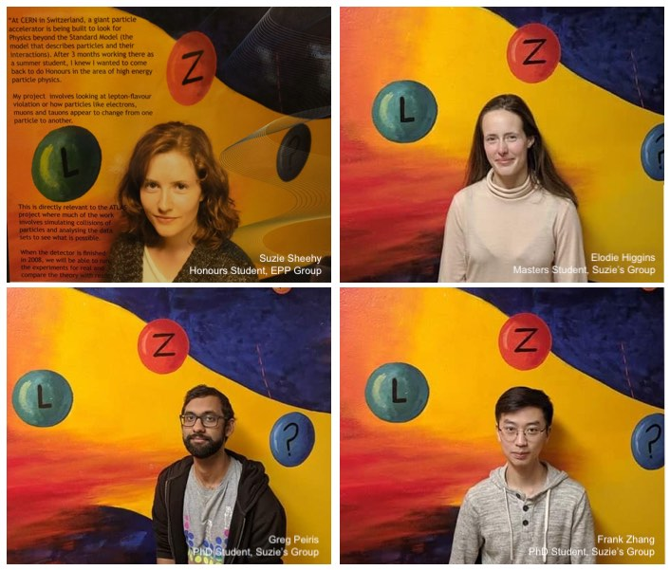
ACKNOWLEDGEMENTS

Slide 22
THANK YOU, h
ANY QUESTIONS?
.

Slide 23
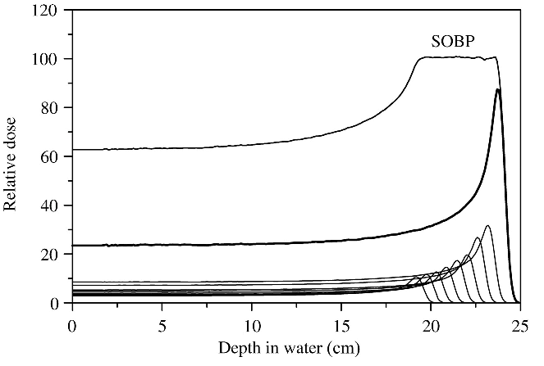
SPREAD OUT BRAGG PEAK
As energy increases, so does the depth of the peak
Extremely precise, therefore a ‘Spread Out Bragg Peak’ (SOBP) is needed to span width of the tumour

